Slide 1




Vanguard Electric, LLC
A company
1235 Commerce Dr-Suite K
Morrow, GA 30228
Telephone: 678-466-6466
CORPORATE VIEW
www.vanguardelec.com

Slide 2

What we do
Manufacturer (under OEM manufacturing agreements with top vendors worldwide) of high quality electrical components and products.
Business Lines
  Substation and Distribution : Porcelain Post type insulators.
  Transmission: Porcelain, Glass and Polymer Insulators, Line hardware.
  Cable Accesories
  Services: Substation field Services, Panel wiring.

Slide 3

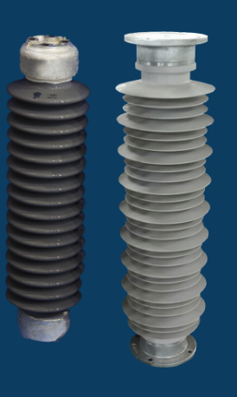
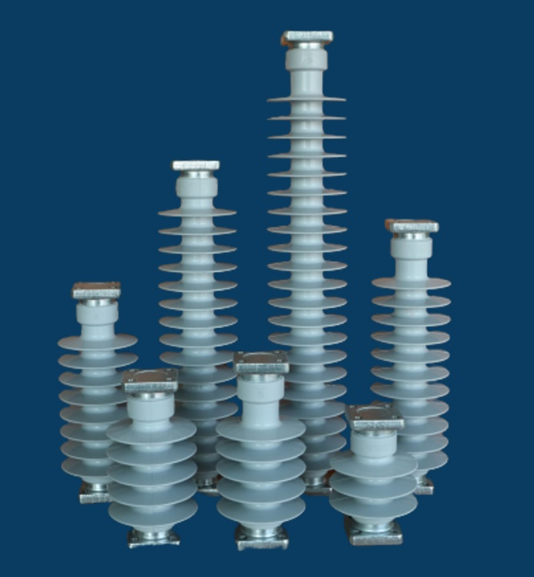
Substation
Semi Conductive Glazed (SCG) and Hybrid – Post Type Insulators
Porcelain – Post Type Insulators
Polymer – Post Type Insulators

Slide 4
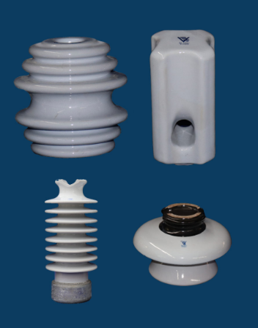
Distribution
Porcelain Insulators

Slide 5

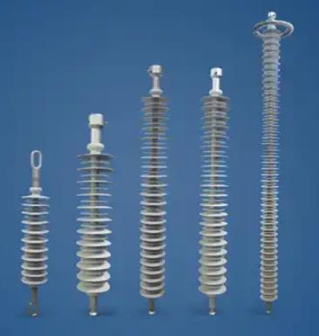
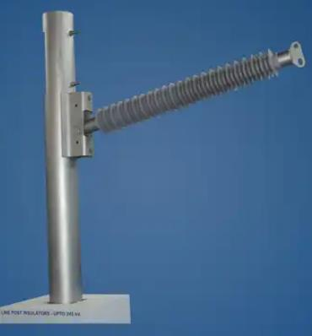




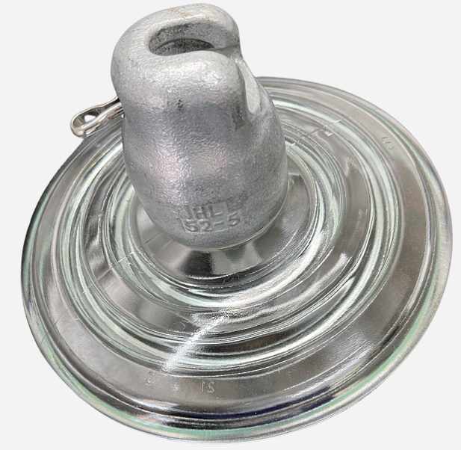
Transmission
Porcelain, Glass & Polymer Insulators
Line Hardware, Preformed wire , Dampers, OPGW and ADSS

Slide 6
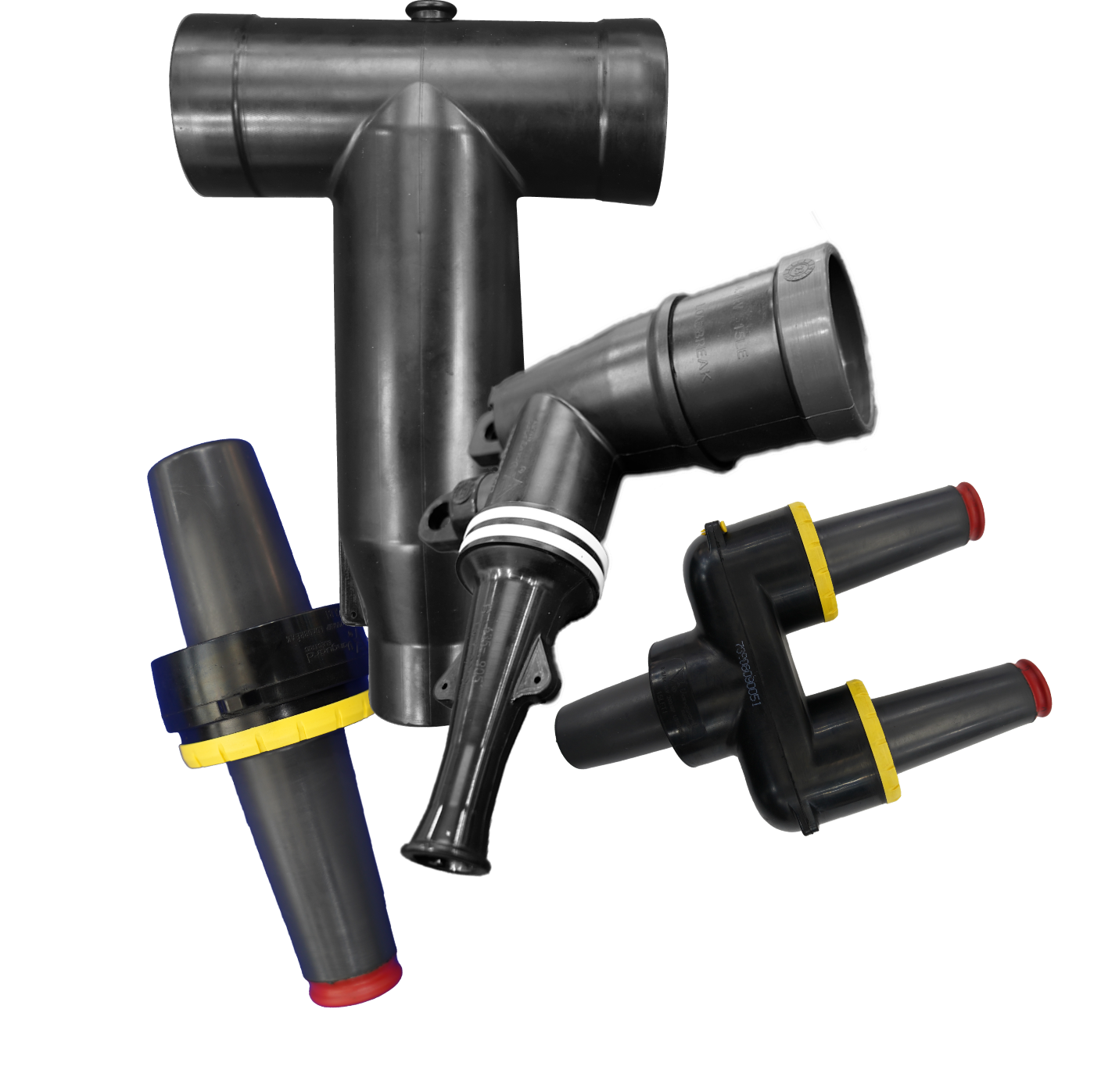
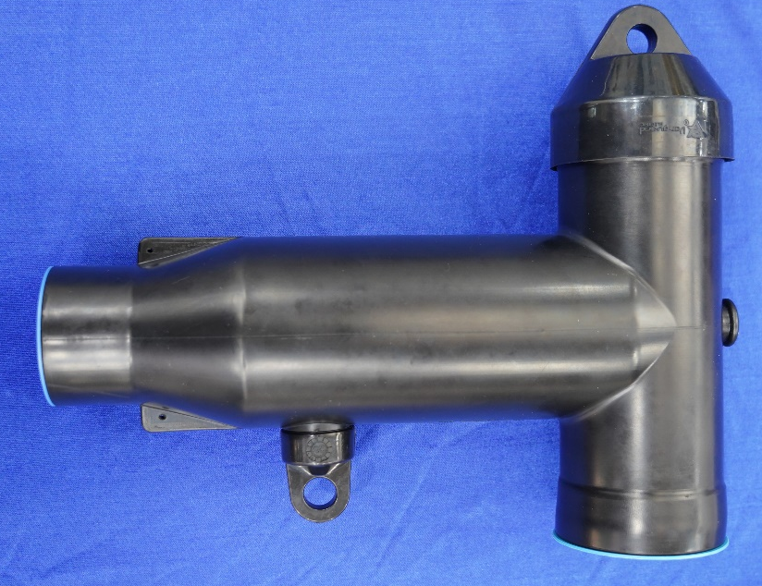
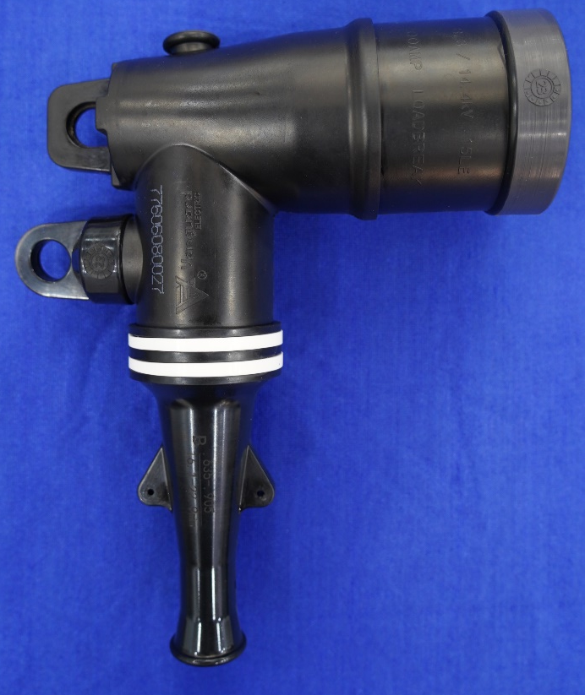
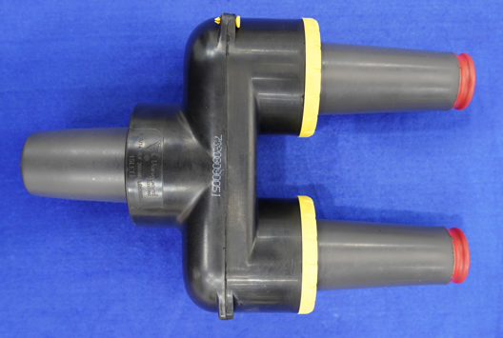
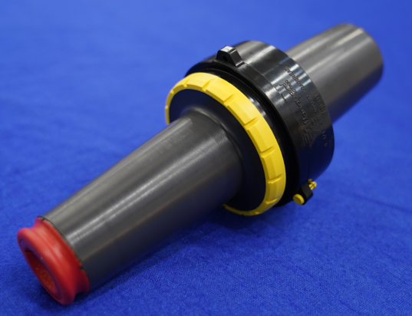
Cable Accessories
600 A. Tee Body Connectors
15 kV & 25 kV 200 A Elbow Connectors
15 kV & 25 kV 200 A Bushing Inserts

Slide 7
What Makes us different
Company was designed and built to compete in the commodity products business
  All back office outside U.S
  All Inside Sales outside the U.S .
  Low costs of operation.
Powerful Domestic and International Logistic capabilities
  2 Warehouses: Wallace NC, Morrow GA – 100,000sqf.
  Very capable International and domestic logistics crews.
  State of the art ERP system (Netsuite).
Highest level Domestic Sales executives
Nimble, aggressive.

Slide 8

HR Supporting Vanguard’s Growth
Recognizing Our Need for Scalable HR Leadership
  Vanguard Hired a part-time Executive level Consultant (Sue Dunlap) as HR Director to establish strong systems, structure, and long-term HR stability.
  Brought on a dedicated HR Coordinator as the main point of contact between the HR Director and the company.
  Together, the HR Coordinator and HR Director maintain policies, ensure compliance, and develop new programs that support Vanguard’s growth.

Slide 9

Programs That Drive Employee Wellbeing & Company Success
HR - What Sets Vanguard Apart
  Employee Referral Program – rewarding employees who help bring strong talent into the organization.
  Immigration Sponsorship – supporting our back-office team by sponsoring work visas and pathways to U.S. residency.
  Holiday Schedule – two full weeks off from Christmas through New Year’s, with skeleton hours replaced throughout the year.
  Generous Holiday Schedule (Paid Holidays) – strong holiday programs for back-office employees; each division follows its own holiday calendar.
  Subsidized Employee Benefits – Vanguard covers a large portion of benefit costs to keep expenses low for employees.
  Semi-Annual Company Meetings – destination-based meetings bringing teams together for collaboration, culture, and strategic alignment.

Slide 10
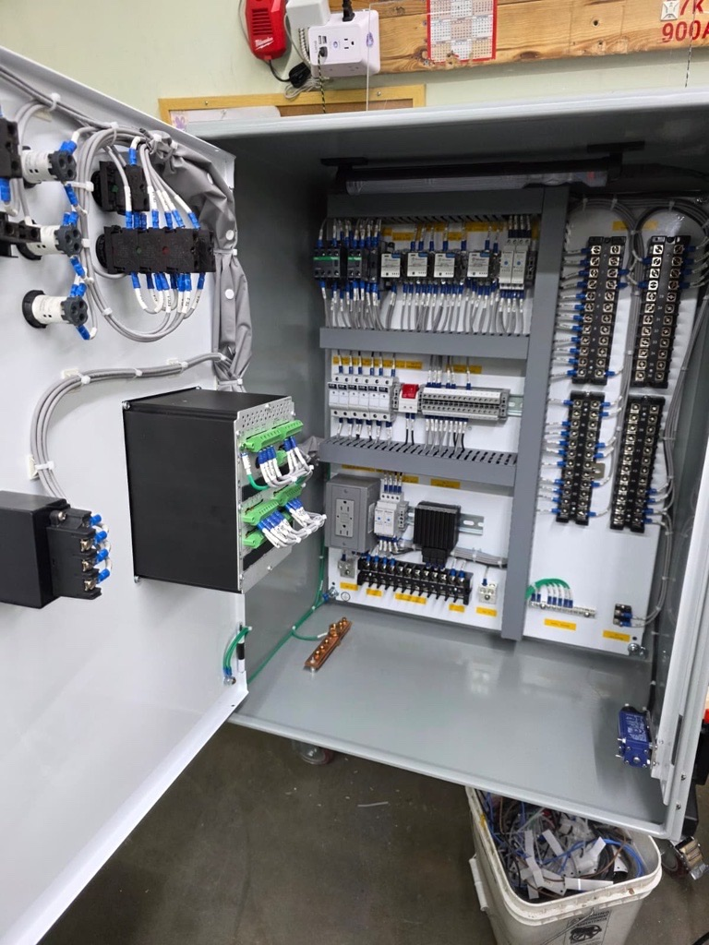
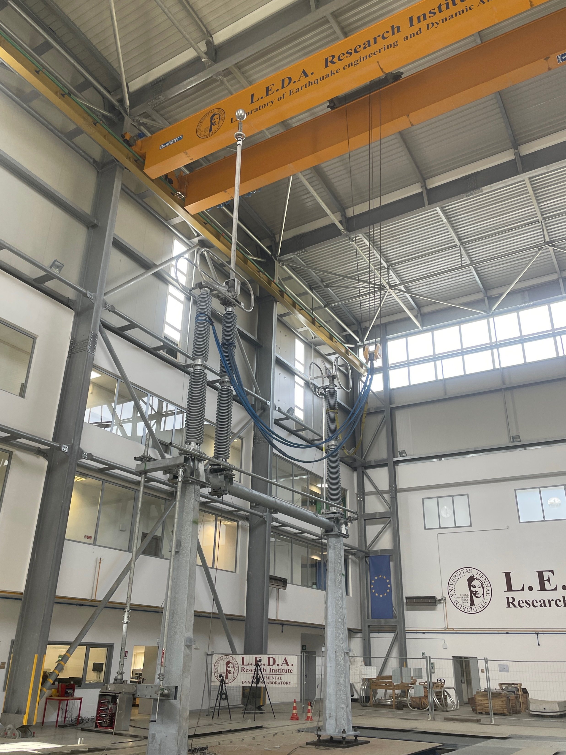

Intra-Group Collaborations
758kv Seismic Insulators for PG&E
Insulators for Capacitor Bankss
CapSwitcher Panels

Slide 11











North American Customers

Slide 12
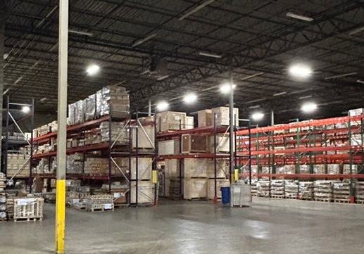
Thank you.

