Slide 1

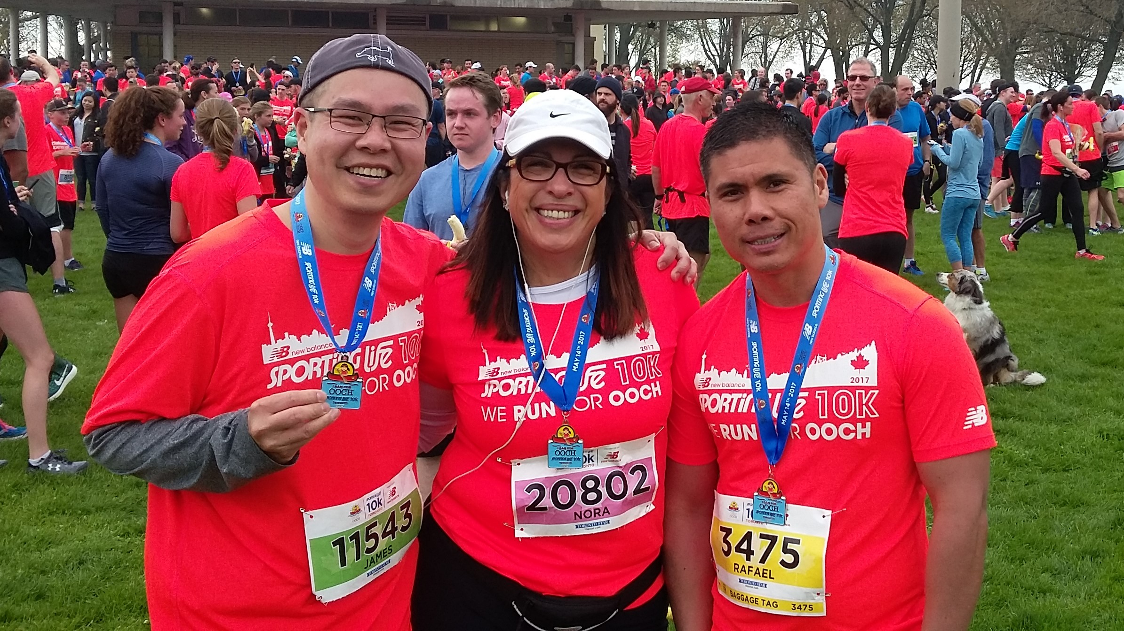
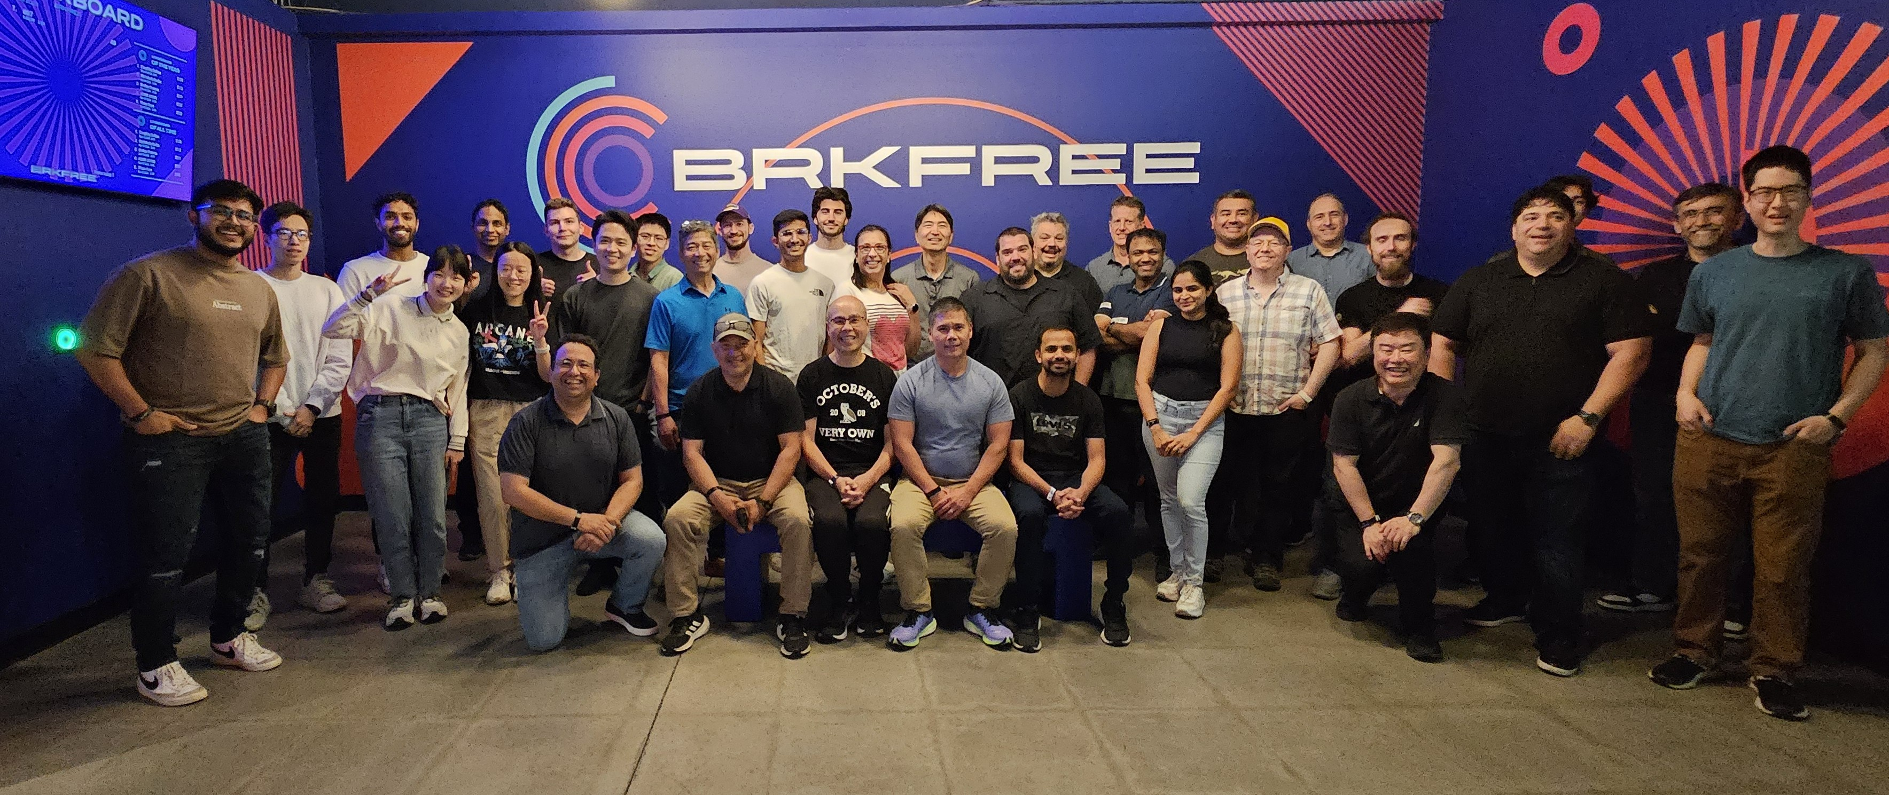
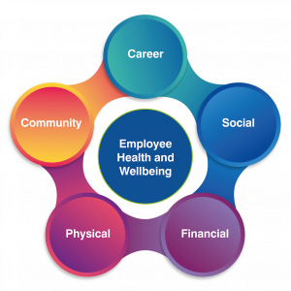
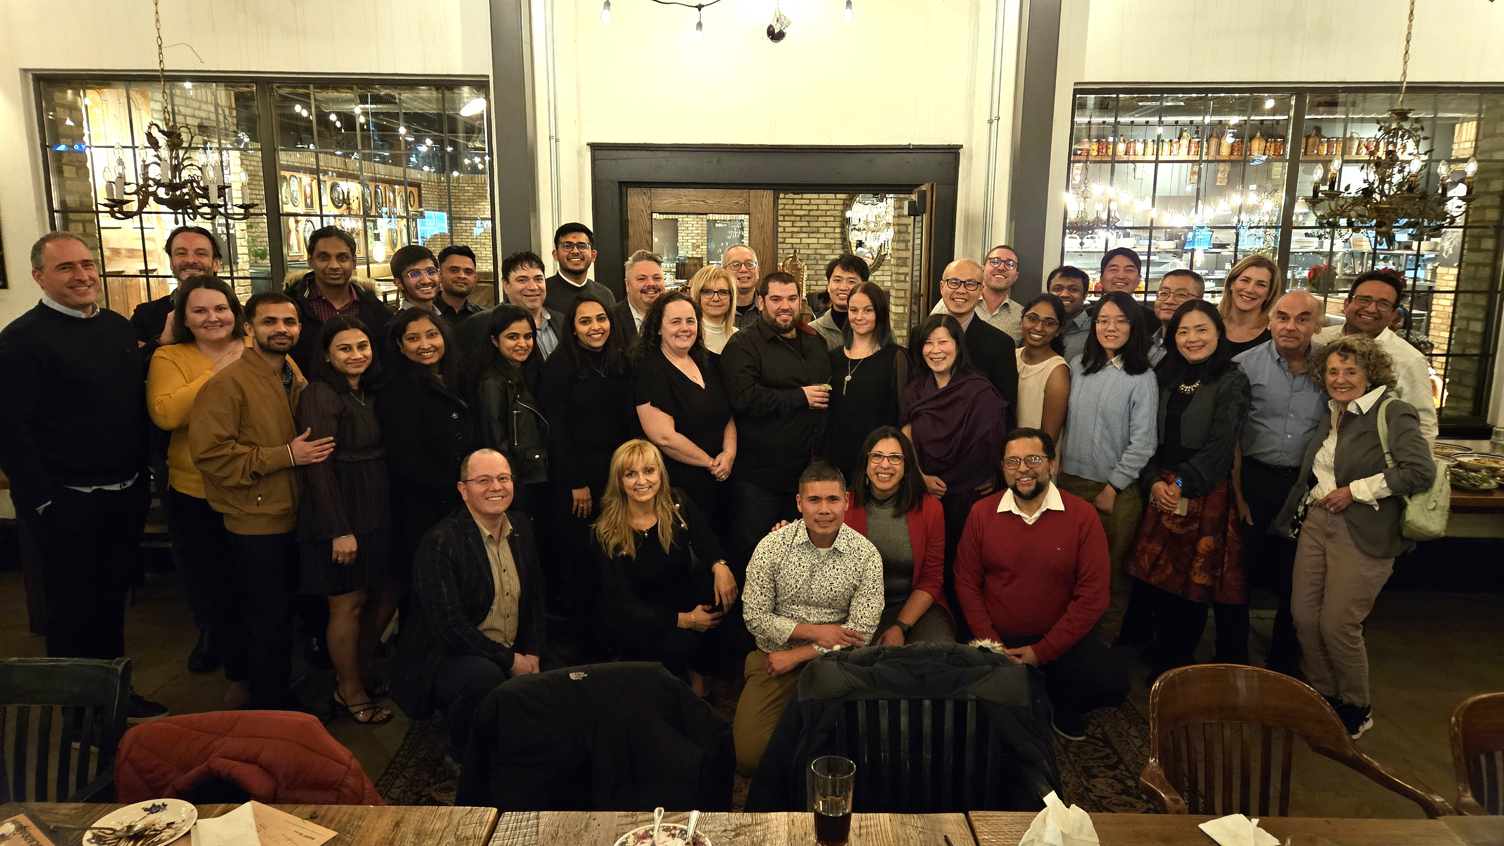
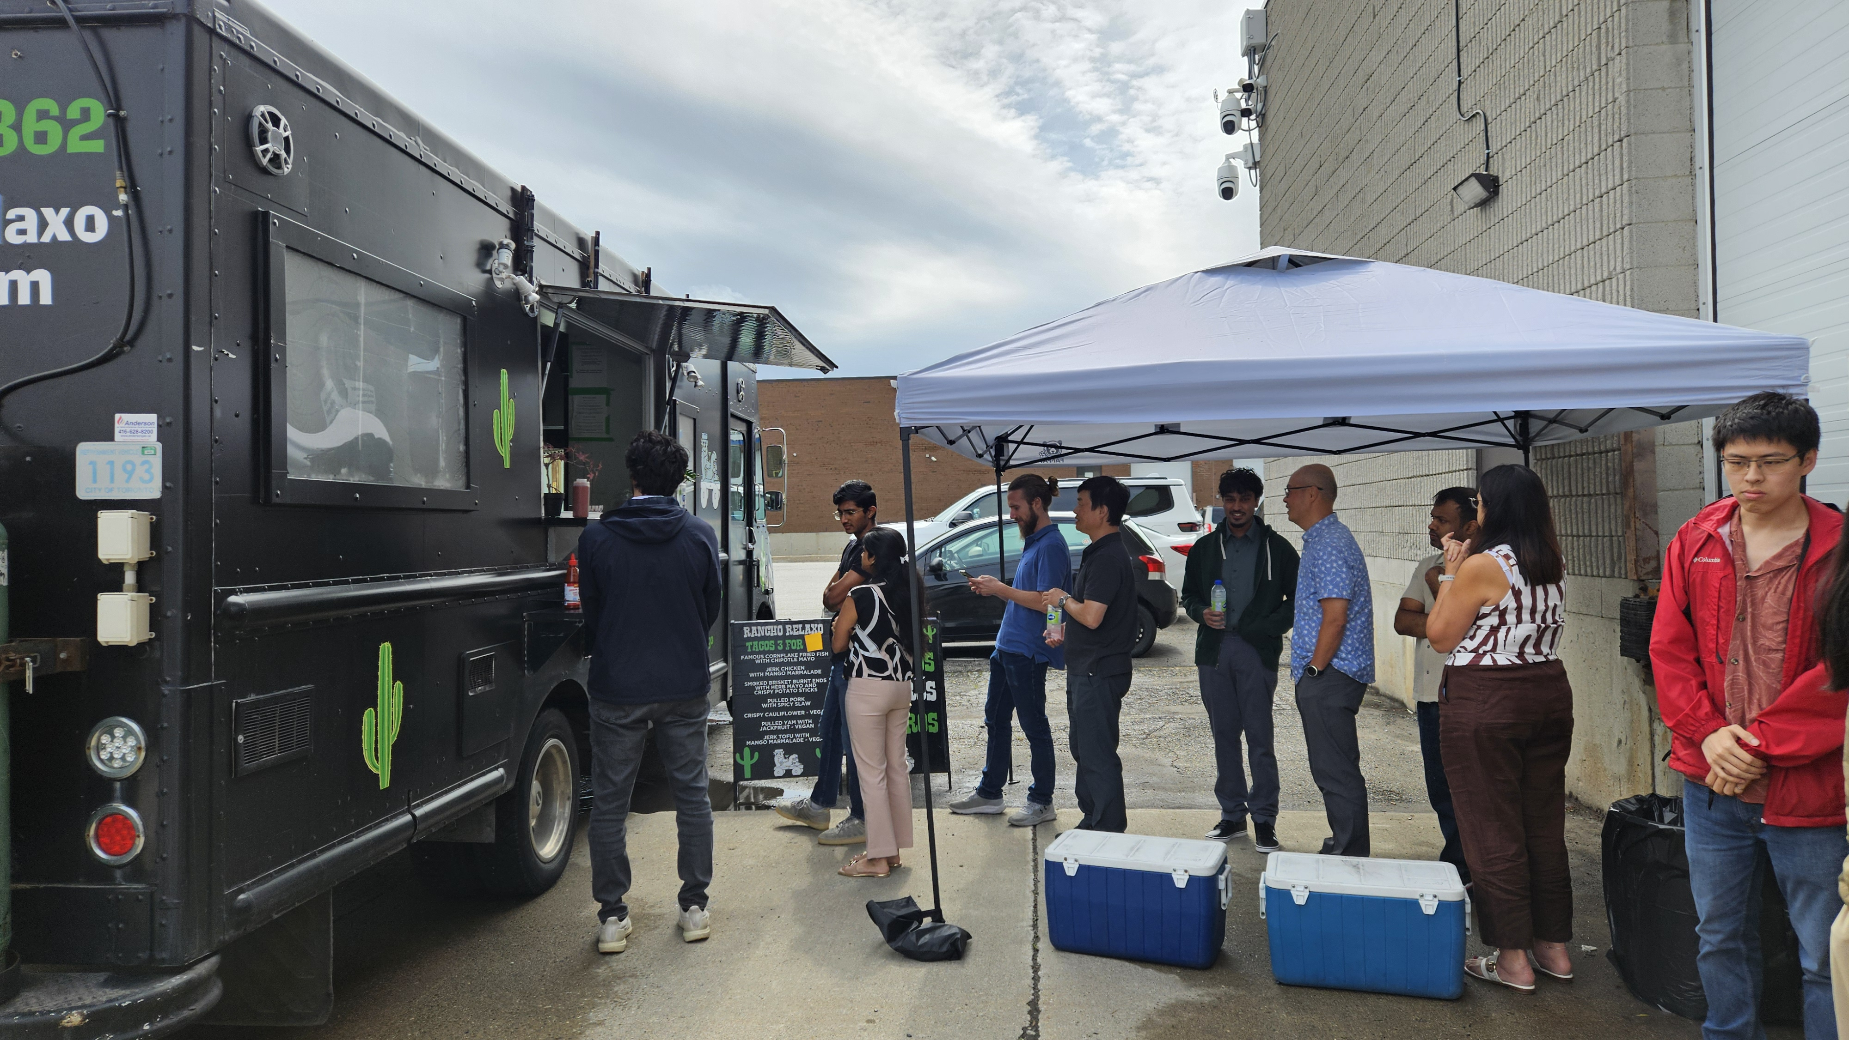
EMPLOYEE WELL BEING
Annual Goal Setting
Learning Plans
Training
On-the job stretch assignments
Lunch and Learns
Charity Events
Fun Runs
Sports Teams
Team Building Events
Company BBQs
Annual Holiday Party with Partners/Spouses
Lunch Walks
Ergonomic Reviews
Flexible working location / hours
Health and Safety Committee
Comprehensive Benefits
Vacation
Compensation
ESOP
TOUCHLESSTM MONITORING SOLUTIONS
Copyright 2025 Systems with Intelligence Inc.

