Slide 1
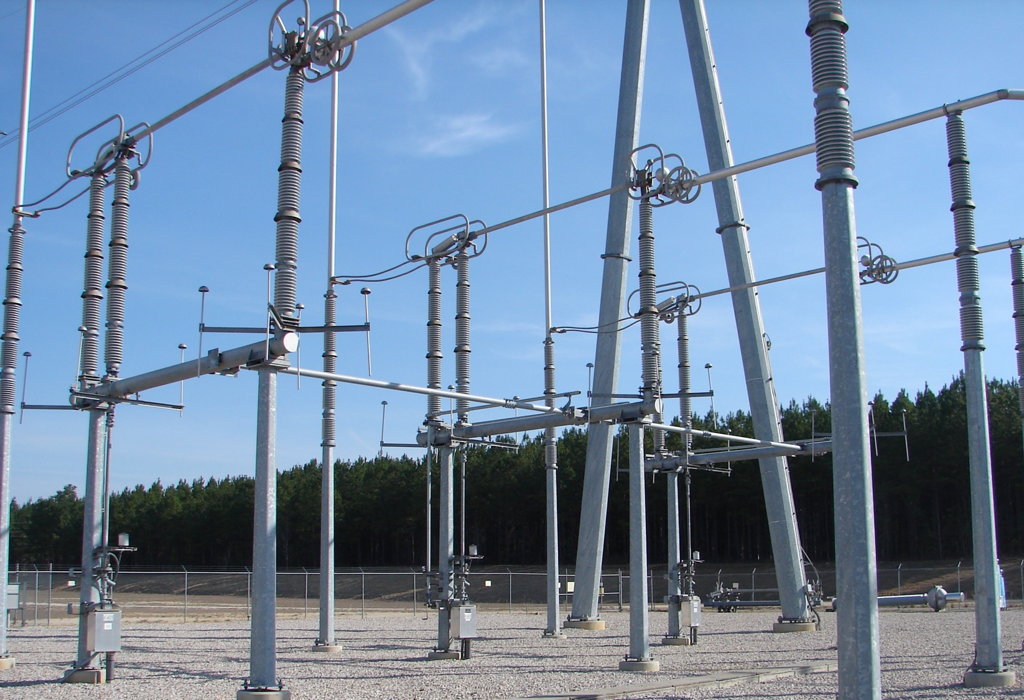

2025 SSIH Leadership Summit Southern States LLC November 19‐20, 2025 Rev-02
Notes:
Add note to this slide

Slide 2

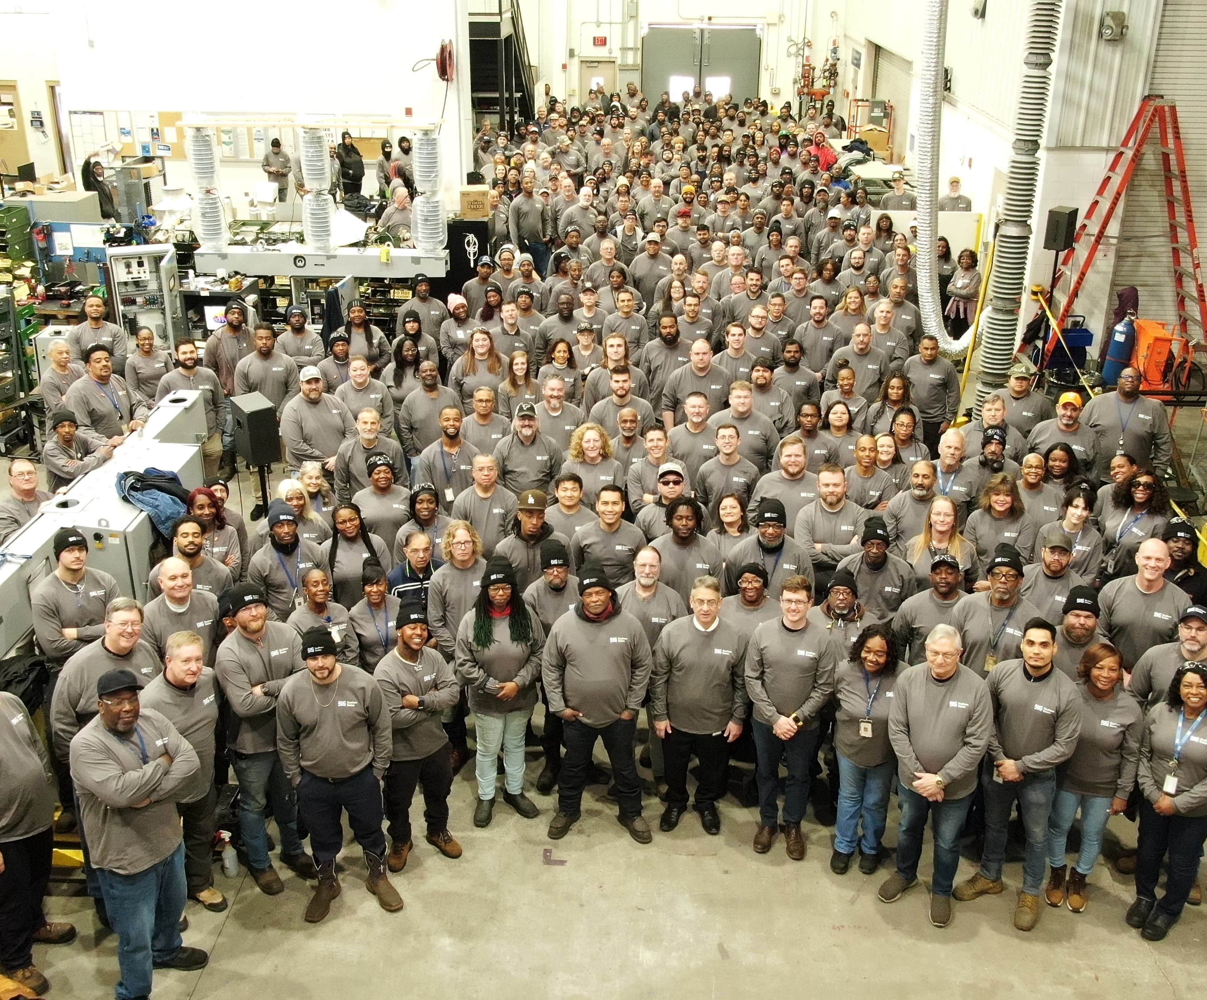
OUR MISSION AND VISION STATEMENT
Mission
Built on more than a century of innovation, Southern States enhances reliability, power quality, resilience, and safety for the future of our power infrastructure with industry-leading equipment, service, and solutions
Vision
Southern States powers the future as a trusted partner with innovative solutions, while safeguarding today’s grid infrastructure
Powers the Future
Notes:
Add note to this slide

Slide 3

Regular Engagements with Employees
Monthly Communications Meeting (Business Update)
For all employees. 1st shift, 2nd shift, TEAMS for remote and travelers
Monthly Employee Empower Hour with CEO
Monthly 1-hour open forum with cross section of employees on first shift and second shift
The group of invitees each month are selected randomly from everyone who celebrates a birthday in that month
During this meeting, employees are able to voice their thoughts on any of the topics below or any other specific one they would like to discuss including Culture, Activities, Workday, Work Related Concerns, Policies, Training, Improvement on Communications, Safety Culture, Quality, Other
Quarterly Management/Leadership Exchange
To bring together the SSL Management/Leadership team to share business philosophies and practices to drive to:
A common experience of our Customers as “one-SSL” from all Divisions and Support Functions
A common experience of our fellow employees as “one-SSL” from all Management levels
A common message to our stakeholders as “one-SSL”
Our Stake holders include our Owners, Board of Directors, Customers, SSIH Partners, Suppliers, Service Providers, SSL Employees, and our Community
Executive Leadership
Truist Leadership Institute, Communications, Management Assessment and next-phase leadership development
Annual Family Day, Christmas Luncheon, Halloween Dress up, Health Fairs, Annual Retirement Luncheon, others

Slide 4
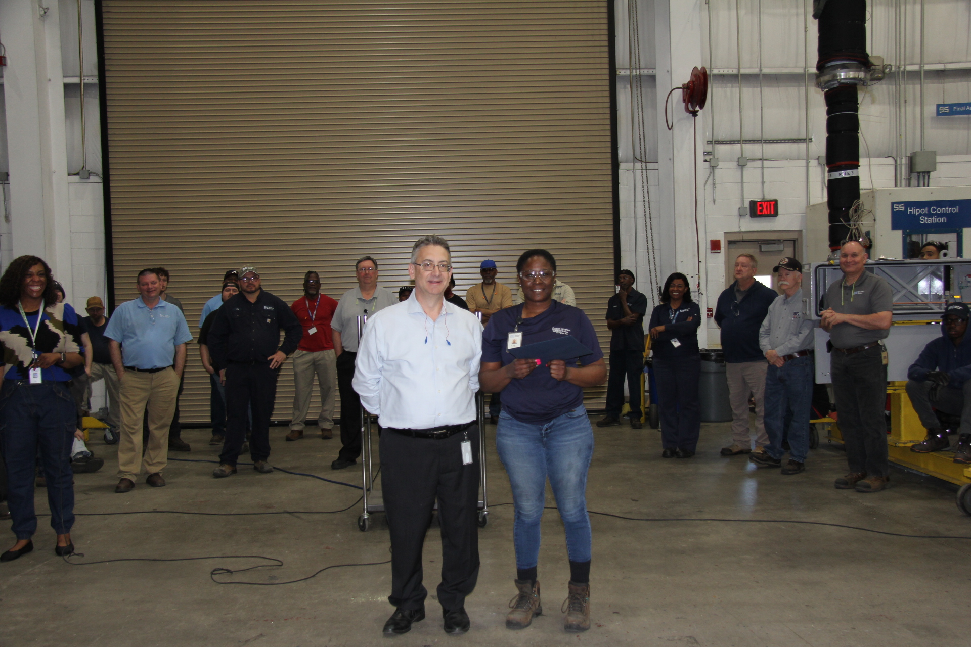
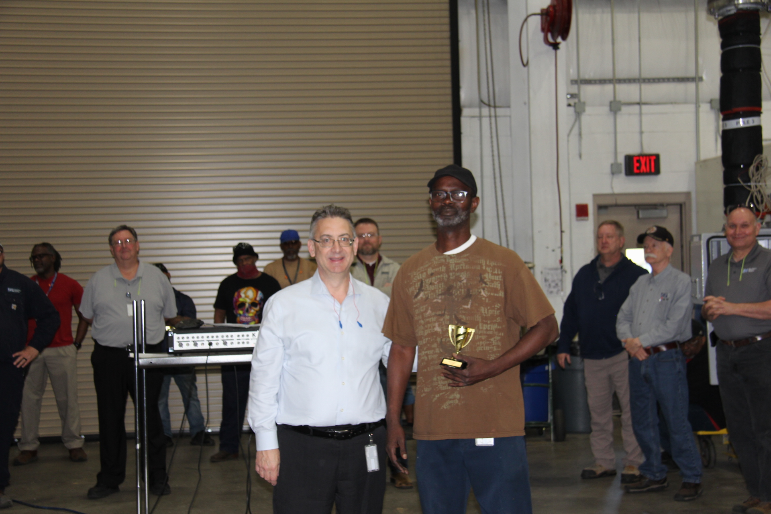
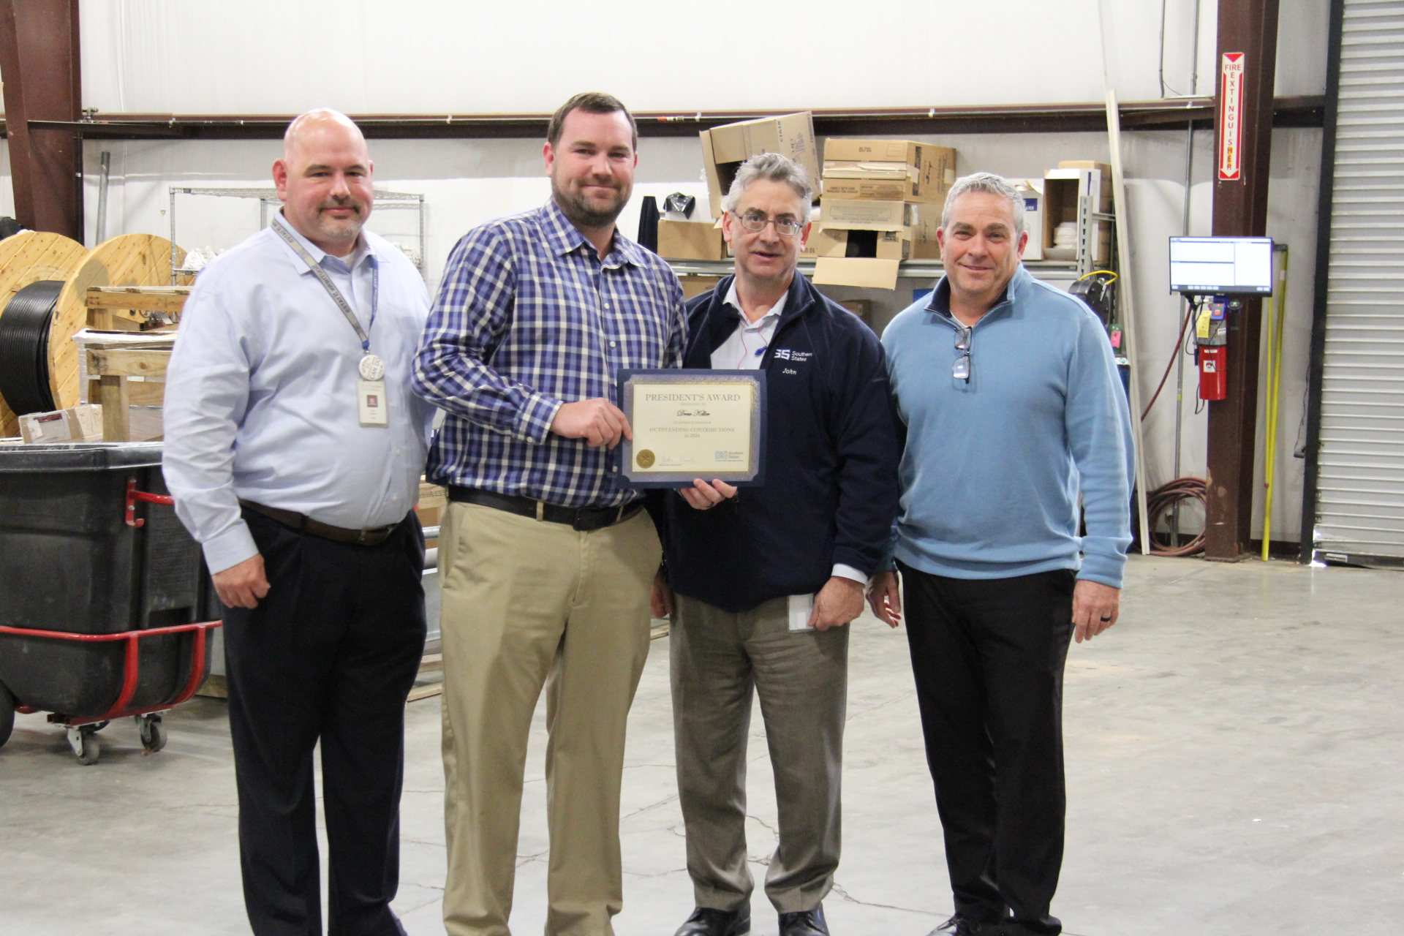
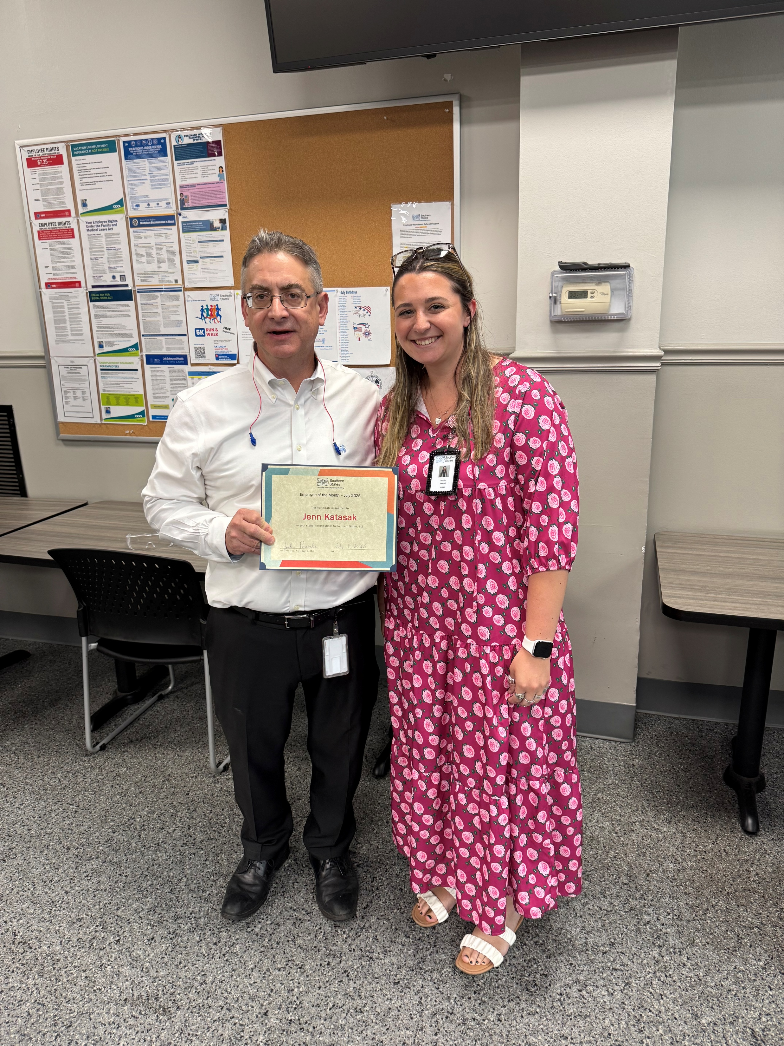
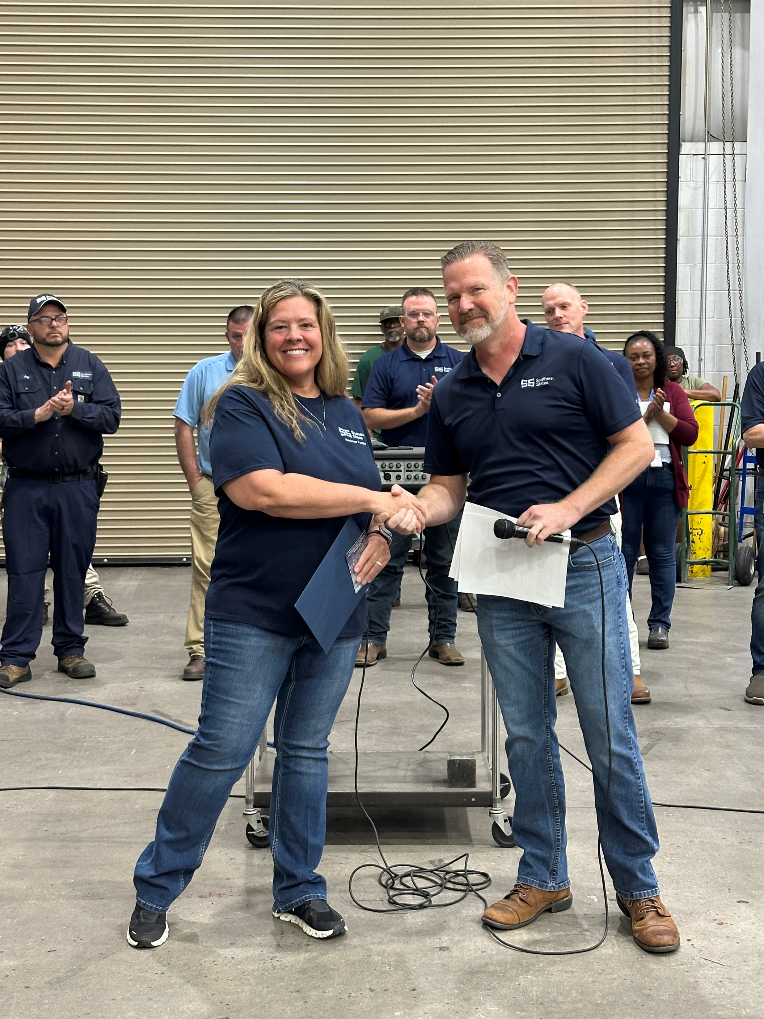
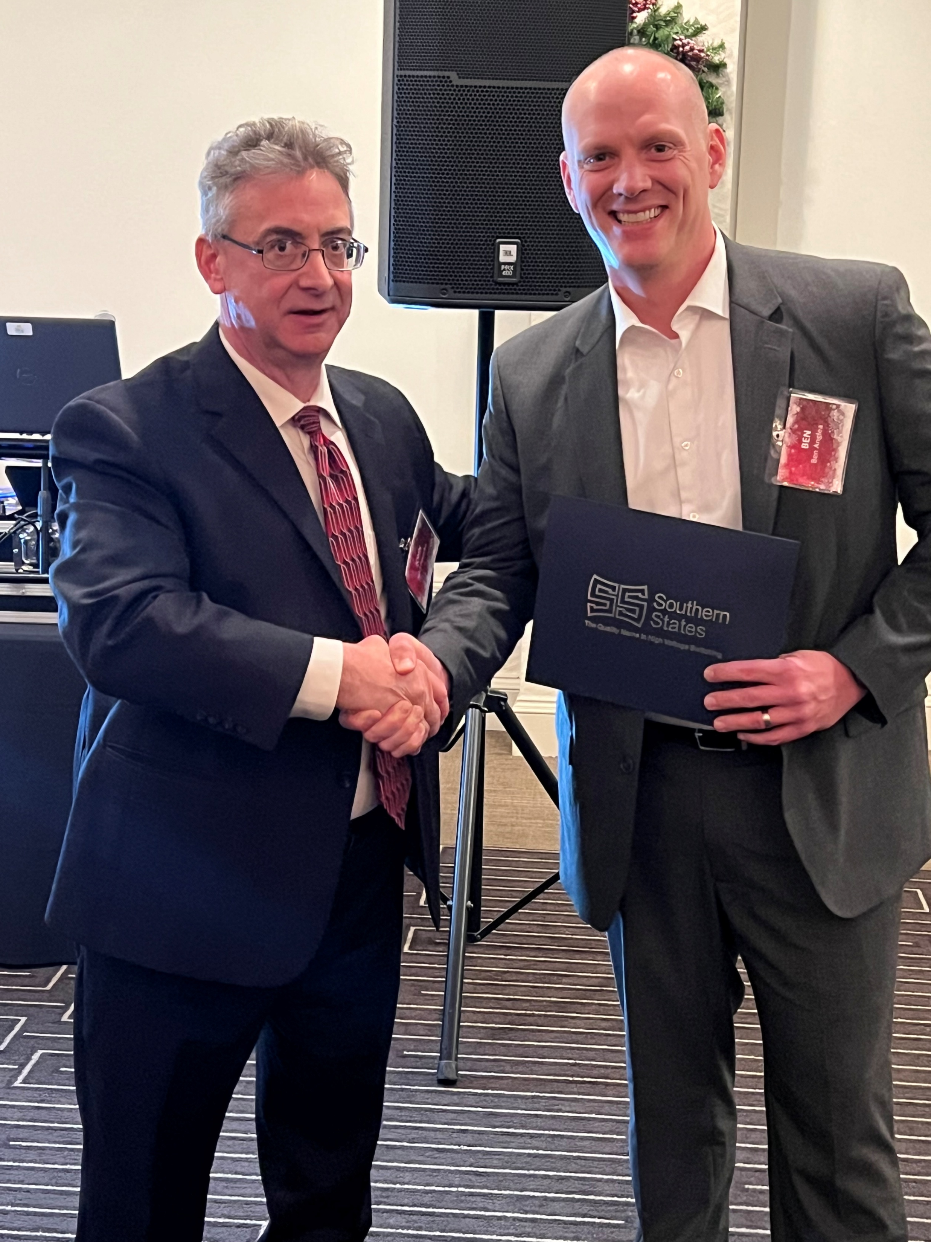
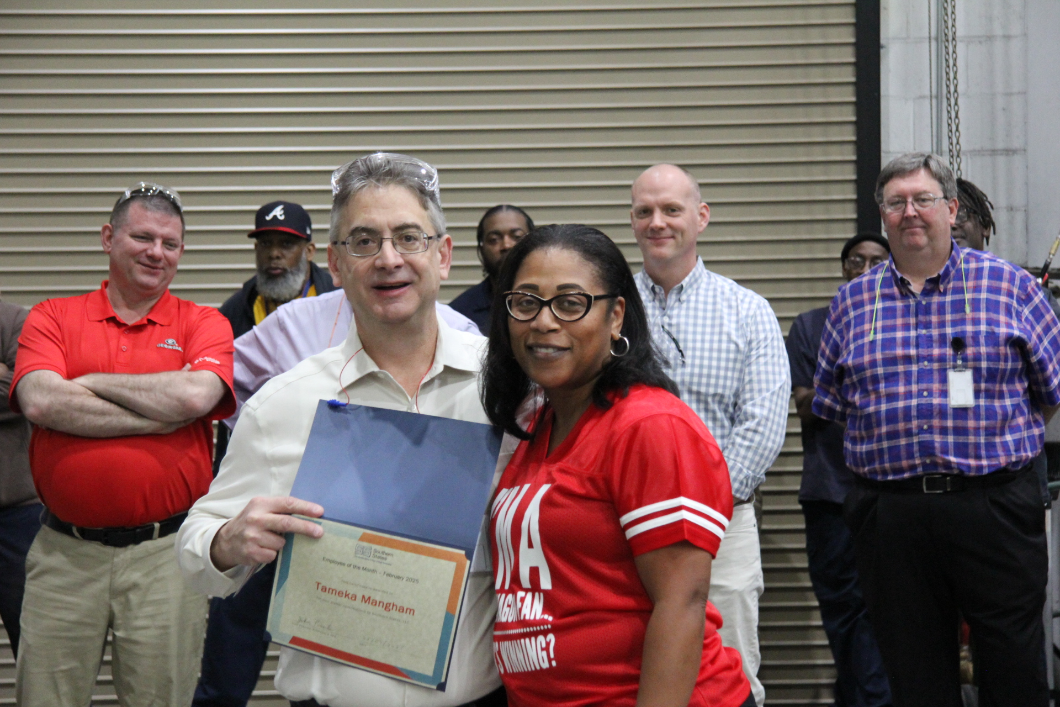
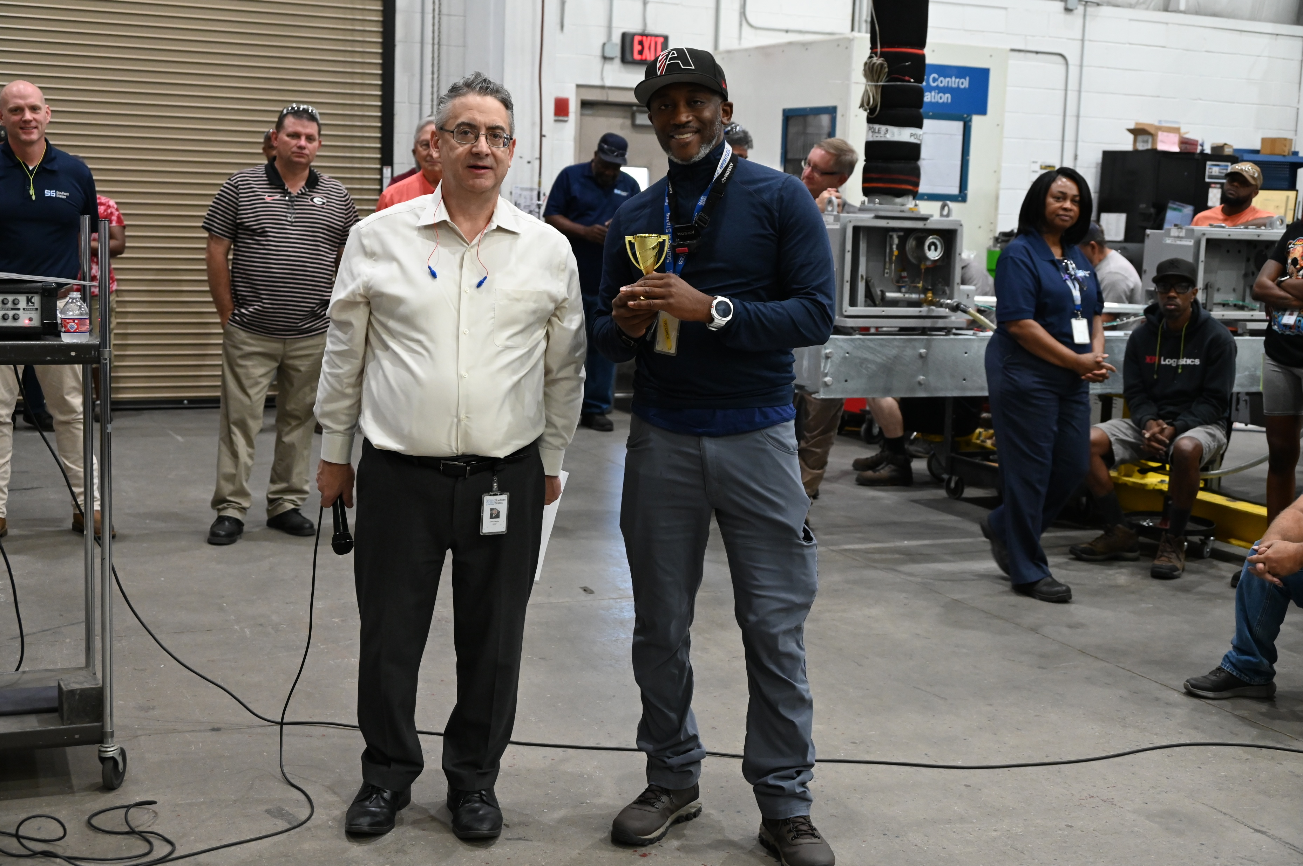

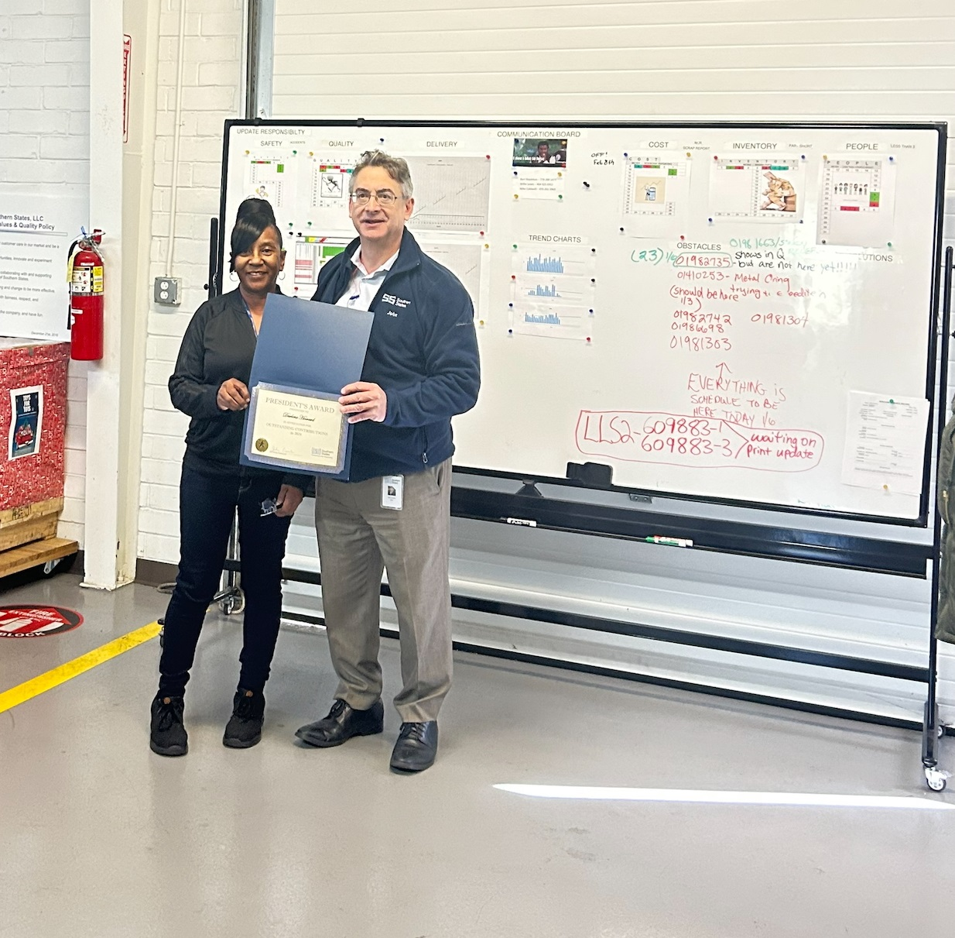
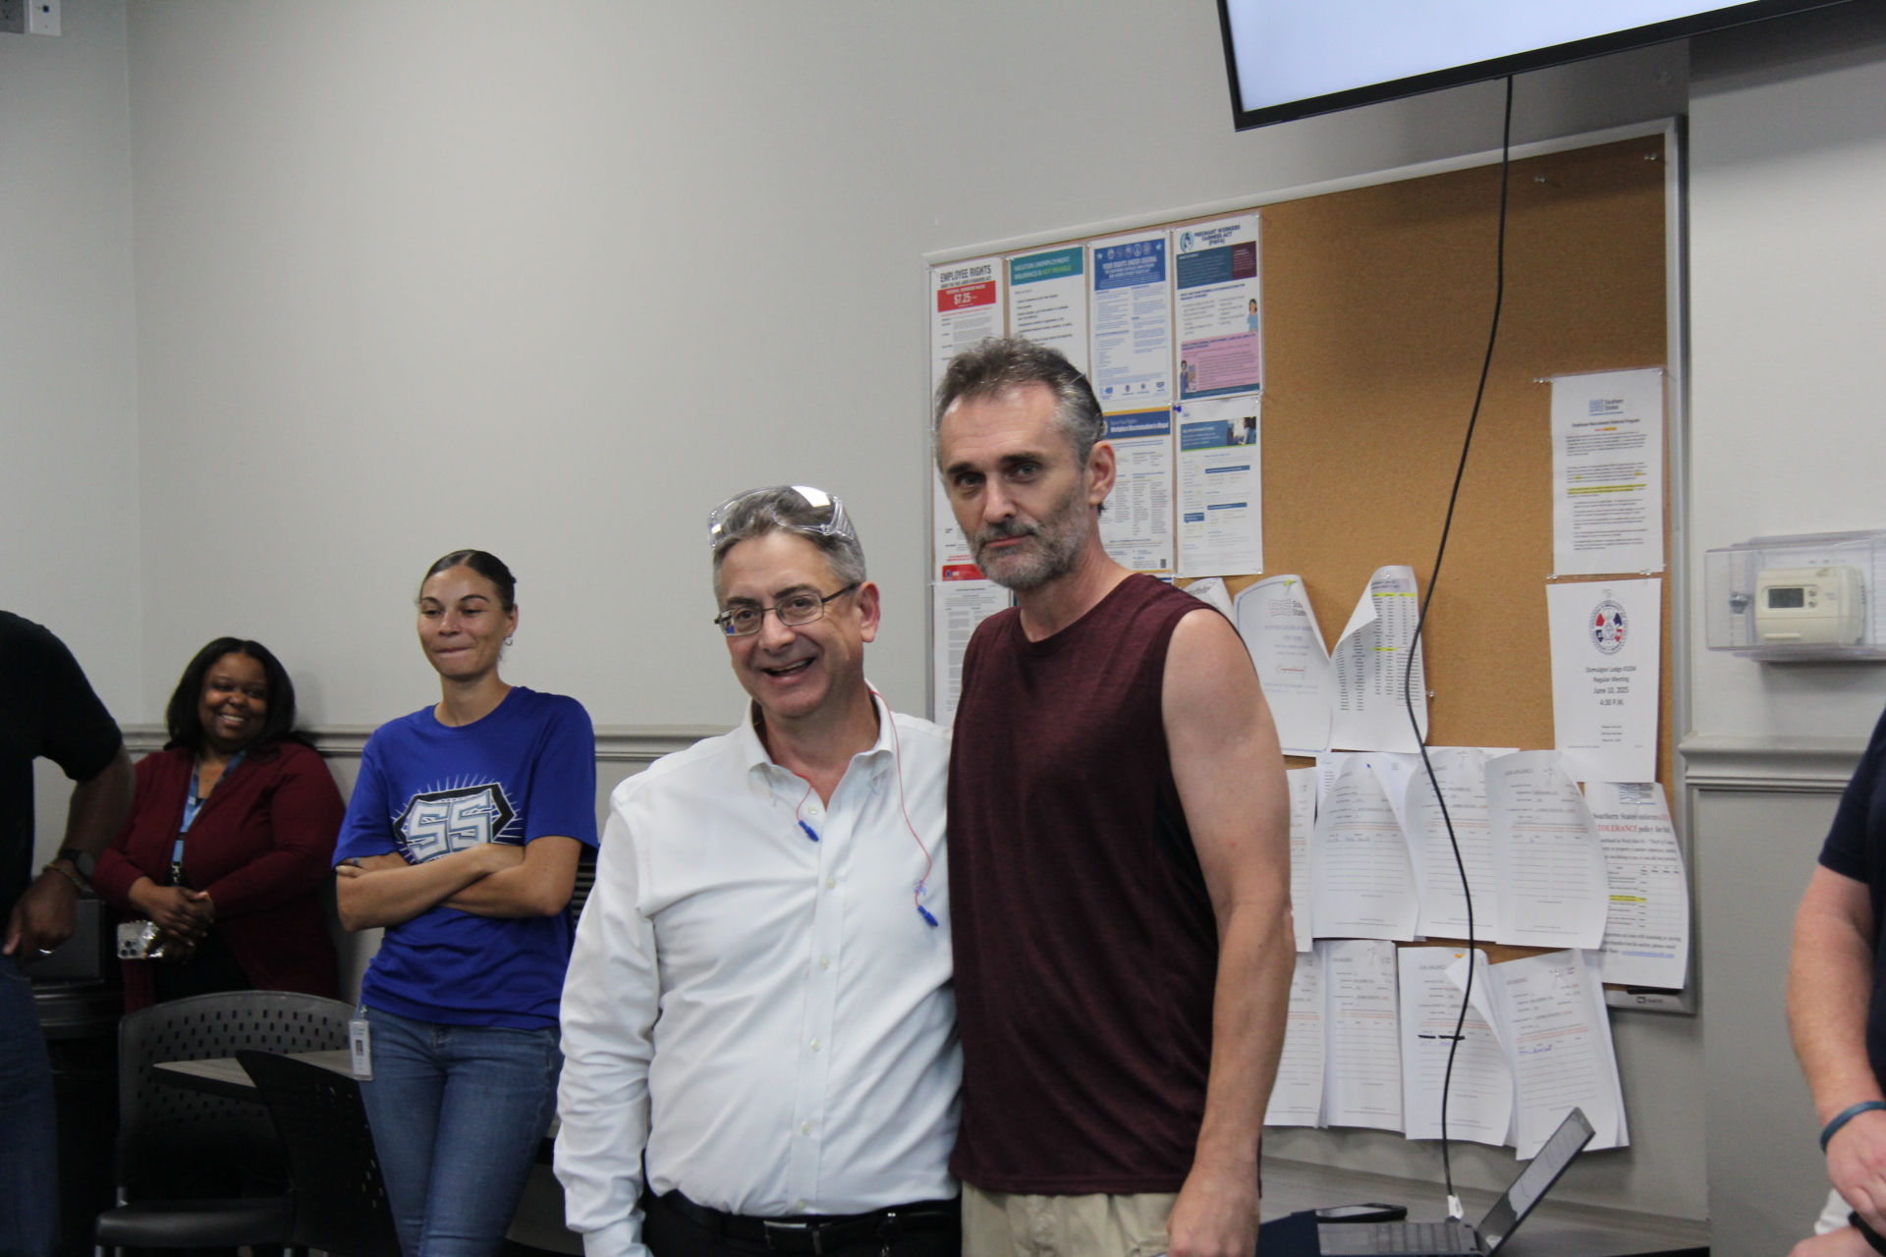
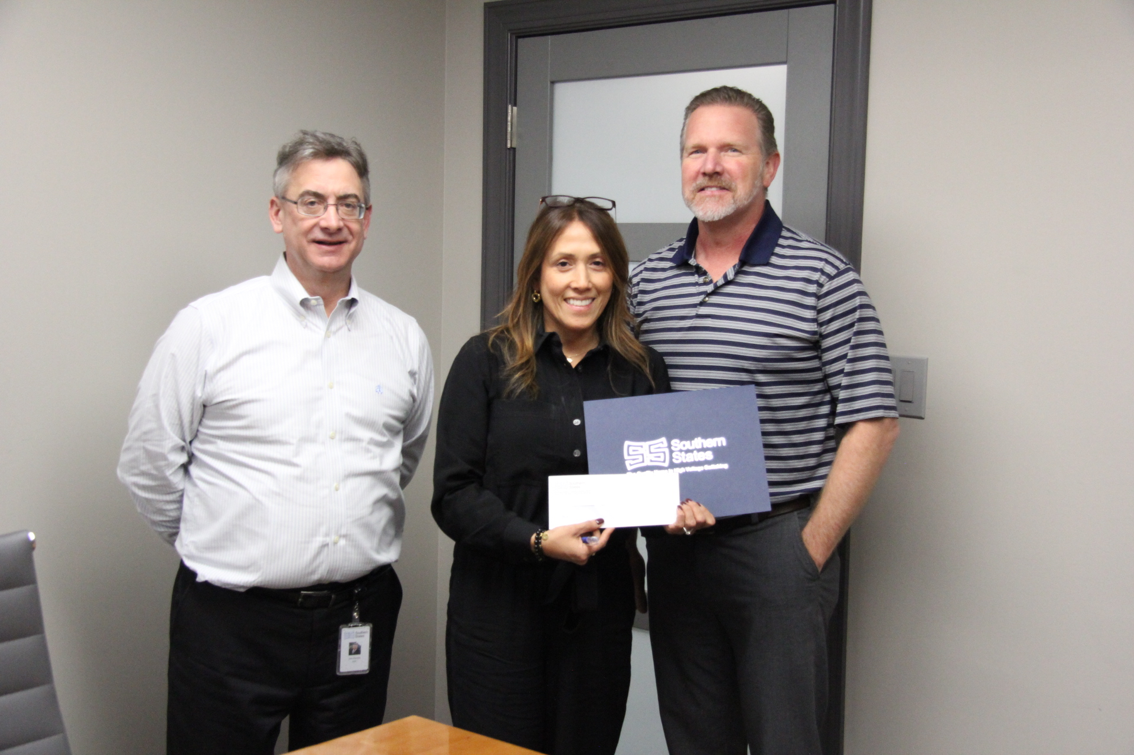
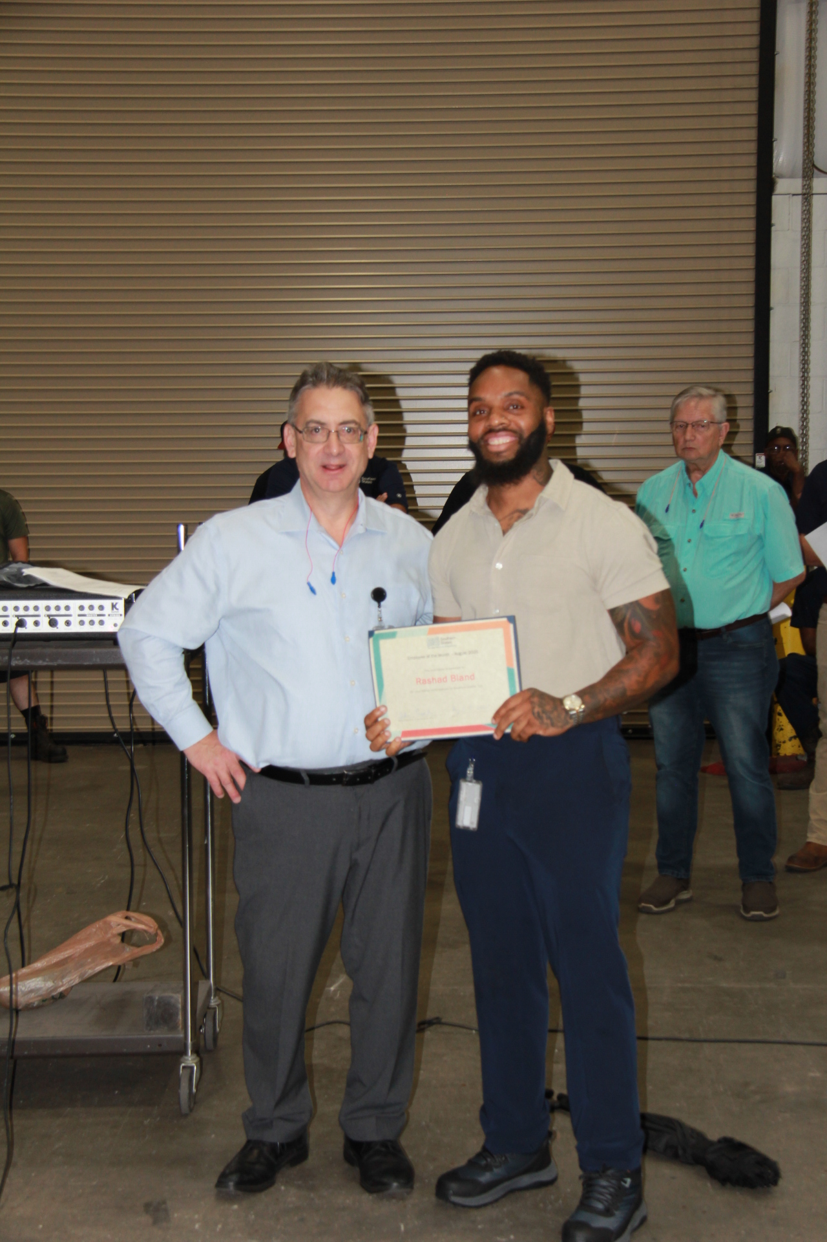
Awards and Recognition
Employee of the Month, Core Values Award
Annual Presidents Award

Slide 5
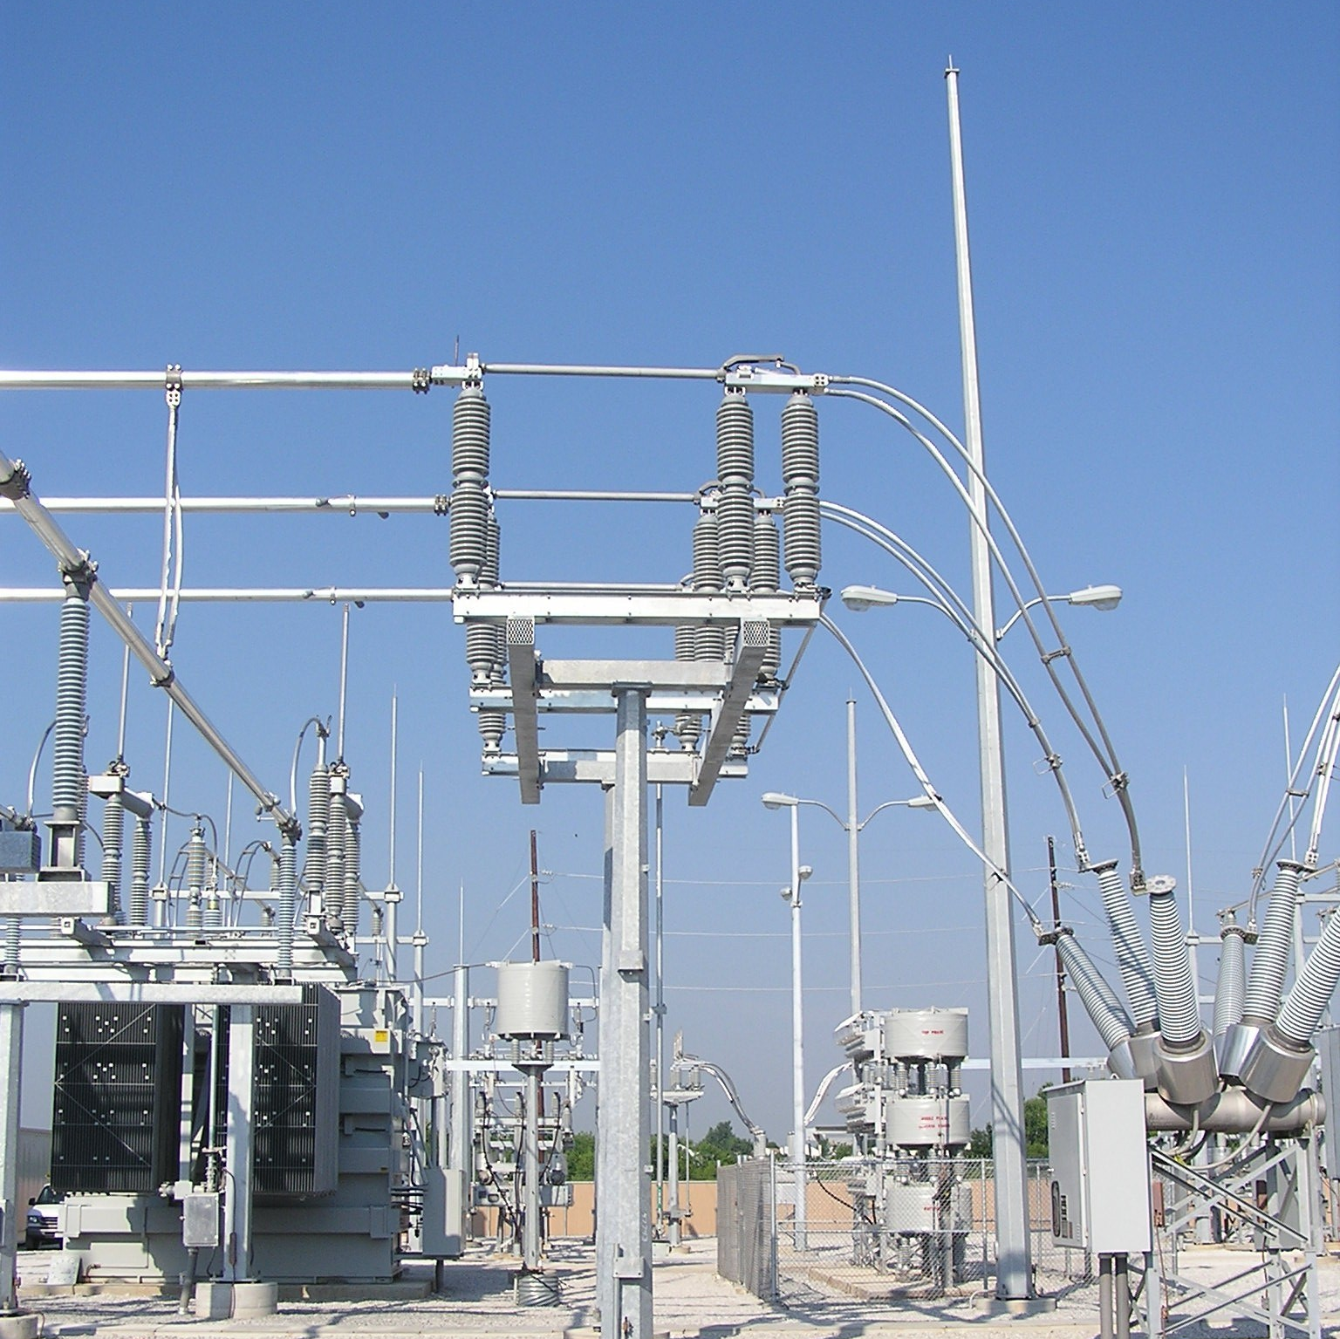
Switch Division Transmission Division Sensors Division
Notes:
Add note to this slide

Slide 6
Switch Division Vice President and General Manager
What is your background
WLHamilton Inc. (dba RRS Inc. / Hamilton Properties)
2001 – 2013
Standalone automotive facility
Residential property rehab and rentals
MIDAS
2014-15
District Manager (Atlanta) for largest independently owned automotive franchisee group in the US (Katz).
Southern States
2015-18
Area Sales Manager (Switch)
2018-20
National Sales Manager (Switch)
2020-22
Director, Sales & Marketing (Switch)
2023
General Manager (Switch & Transmission)
2024-25
Vice President & General Manager (Switch, Transmission & Sensors)

Slide 7
Switch Division Management Team
VP and GM
Switch Division
Lon Hamilton
Director of
Engineering
Joe Andreyo
Manager Business
Development
Transmission Division
Thermando Stephens
Manager
Product
Dustin Hane
Manager
National Sales
Amit Modi
Manager
Operations
Greg Priest
Manager Marketing
Communications &
Operations
Maria Fischer
Manager
Order Engineer
Adam Palmer
Supervisor
Sales Coordination
Dodie Cason
Manager Assembly
Operations
John Stephens
Manager
Machining
Steve Hymes
Supervisor
Motor Mech
Ashley Horton
Supervisor II
Assembly
1st Shift
Alan Pierce
Director
Embedded Systems
Engineering
John Gerthoffer
Supervisor
Final Assembly
1st Shift
Billy Rice
Manager
Logistics
Joe Carlton
Supervisor
Transmission Design
Larry Beagan
Supervisor
Transmission
Assembly 1st Shift
Chris Hilton
Manager
Manufacturing
2nd Shift
Derrick Reid
Manager
Motor Automation
Chris Ekpoudom
Supervisor
Op Mech
1st Shift
Elizabeth Edmonson
Supervisor
Fabrication Shop
Jeremy Hilton
Manager
Sustaining
Engineer
Danny Hoss
Supervisor
Engineering
Services
Nedra York
Supervisor
Shipping
1st Shift
Sola Collins
Supervisor
Fabrication Shop
2nd Shift
Freda Alexander

Slide 8
Switch Division Product Focus
Disconnect Switches
Ground Switches
Motor Operators
Sensors (ICS, Far Field, Arrestor, Vacuum)
Special Purpose Products (LBI vacuum interrupter, MACI, SIS)

Slide 9
Switch Division Market Focus
Disconnect / Ground Switches
Largest product basket of disconnect switches in the US market
Largest in the world when considering our partnership with Coelme / egic
Special Purpose Devices
MACI
LBI
SIS
ICS / Far Field
Flexibility
SSLLC has always prided itself on being the most flexible company to work with as it relates to both up front sales activities, but also within design and new offerings

Slide 10
Switch Division Recent Intra-Group Collaborations
Coelme / egic
TV-70 / ESD
SSP 345kV
SSP 765kV
VCB
Hydro Quebec homologation
Vanguard Electric
Southern States largest supplier of station post insulators
Many other smaller products purchased
Diram
Ground switch supply for cap banks
SWI
Current collaboration on sensor asset monitoring capabilities
Marketing // Logistics // Procurement
Future opportunities for collaboration
Sales Channel
Interaction with SWI on Selling Channel
Immersive Selling tool for Grid Security
International with Stephen Lord for Grid Security

Slide 11
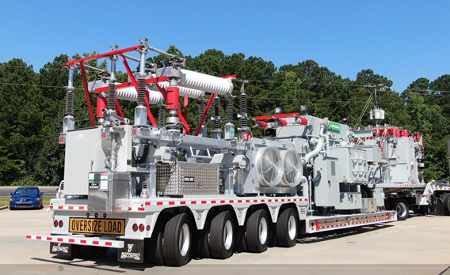
Grid Services Division
Notes:
Add note to this slide

Slide 12
Grid Services Division Vice President and General Manager
Industry since 1996
GE-Hitachi HVB – 9 years
Field Service Technician – Gas Circuit Breakers
Site Project Manager - GIS
Service Department Manager
National Sales Manager
Southern States – 8 months
PSD Area Sales Manager
General Electric – 3 years
Account Manager GE Energy North Texas
Southern States – 18 years
Service Division National Sales Manager, General Manager, and Vice President

Slide 13
Grid Services Division Product Focus
Mission Statement
Southern States Grid Services Division provides value added services to support high voltage transmission and distribution customers (15kV and higher)
Product Support Services – After sales parts, technical support and shop services
Field Services – On-site and training services
Mobile Solutions
Grid Security Solutions

Slide 14
Grid Services Division Management Team
VP and GM
Grid Services
Division
Dave Lombardo
Director
Customer Care
Joey Calderon
Director
Mobile Solutions
Paulo Pereira
Director
Grid Security
Patrick James
Manager
Operations
Johnny Adams
Manager
Product Support
Service
Drew Keller
Chief Engineer
Mobile Solutions
Sam Harmon
Manager
Field Support
Service
Erik Jordan

Slide 15
Grid Services Division Product and Market Focus
Product Support Services
Technical Phone support
Parts sales
Shop Services
Repair/refurbish any SSL product
Life cycle maintenance – assist customer over life of product
Field Services
Field Support
Installation supervision
Commissioning Services
Opportunistic turn-key installation capabilities
Equipment / project assessment
Training services (at SSL or customer location)

Slide 16
Grid Services Division Product and Market Focus
Mobile Solutions
Equipment agnostic
Preferred suppliers (SSL, Northern, etc), but access to entire industry of manufactures to give us best oppy for price, lead-time, and meeting customer specification
Not tied to one type of mobile
Substations
Capacitor banks
Stat Com
Skid mounted solutions
Single piece of equipment solution (switch, circuit switcher, disconnect switch, regulator, etc.)
Playing tariff game right now with major equipment suppliers…but quoting to ALWAYS recoup tariffs not built in cost structure
Customer focused custom solutions
DS drives to standard designs with less ability to custom solution
SSL starting to drive to standard designs when makes sense, but still embraces custom and customer driven solutions when differentiator
Focus on Co-op market
More “cooperative” selling approach (better pricing, more integrated project management approach)
Higher customer satisfaction and word of mouth marketing approach
https://www.southernstatesllc.com/products/mobile-substations/mobile-substations

Slide 17
Grid Services Division Product and Market Focus
Grid Security Solutions
Asset Protection
UL-752 level 8 & 10 compliant ballistic walls
Opportunistic approach, smaller market and specific project needs
Asset Monitoring
Touchless monitoring solutions for critical assets enhances grid resilience, safety, and security while lowering O&M costs
In cooperation and with support of SWI
Airspace awareness and protection
TrueView® radar system – drone tracking system
SkyDome® Manager® - command and control software
DroneHanger® and DroneHunter® – fully autonomous, radar guided, and purpose-built drone designed to identify, interfere, and (with possible upcoming legislation) capture or neutralize unauthorized drones in substation, data center, etc., airspace
In cooperation and with support of FORTEM Technologies
https://www.southernstatesllc.com/products/grid-security-products/airspace-security

Slide 18
Grid Services Division Recent Intra-Group Collaborations
Northern Transformers
Provided many of their transformers on Mobile Solutions Products
Northern installed a transformer on an SSL designed trailer and helped with complete transformer accessories installation
Diram / Advansa
Provides complete P&C designs for Mobile Solutions projects
Integrated designs into complete cabinet layouts
Complete procure and assembly of the design to include cabinets, devices, wiring, and testing
Team traveled to MG Power location in Canada to assist (and in cases, lead) the testing and troubleshooting of our CNL project that was executed in Canada
ACT/MG Power
Supported Mobile Solutions in completing the CNL project in Canada due to tariff uncertainty
Expertise provided greatly helped us complete the most challenging project / customer to date
Grid Security Europe and Middle East promotion”
System with Intelligence
Supported Grid Security Solutions with Asset Monitoring products and services
Introduction of Immersive Selling Tool
Vanguard Electric, LLC
Supply Chain

Slide 19
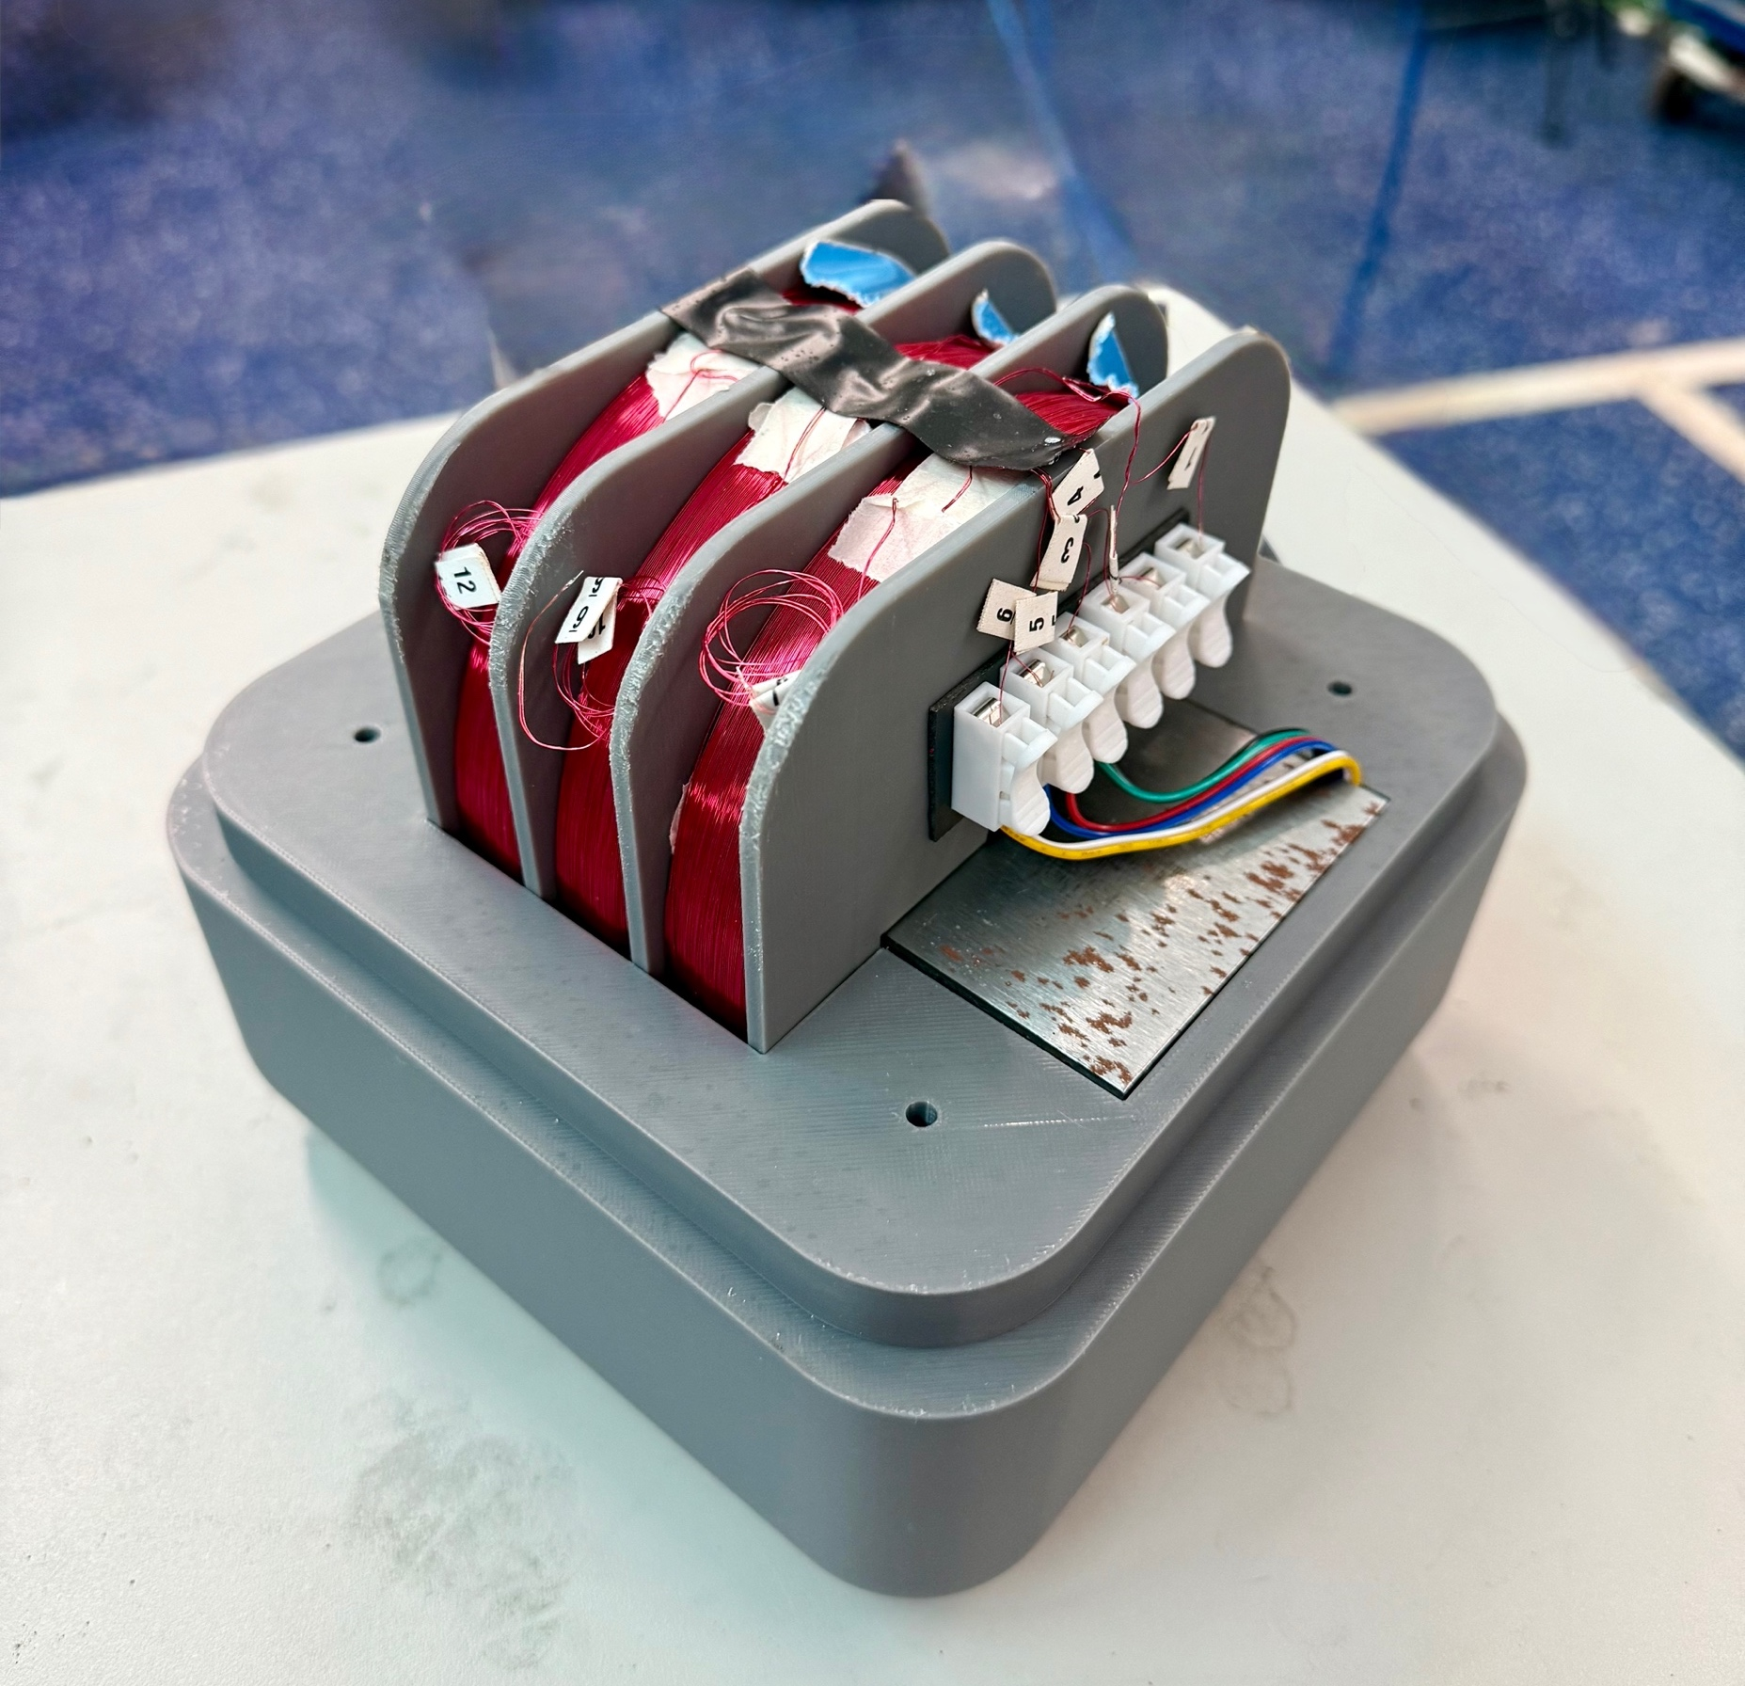
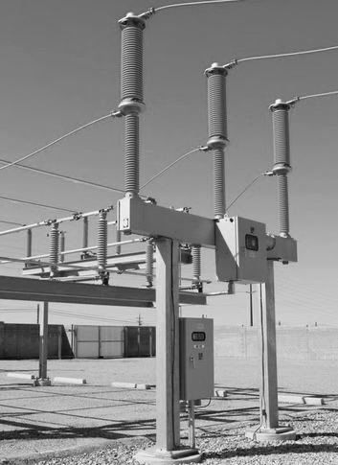
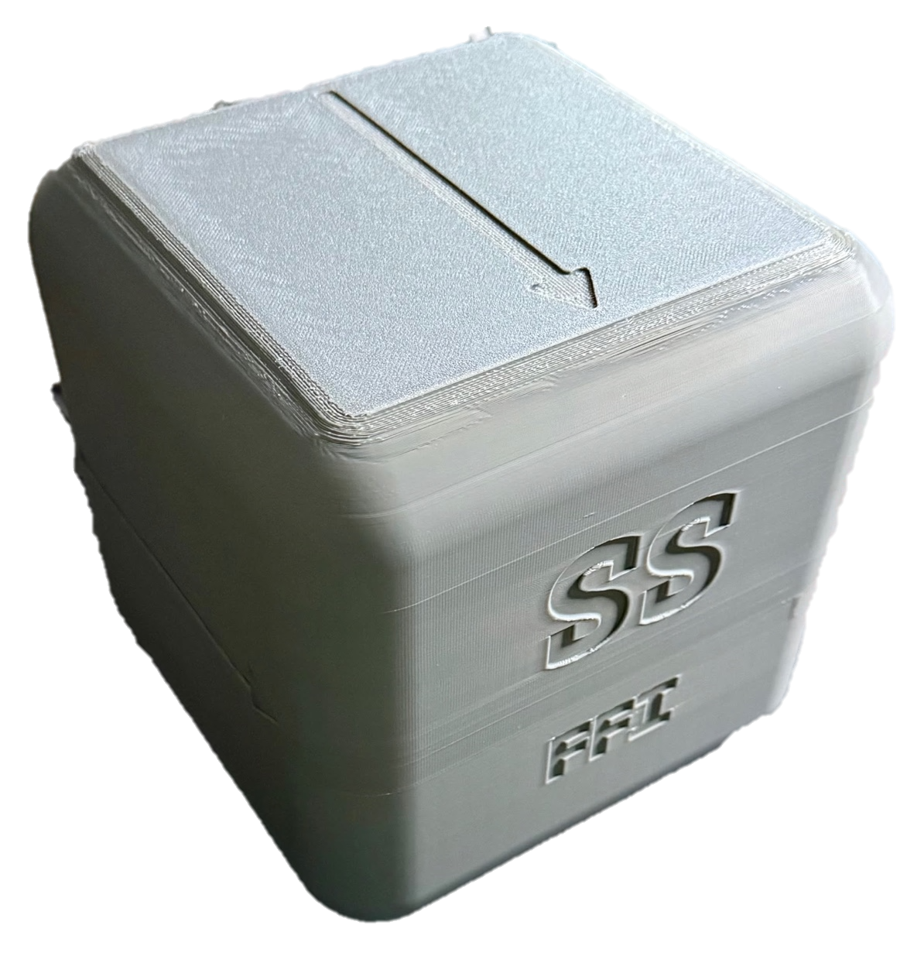
Advanced Technologies Development
Notes:
Add note to this slide

Slide 20
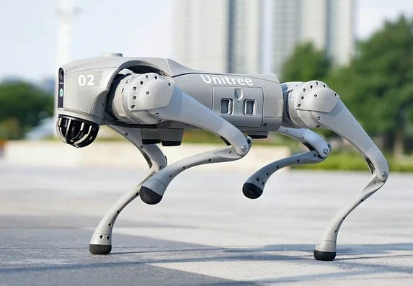
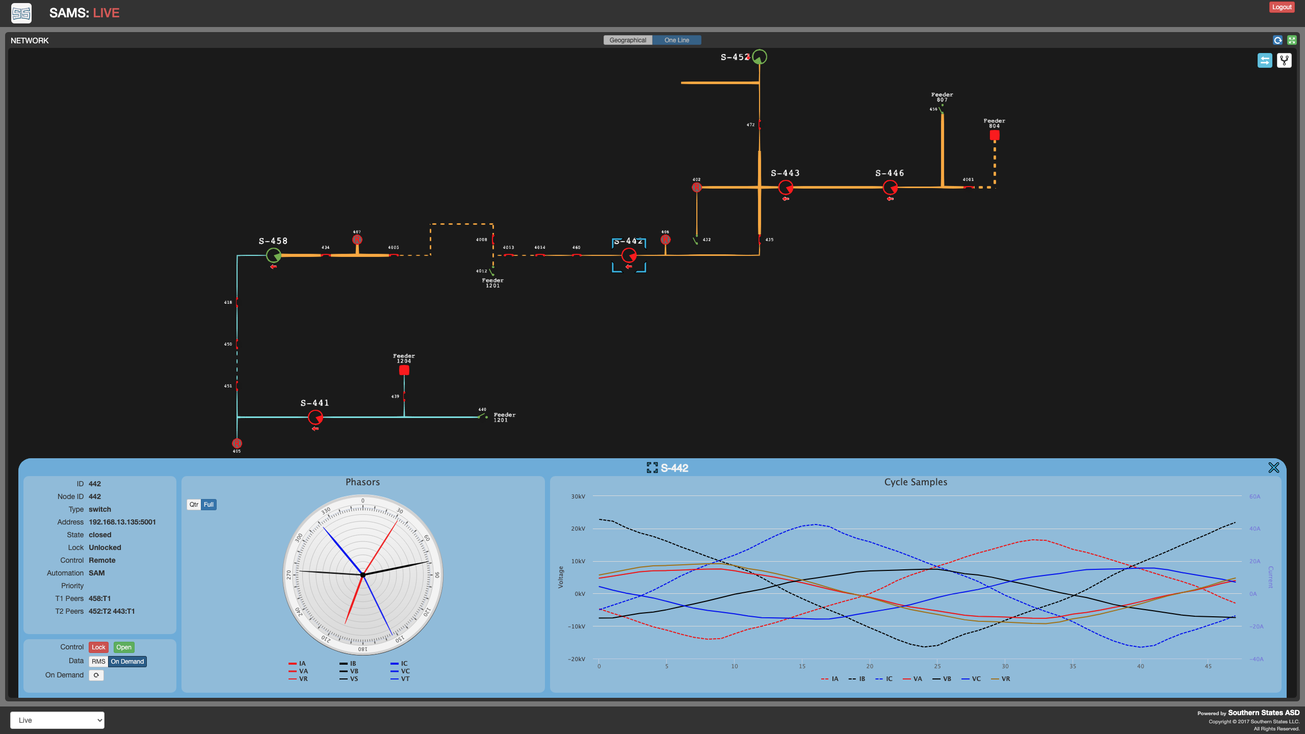
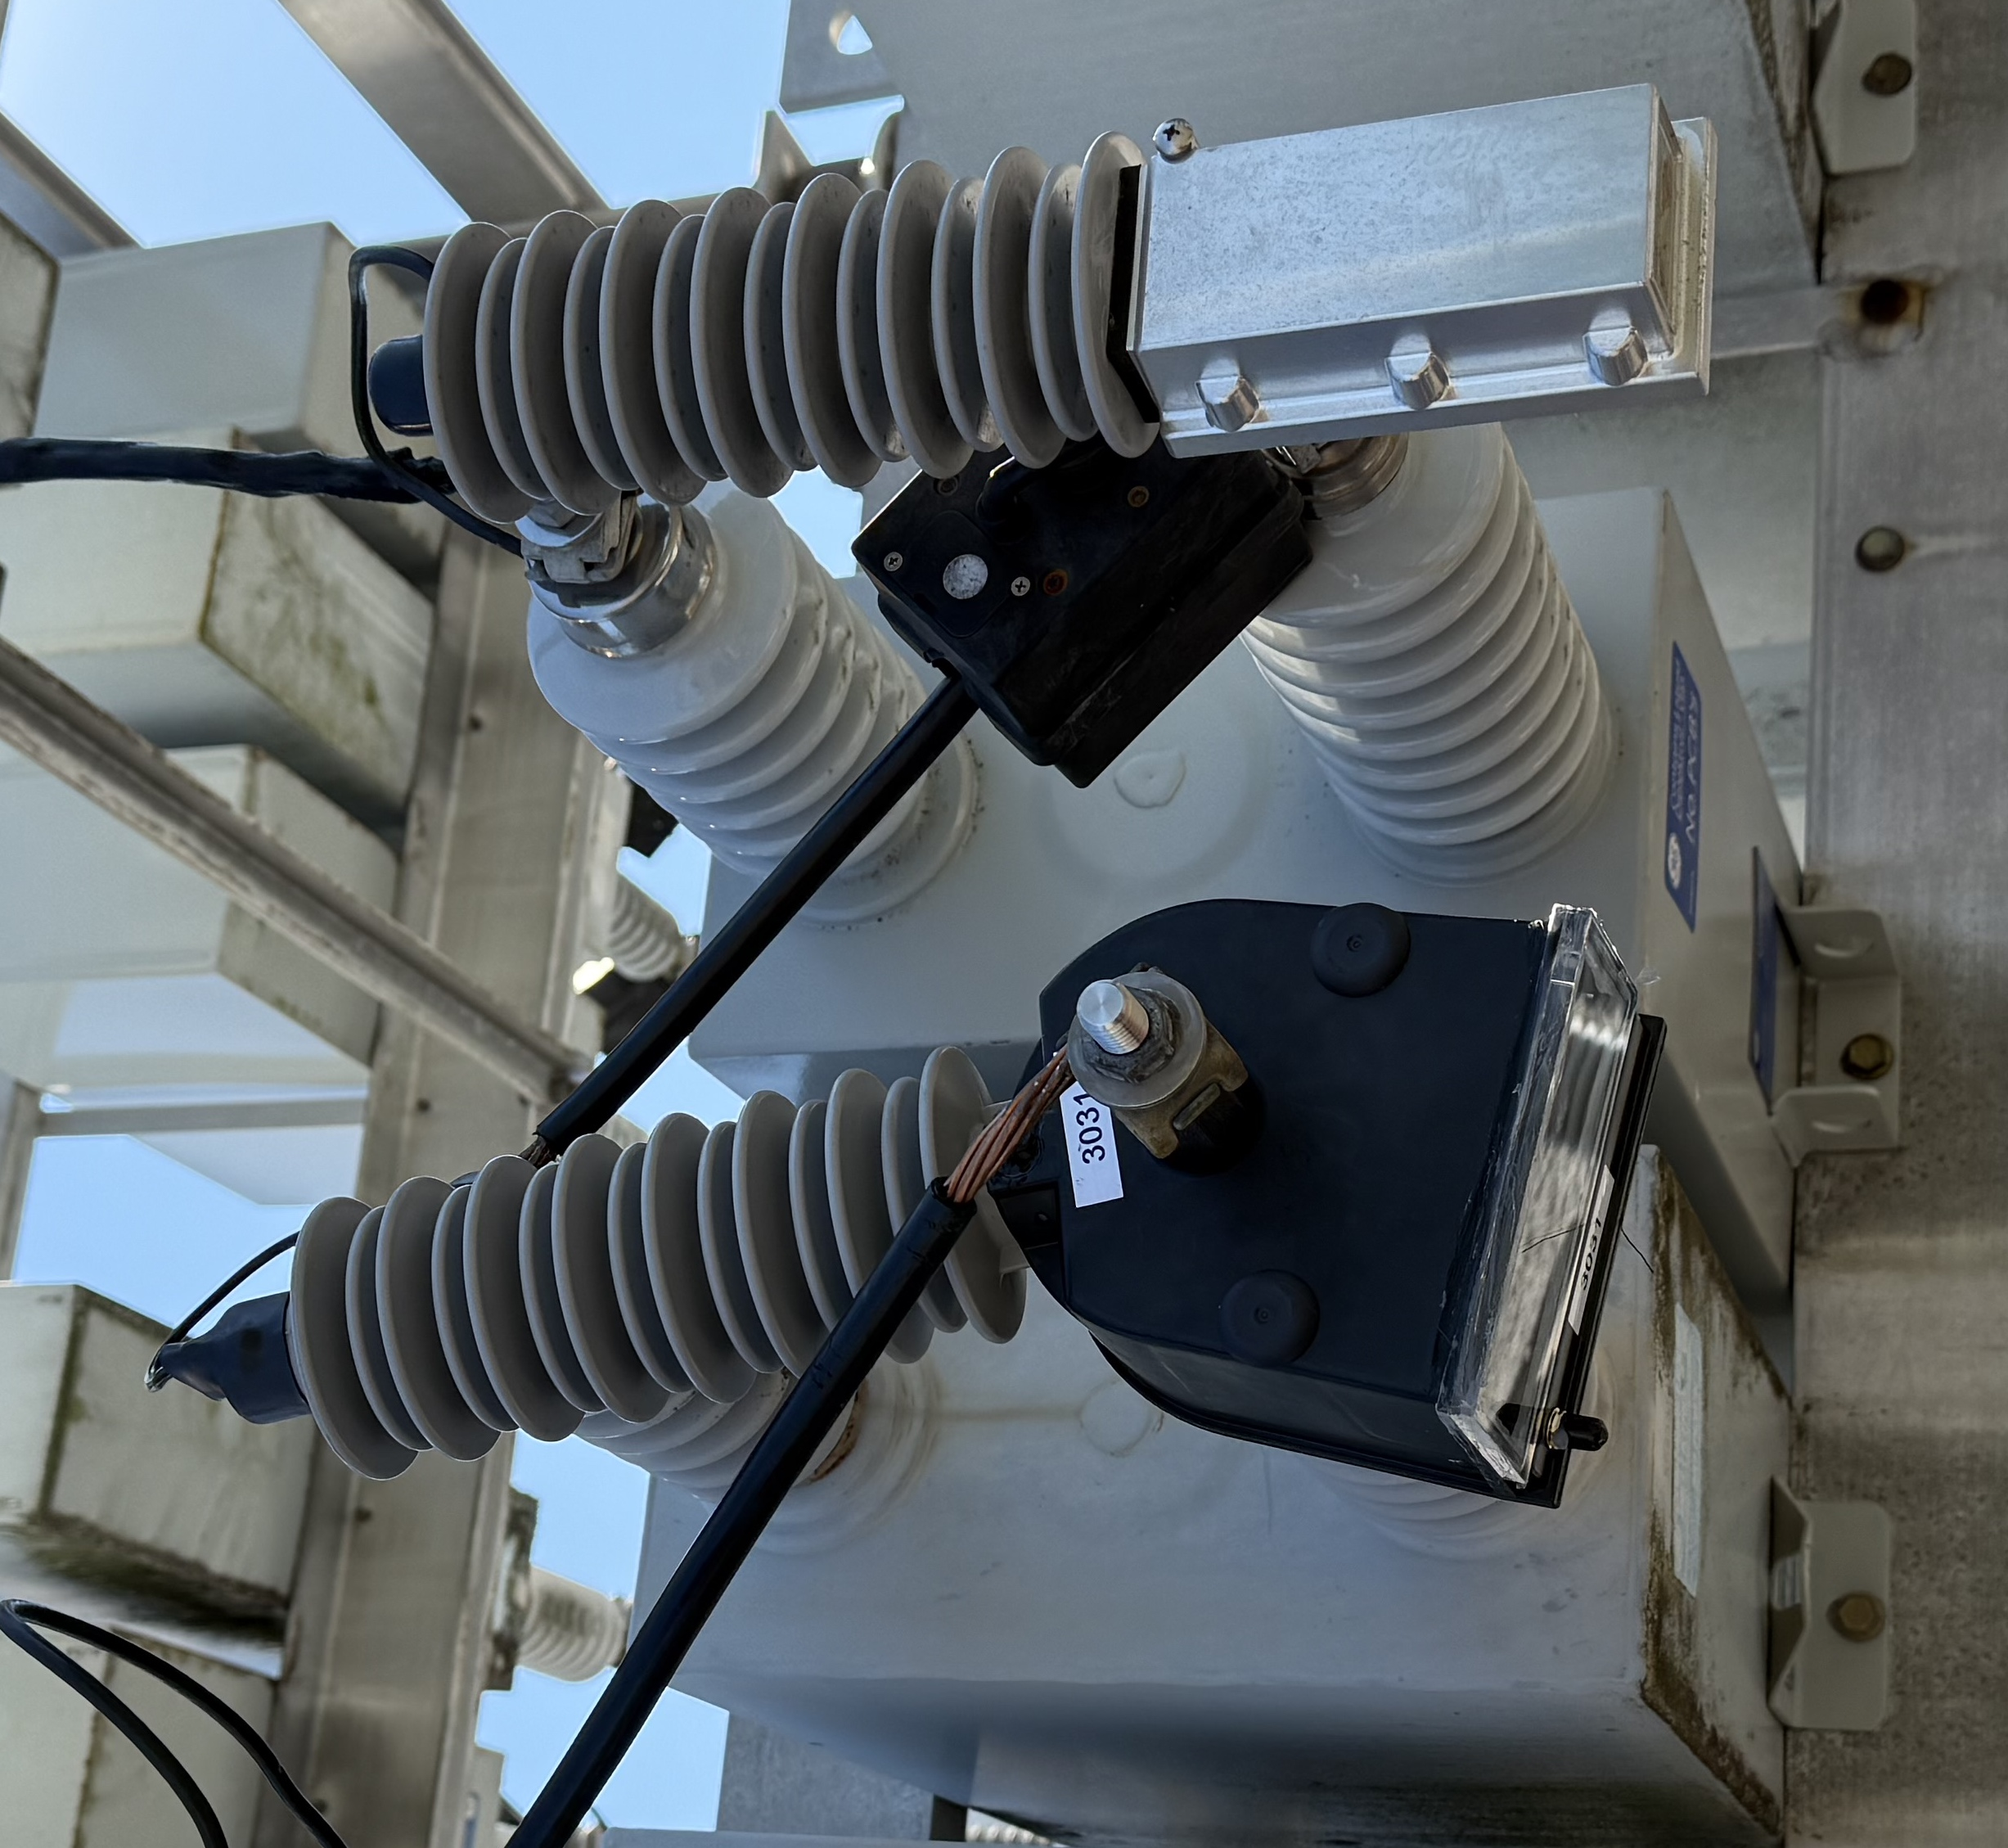

ATD Product Focus
R&D of new tech that can transform the industry
Technology Exploration – Distributed Computing, Blockchain, Robotics, AR/MR, AI
Advanced Applications – TFDIR, DFDIR, SafeClose
Automation – SAM, Feeder Buddy
Sensors – CapMD, Arrester Health, Ground-grid, Far-Field I/V
Anything that serves the purpose

Slide 21






ATD Director – Steve Fan
R&D Engineer
Senior Engineering Manager
Pre-Med
BSEE
MSEE
MBA
Dir of Utility Apps & Solutions
AVP of Engineering
Dir of R&D
2004
2006
2009
2013
2015
2018
Present

Slide 22
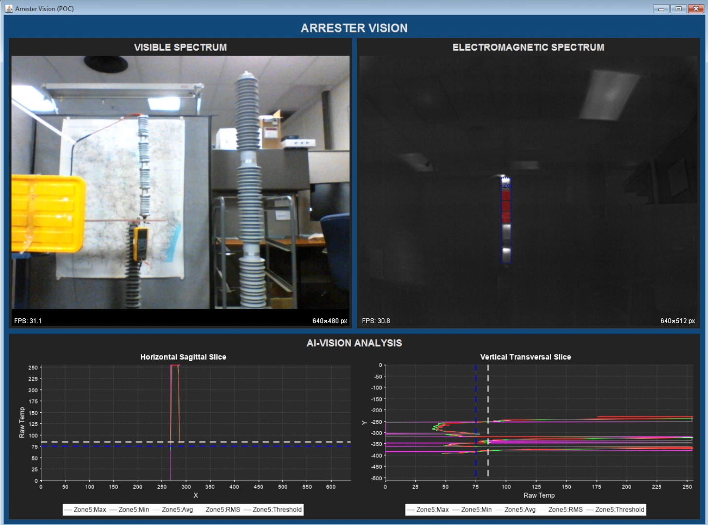
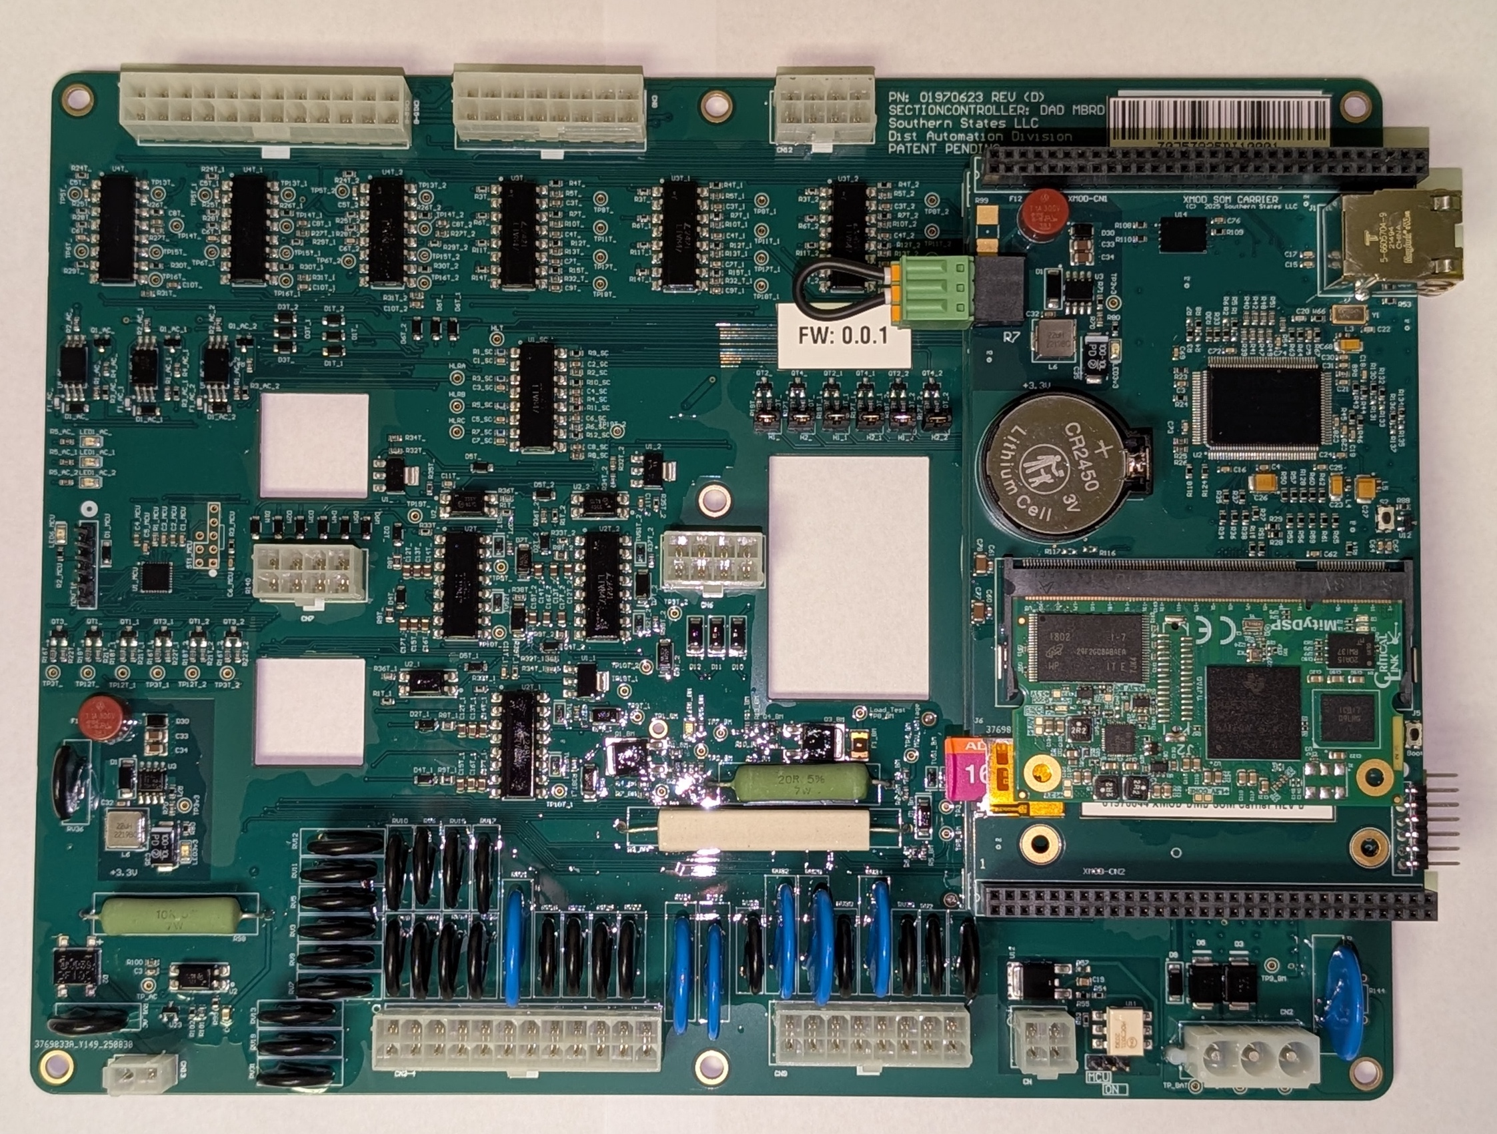
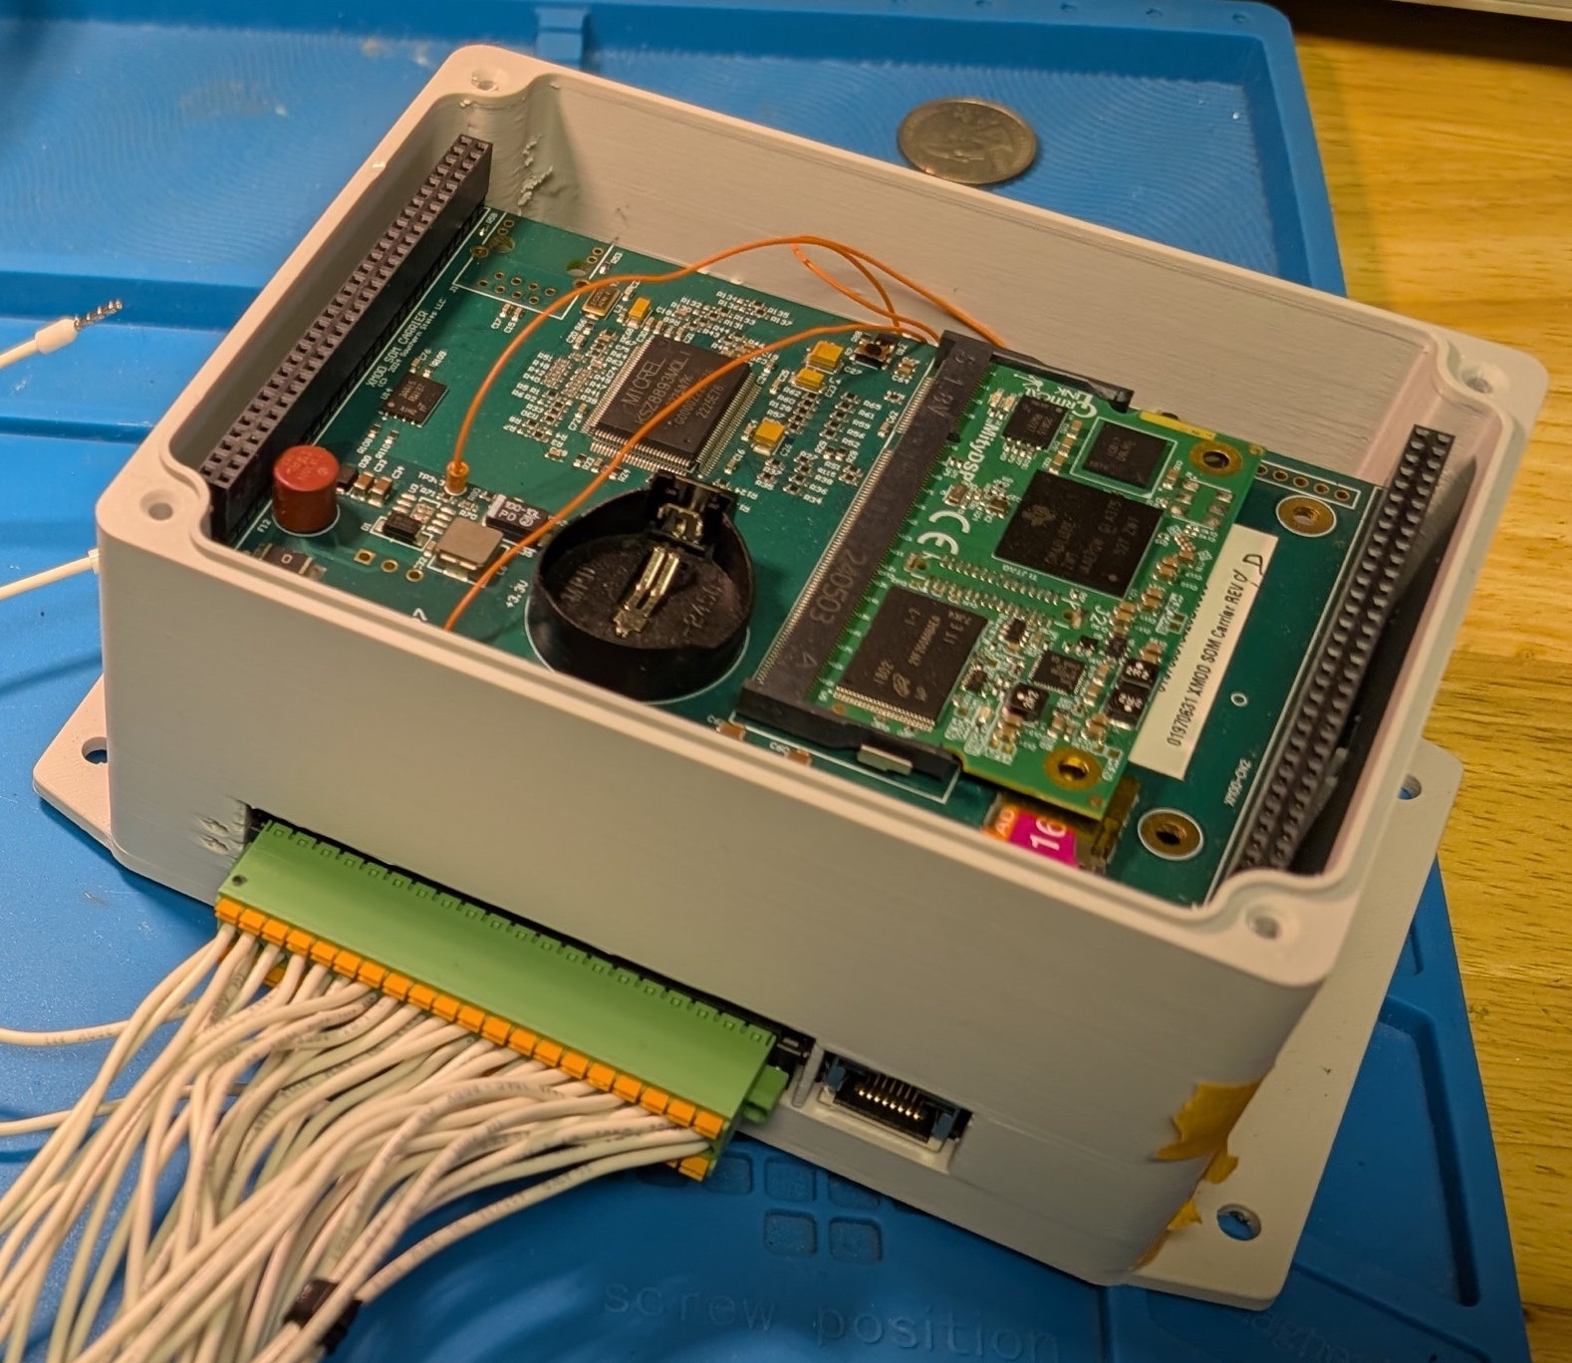
ATD Recent Intra-Group Collaborations
Diram
PCBA designs
SAM PCBA and enclosure Assemblies
Prototype PCBA manufacturing
SWI
Arrester health monitoring prototype thermal sensor (IM500)

Slide 23
ATD Employees
Steve Fan
Tan Tran Master of Testing
Nick Mulkey Master of Design
Buddy Reneau Master of Business
Joe Boike Master of Controls
Kaleb Benton Master of Software
Jiyuan Fan Master of Electrons
Freedom to Explore and Fail
“Failure is a prerequisite for great success. If you want to succeed faster, double your rate of failure.” – Brian Tracy

Slide 24
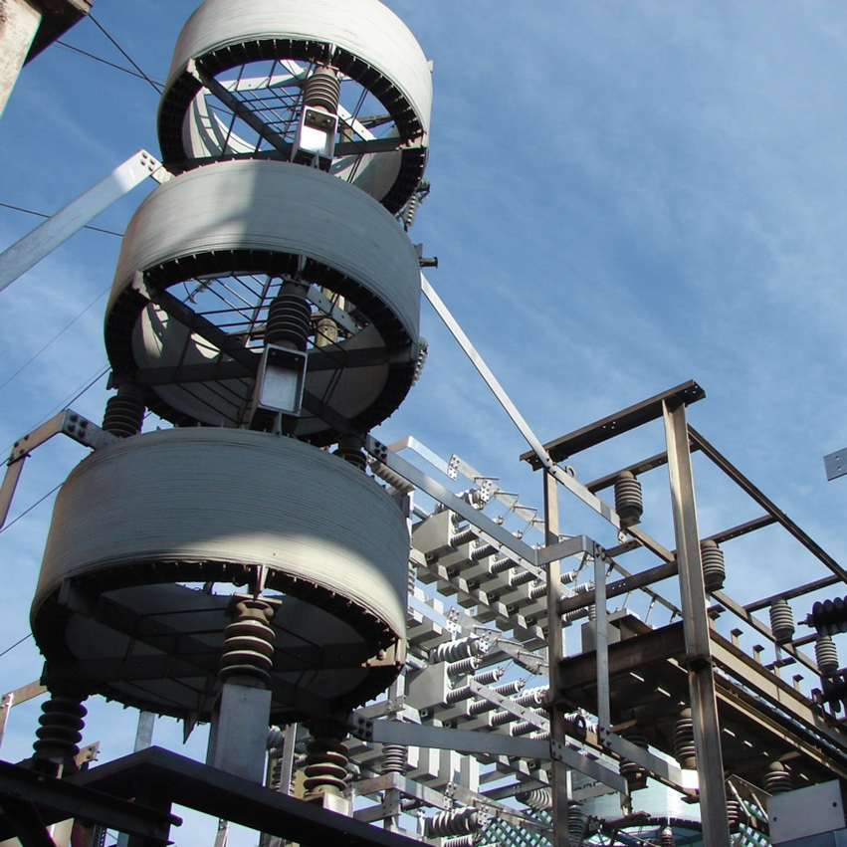
Power Systems Solutions Division
Notes:
Add note to this slide

Slide 25
Power Solutions Division Vice President and General Manager
Karl Fender
BSEE and MBA from USC
US Navy Officer
USS Tecumseh (SSBN-628)
USS Narwhal (SSN-671)
23 years in various engineering and commercial leadership roles at Cooper Power Systems / Eaton all in the power capacitor business unit
7 months as a FACTS Business Development Manager for Siemens
9.5 years at Southern States, LLC
National Sales Manager – Power Switching Division
General Manager – Power Switching and Power Systems Solutions Divisions
General Manager – Power Systems Solutions Division

Slide 26
Power Systems Solution Division Management Team
VP and GM
Power Systems
Solutions Division
Karl Fender
Director
Marketing
Alejandro Reynoso
Director
Business
Development
Matt Pugh
Director
Power Electronics
John Schwartzenberg
Chief
Engineer
Alejandro Deschamps

Slide 27
Power Solutions Division Product Focus
PSSD delivers engineered solutions that improve power quality, grid stability, and overall system reliability by combining proven and advanced power systems technologies.
Shunt capacitor banks and harmonic filters for utility and industrial applications
Open style (IP00) – MV to EHV
Metal enclosed – 2.4 to 38 kV
STATCOMs for fast dynamic reactive power control and improved voltage stability
Sub-cycle transfer and disconnect switches for critical power continuity
Modernization and upgrade programs for legacy SVC and HVDC systems
Electrical studies to help customers solve problems and specify optimal solutions

Slide 28
Power Solutions Division Market Focus
PSSD focuses on multiple markets, adapting its portfolio to the specific needs of each sector, from technical configuration to delivery time, standardization level, and service approach. In 2026 our market focus will be on:
STATCOMs for the US C&I and Canadian markets
Renewable and energy storage capacitor banks
Metal-enclosed capacitor banks and filters
Commercial & Industrial MV power quality
Utility MV to EHV capacitor bank
Data centers requiring voltage stability, harmonic mitigation, and high reliability power systems

Slide 29
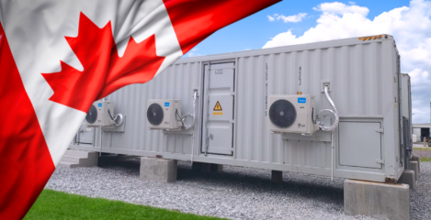
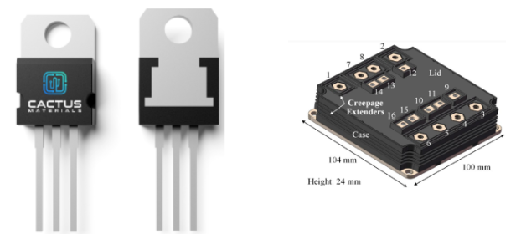
Power Solutions Division Recent Intra-Group Collaborations
Diram
PSSD’s business with Diram has grown at a 129.85% CAGR
Over 250 capacitor banks manufactured at Diram shipped into the USA
Just delivered the our STATCOM to a Gerdau steel facility in Texas
Jointly developing creative approaches to address evolving market challenges and opportunities
Northern Transformers
Occasional RFQ for STATCOM transformers in Canada. Looking for opportunities to strengthen collaboration
Cactus materials
Collaborating on the PSSD product roadmap as a strategic partner
Vanguard Electric
Southern States largest supplier of station post insulators
CAGR – 129.85%

Slide 30
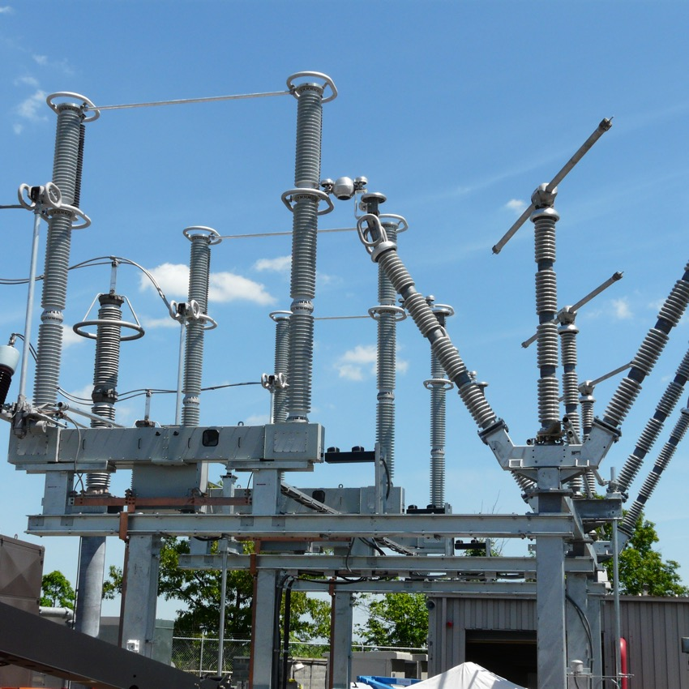
Power Switching Division
Notes:
Add note to this slide

Slide 31
Power Switching Division Vice President and General Manager
My Background
More than two decades in the global high-voltage switchgear industry, leading engineering organizations, manufacturing operations, and strategic growth initiatives across multiple international regions. My career has centered on new product development, customer partnerships, and technical solutions that support reliability and technology evolution.
Career Highlights
25+ years in high-voltage switchgear, power distribution, and industrial equipment
Leadership of engineering, manufacturing, quality, service, and commercial teams
Proven track record of turning around product lines, building new P&Ls, and driving revenue growth
Extensive hands-on experience with high-voltage circuit breakers, switchgear, and power conversion technologies
International Experience
Worked directly with global utilities, EPCs, and OEM partners across North America, South America, Europe, the Middle East, and Asia
Led cross-border engineering development programs and multi-regional product strategies
Deep experience with IEC and IEEE standards, international testing, and global supply-chain alignment
Built collaborative technical relationships with international manufacturing and engineering groups
Leadership Focus
Strategic product road-mapping and technology development
Improving reliability, innovation, and customer value in switchgear solutions
Cross-functional team building and organizational modernization
Driving customer-centric partnerships and market-expansion initiatives

Slide 32
Power Switching Division Management Team
VP and GM
Power Switching
Division (PSD)
Kevin Goldstein
Chief Engineer and
Manager
Design Engineering
Brian Roberts
Director
Operations
Wes Wadsworth
Manager
National Sales
Caleb Harrison
Manager
Applications
Engineering
Bradley Thomas
Manager
Production PSD –
Spencer
Bart Stapleton
Technical
Manager, CSR
Wade Zahn
Supervisor II
Assembly 1st
Shift -McGarity
Willie Lewis
Supervisor I
Assembly 2nd
Shift - McGarity
Thomas Baker
Supervisor I
Assembly 1st
Shift - Spencer
(Bart Stapleton)

Slide 33
Power Switching Division Product Focus
Purpose-Built Products That Solve Real Grid Problems
Every product is engineered for a specific known grid challenge — eliminating compromise, improving reliability, and reducing total lifecycle cost
Key Product Families
CSV Vertical Circuit Switcher — 3-cycle, 40kA interrupting capability; adaptable bases save hundreds of thousands in retrofit costs; optimized for transformer-limited faults
HSV Horizontal Circuit Switcher — 5-cycle, 40kA interrupter capability; switch position supports various orientation including horizontal upright, vertical, underhung, and mobile substations
CapSwitcher® — pre-insertion resistor design for superior transient suppression; eliminates inrush reactors; 10,000-operation life with simple, robust mechanics
RLSwitcher® — patented interrupter engineered to protect multimillion-dollar shunt reactors; 10X lower reignition probability; eliminates destructive TRV impacts
LLS® Load & Line Switcher — upgrades ANY disconnect into a full load-break switch; single-gap design above 72.5kV; delivers modern capability at a fraction of replacement cost

Slide 34



Power Switching Division Market Focus
What We Do
PSD specializes in Definitive Purpose Products, which are purpose-built for the switching application, but we also offer the flexibility to custom-engineer a solution for any unique installation.
Our Growth Strategy
We will drive growth by promoting standard products as our primary offering. Our deep engineering expertise is reserved as a premium service, creating a tiered value model.
Creating Our Market
We are not just serving a market; we are defining it. By establishing the standard for definitive purpose products, we create a niche that we are uniquely positioned to lead.

Slide 35
PSD – How We Win in Each Market
Market Segment | Customer Needs | PSD Value Proposition | Strategic Actions
Utilities | Reliability, long lifecycle grid modernization Executive Relationships with suppliers | Engineering depth New CO₂/O₂ & Vacuum Products Lead time advantage vs. dead-tank breaker | Expand blankets Promote definitive purpose equipment Develop tailored messaging for customers Own PSD customer relationships
Renewables | Fast deliver Standardization Lowest cost | Short lead times Standard offerings | Define standard offering to accelerate lead-times
OEMs/ C&I | Customization Engineering support Ship date precision | Engineering depth Repeatable custom builds Renewed CSH offering | Co-develop solutions Improve delivery schedule & visibility
PSD will meet each market focused on their priority of needs to win business.

Slide 36
Power Switching Division Recent Intra-Group Collaborations
High Voltage Solutions Kft located in Budapest, Hungary
Started working together in 2022 and signed a new two-year agreement thru 2027
145kV 40kA CO2/O2 Live Tank Circuit Breaker
3.5kJ Spring-Spring modular Mechanism
Future Considerations
145kV 63kA or 245kV 40kA CO2/O2 LTB
38kV CO2/O2 Cap Switcher 25kA Interrupter
4.6kJ modular Mechanism
0.2kJ 38kV O-CO Mechanism
Vanguard Electric, LLC
Supply Chain
COELME/egic
72.5kV 31.5kA Vacuum Live Tank Circuit Breaker development
HVS & Diram
Initiated multi-national sales channel discussions for local Applications Engineering and technology licensing

Slide 37
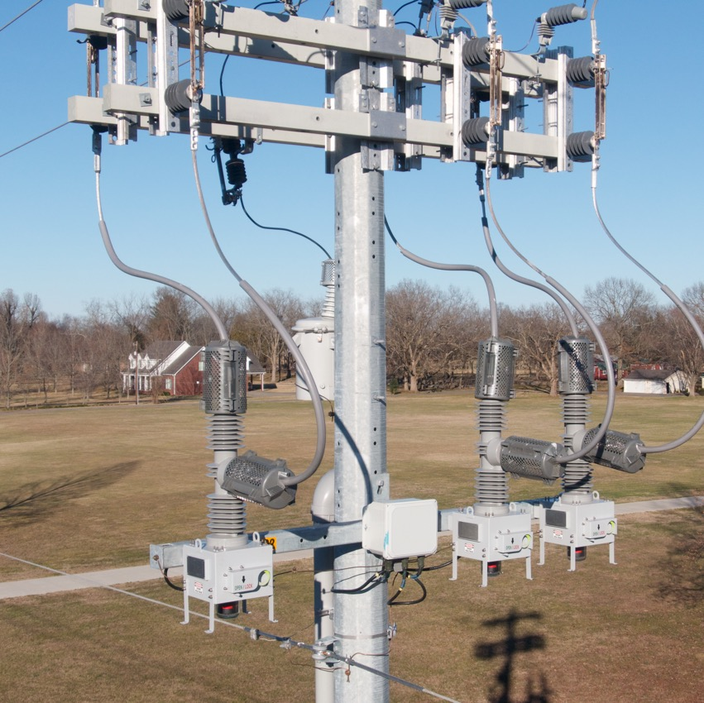

Distribution Automation Division
Notes:
Add note to this slide

Slide 38
Distribution Automation Division General Manager
Hold a Bachelors Degree in Electrical Engineering
Focus on digital control systems
Spent 12 years of my career in the SCADA, OMS, DMS, ADMS, RTU sector
Worked for Advanced Control Systems (ACS; Formerly owned by EFACEC, currently owned by INDRA)
Worked on projects in the US, Canada, and Central America for utilities, helping them automate their distribution grid
ACS’s Subject Matter Expert (SME) on automated fault restoration, integrated volt var control, SCADA
Co-developed and installed the distribution automation platform that GA Power put in service in 2010, and still use today
During Hurricane IRMA alone, this system helped GA Power avoid 82 million minutes of interruption/outage
Been with Southern States since 2018
Solely focused on building the Distribution Automation business

Slide 39
Distribution Automation Division Management Team
GM
Distribution
Automation Division
Sam Mullinax
Manager
National Sales
Chip Pinion
Manager
Applications
Engineering
Shelcey Harp
Manager
Engineering &
Operations
Ryun Kim

Slide 40
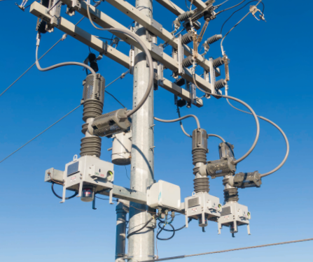
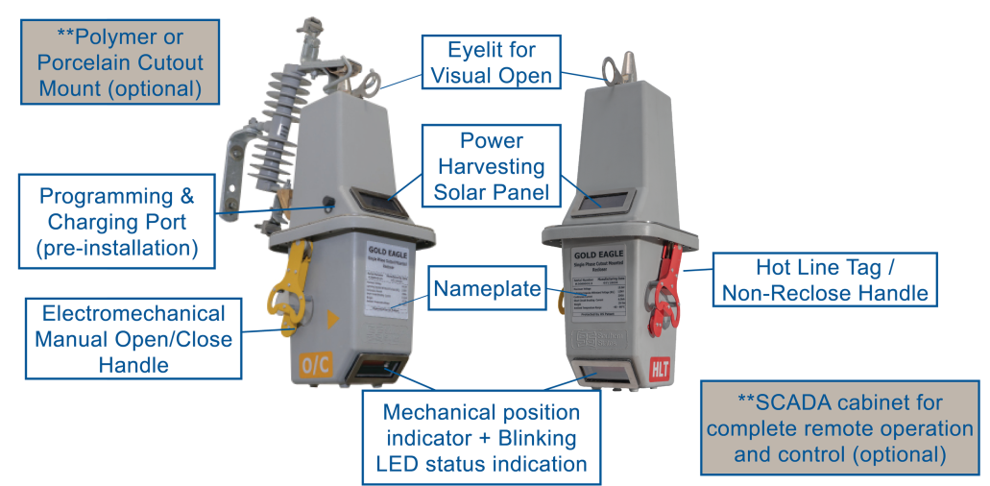
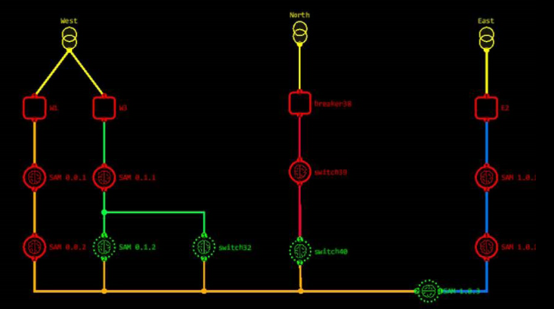
Distribution Automation Division Product Focus
Provide solutions to distribution utilities in the US and Canada to help them automate their system in order to improve reliability
Our current solutions:
3 Phase Reclosers
15.5kV – 38kV
Ganged and Triple Single
Substation mount for breaker applications
Pole top and pad-mounted
Single Phase Reclosers
SEL Controlled
Cutout Mounted self contained
Automated Fault Restoration
DFDIR
Upcoming solutions
Safe Close
Test Buddy

Slide 41
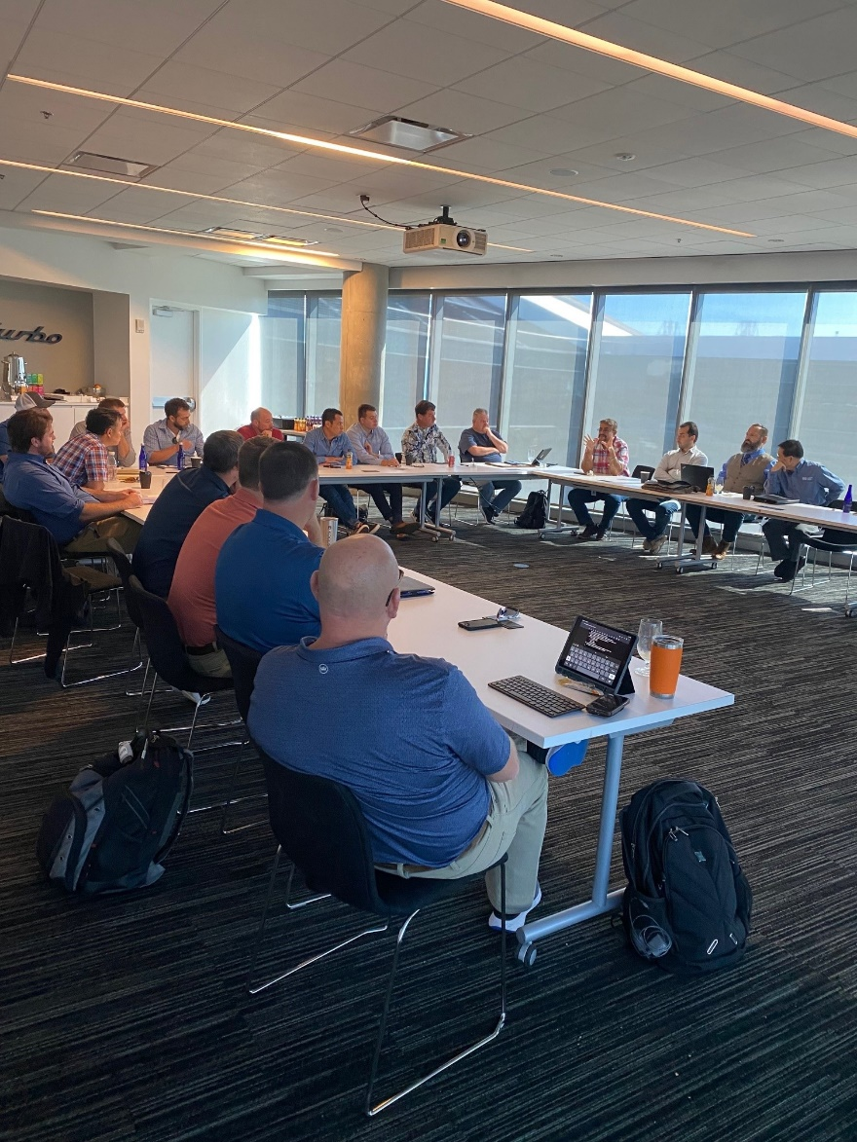
Distribution Automation Division Market Focus
We focus on creating products with unique features that solve problems for our customers
Customer input is used for every product we bring to market
The Distribution Advisory Council (DAC) spearheads our new product ideas

Slide 42
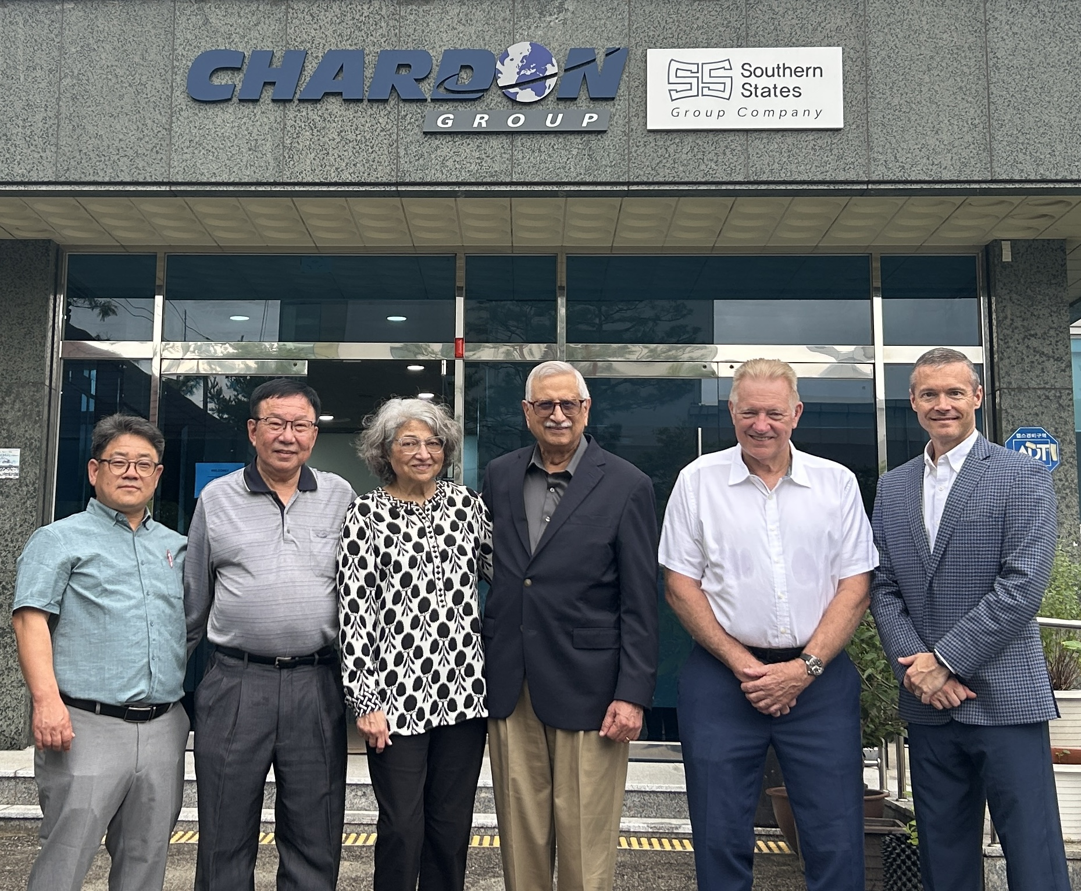
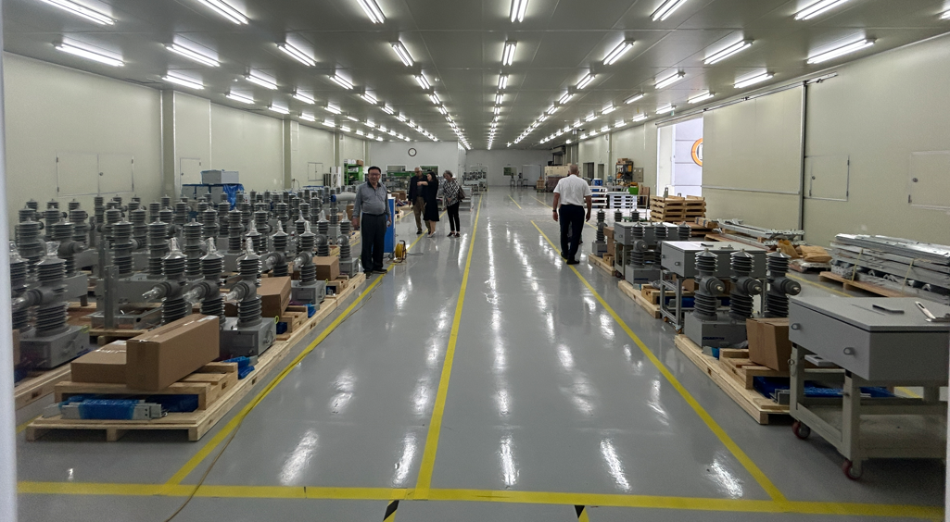
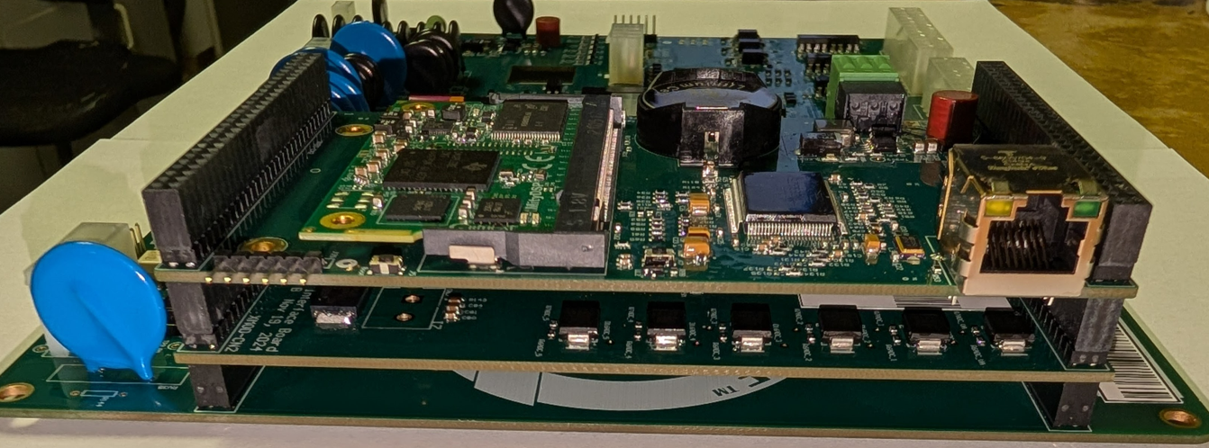

Distribution Automation Division Recent Intra-Group Collaborations
Chardon Korea
Started collaboration in 2016, partnered in recloser components/production
Factory in Suwon South Korea
Has been a tremendous success for both companies
Diram
Started collaboration in 2024 in printed circuit board (PCB) manufacturing
Preparing to migrate all of our divisions PCB business to Diram

