Slide 1


Slide 2

Leadership Summit
Company Overview
November 19, 2025

Slide 3
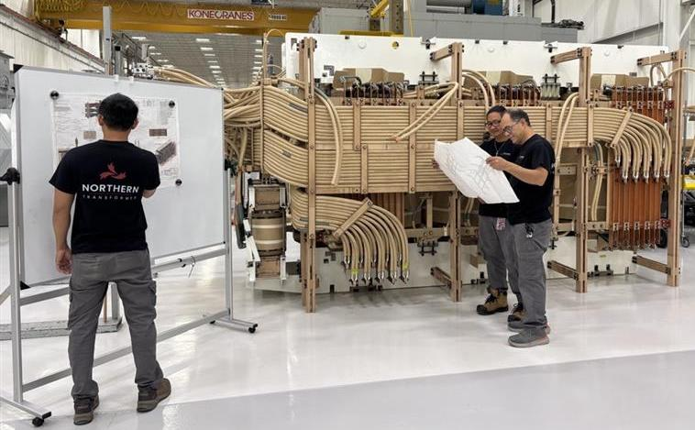

Who We Are
Purpose: Design, manufacture, and test high-quality power transformers for utility clients in Canada and USA.
Values: Care, Quality, and Aspire — delivering trusted solutions and strong client relationships.
Brief History: Founded in 1981 in Concord, Ontario, the company has evolved from a niche distribution manufacturer for ICI clients to a power transformer manufacturer serving utilities. Expansions in 2016 and 2023 enabled the production of power transformers up to 240 kV.
Scale: Serving clients across North America with hundreds of successful projects and a skilled team.
3

Slide 4
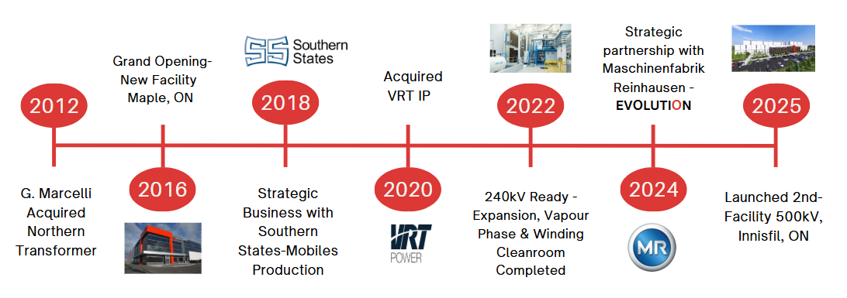
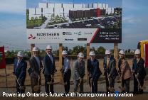
Timeline
And continuous investment in people and processes
4

Slide 5
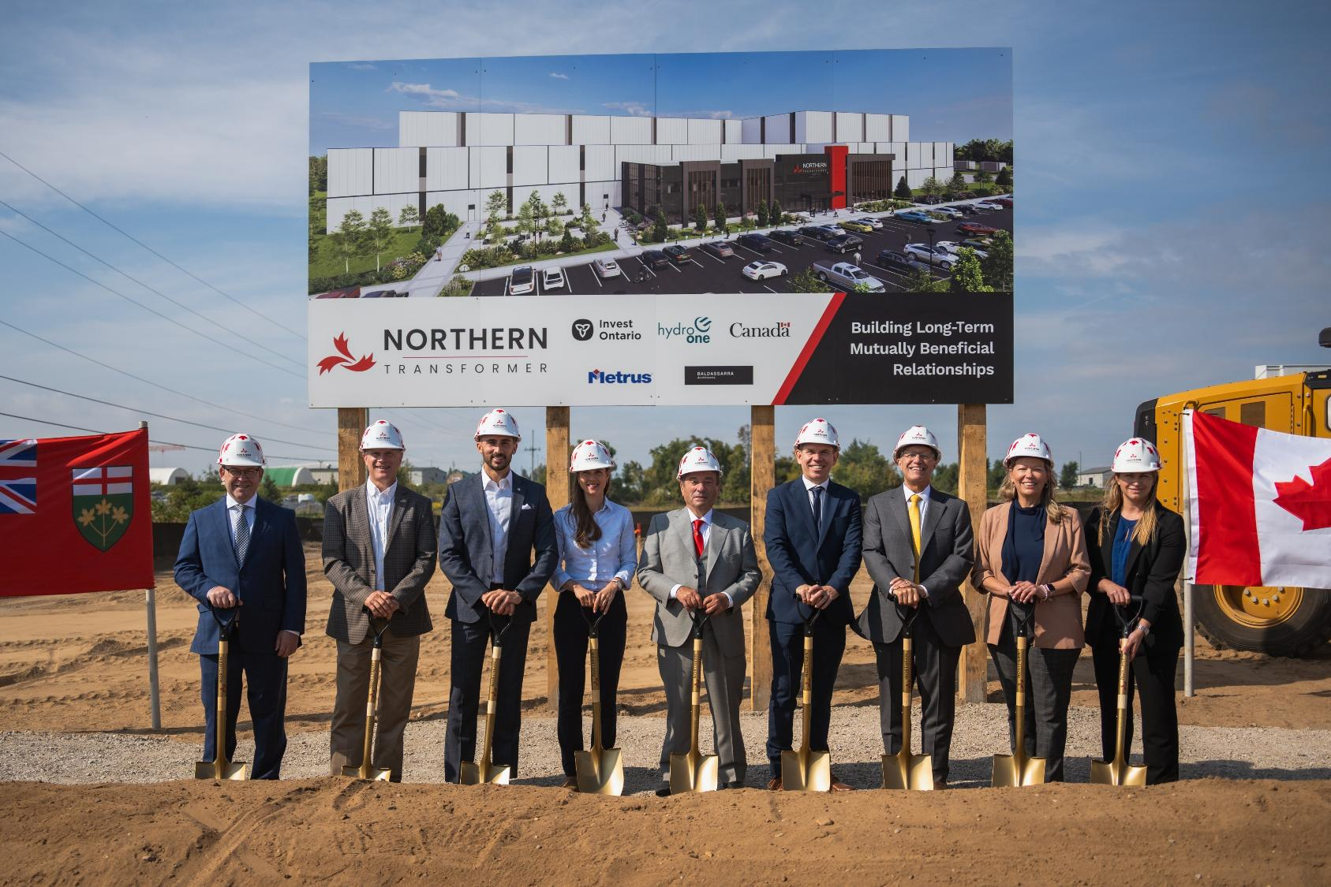

Slide 6
What We Do
Small & Medium Power Transformer (SPT & MPT)
≤ 240 kV ≤ 100 MVA
Utilities – Nuclear Industrial – Renewables – Mining - Petrochemical
Facility: Maple, ON
12,000sqm – 100-ton crane capacity
Large Power Transformer (LPT)
≤ 550 kV ≤ 750 MVA
Utilities/Transmission – Power Generation – Heavy Industry
Facility: Innisfil, ON
18,000sqm – 300-ton crane capacity
Pad Mount & Distribution Transformers
≤ 44 kV
≤ 10 MVA
Utilities – Renewables Local Distribution – Commercial & Industrial.
OEM: High-quality manufacturers around the world.
Opening April 2028
First Client Shipments 2025
Our Three Lines of Business
6
ISO Certifications - Experience with CSA/IEEE Standards and N.A Market

Slide 7
What Sets Us Apart
7

Slide 8
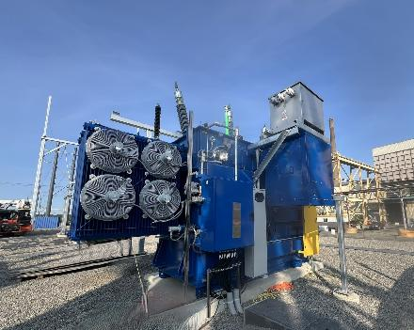
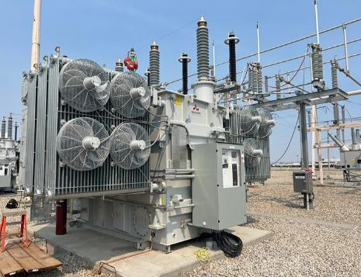
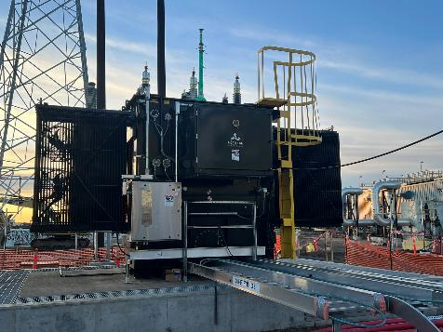
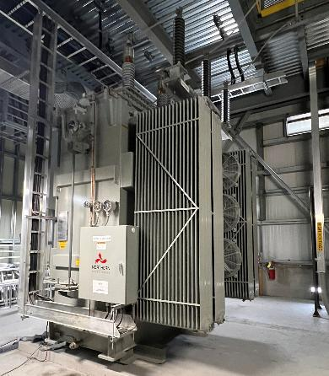
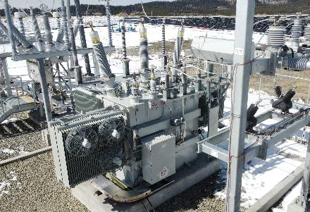
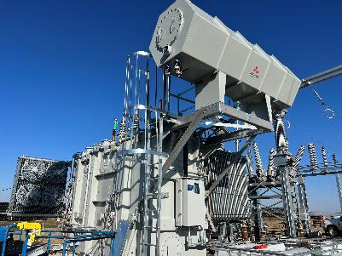
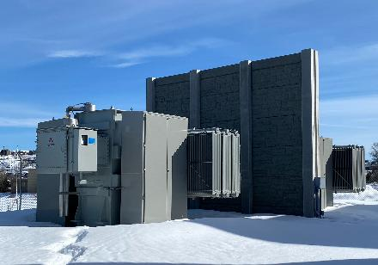
Mutually Beneficial Long Term Relationships
Our clients’ trust defines our success. We are proud to build mutually beneficial long-term relationships by delivering reliable transformers, responsive support, and customized service.
8

Slide 9

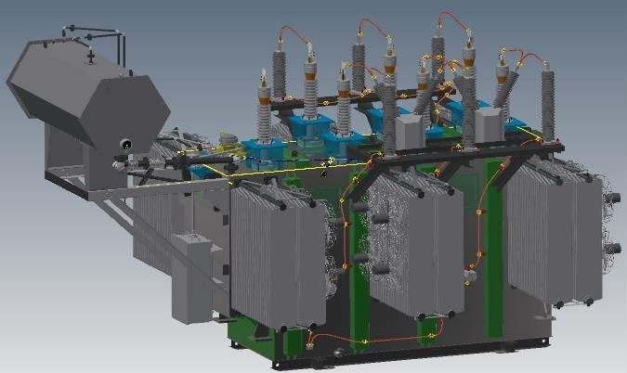
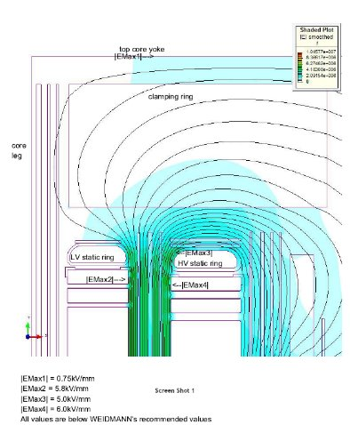
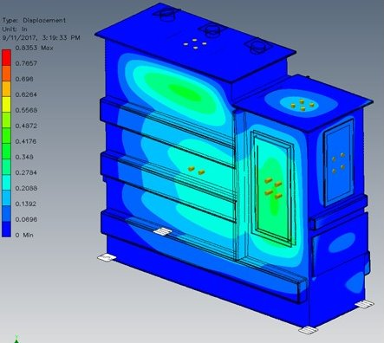
Innovation and Technology
Electrical and Mechanical Design
Inhouse and Externally developed toolset
Advanced Field & Transient Analysis
Graphical Analysis & Visualization
Smart Simulation Capability
3D Transformer Modeling
Enhanced Accuracy & Speed
9

Slide 10

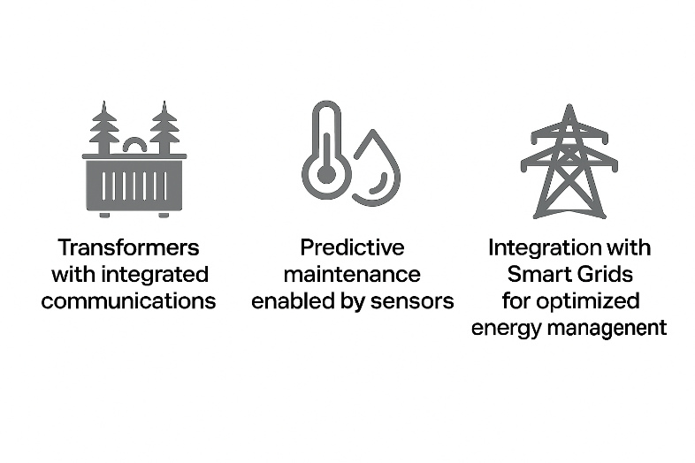

MR Launch Partner for Smart Transformer Technology
10

Slide 11
Leadership Background
11

Slide 12
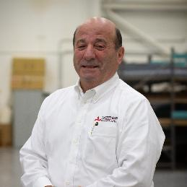
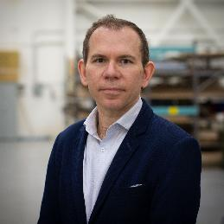
Leadership Background
Giovanni Marcelli, Chairman
Giovanni is a successful entrepreneur who founded Accubid Systems, an estimating software company, in 1982. He grew Accubid into the North American leader before selling the company in 2010. In 2001, he attended a lecture from a professor from the University of Chicago about the advanced age of transformers in the USA and Canada. That lecture made a profound impression on him, and in 2012, he acquired Northern Transformer, anticipating a growing demand for transformers and with the vision of bringing back Ontario to the predominance of Transformer Manufacturing.
He is very passionate about his Family, Employees, and Clients. He also enjoys spending his time hunting and collecting/driving classic cars.
Alexei Miecznikowski, CEO
Alexei has been the CEO of Northern Transformer for 9 years. Before this, he spent 21 years at Celestica Inc., a publicly traded global electronics manufacturing company headquartered in Toronto. Over the course of his career, he held roles in engineering, R&D, operations, business development, and sales. He played a key role developing deep partnerships leading to new lines of business on a global basis. Alexei is a member of the board of the Electro-Federation of Canada, the voice of the Canadian electrical industry.
He has extensive knowledge and experience in the global electronics, solar, and automation industries. Outside of work, he is an avid skier and paddler.
12

Slide 13
Collaboration in Action: Intra-Group Success Stories
13

Slide 14
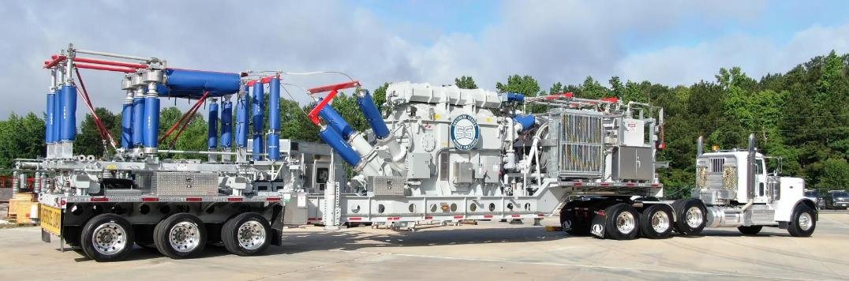
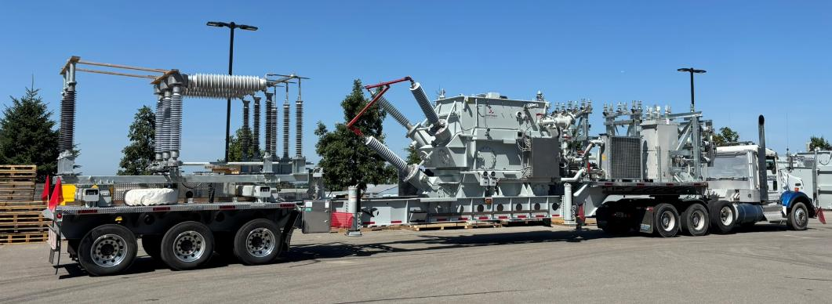

Strategic Business with Southern States Mobiles
Together, we delivered reliable mobile substations, supporting utilities with fast, flexible power solutions across North America.
Collaboration in Action
14

Slide 15
Our Culture: Our People, Well-being, and Growth
15

Slide 16
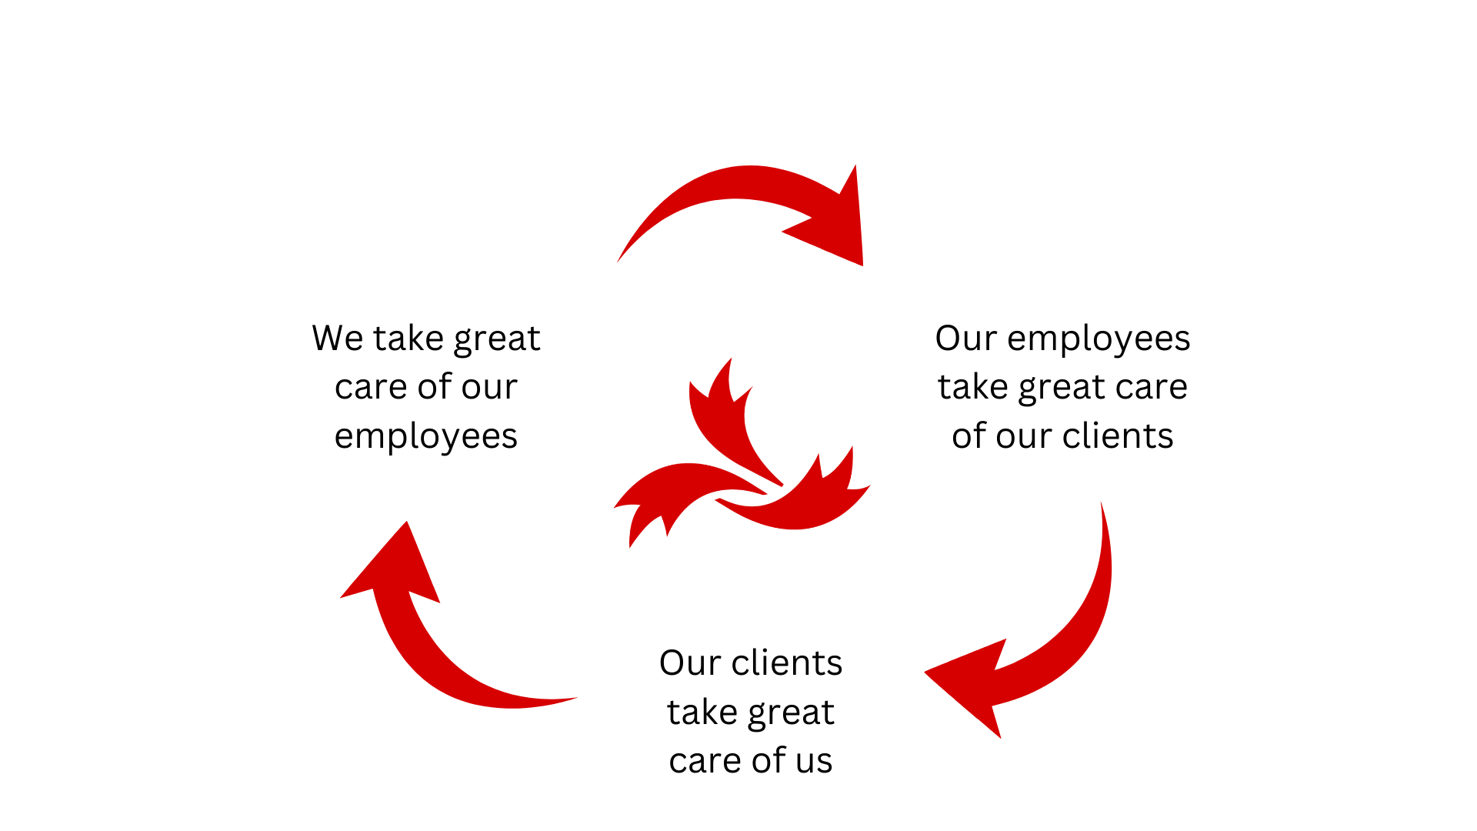
Company Culture
16

Slide 17
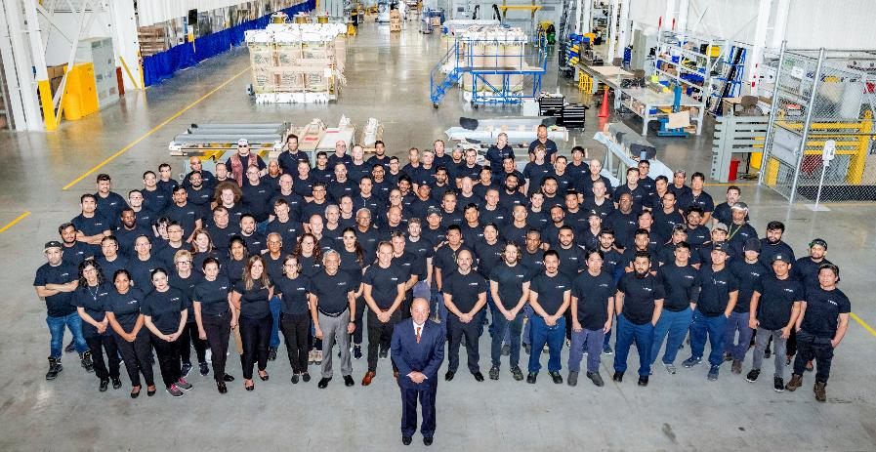
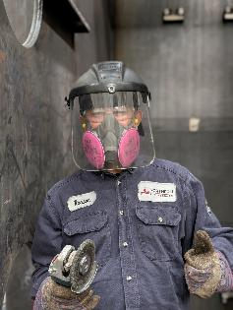
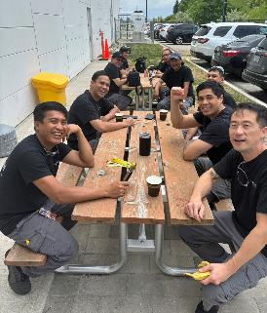
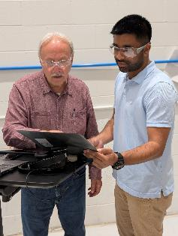
Well-being and growth
Teamwork
“Our people, our power.”
Committed to safety, continuous training, and a supportive work environment.
Safety first
Training
17
Well-being

Slide 18
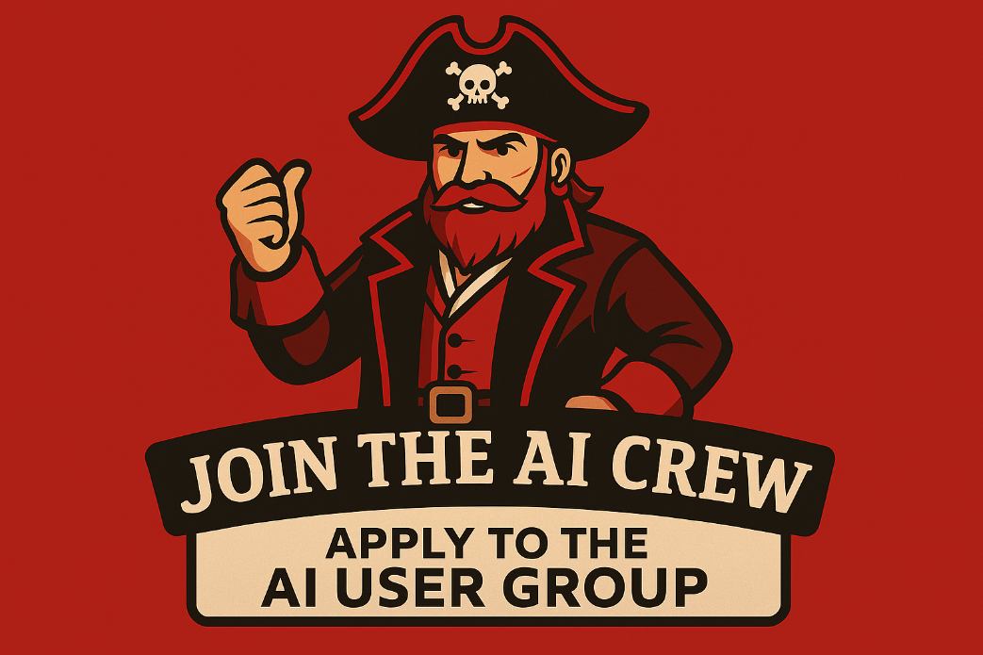
AI Crew Command
Be ye ready to join a crew and chart a course through the uncharted waters of AI? We be lookin’ for shipmates to help spread the word and uncover hidden treasures to share across our company. If ye have the heart of a pirate and the eye for opportunity, hoist yer sails and join the AI Crew!
18

Slide 19
Thank you for your attention
19

Slide 20

Questions?
20

