Slide 1


Presented By Michael Young

Slide 2




Anglo Canadian Technologies Inc.
Barrie, Ontario, Canada
Wilmington, Delaware, US
Barrie, Ontario, Canada
Wilmington, Delaware, US

Slide 3




MG POWER
  ASSOCIATES
PRESENTATION
www.mgpowerassociates.com
Notes:
Our Services
transformer installation
vacuum oil processing = dehydrating > degassification > vacuum filling
Transformer assembly
Full Range Transformer (or Commission???) testing
supervisory work - getting experts on a competitor standpoint
Our services: Censors and online monitoring systems???

Slide 4


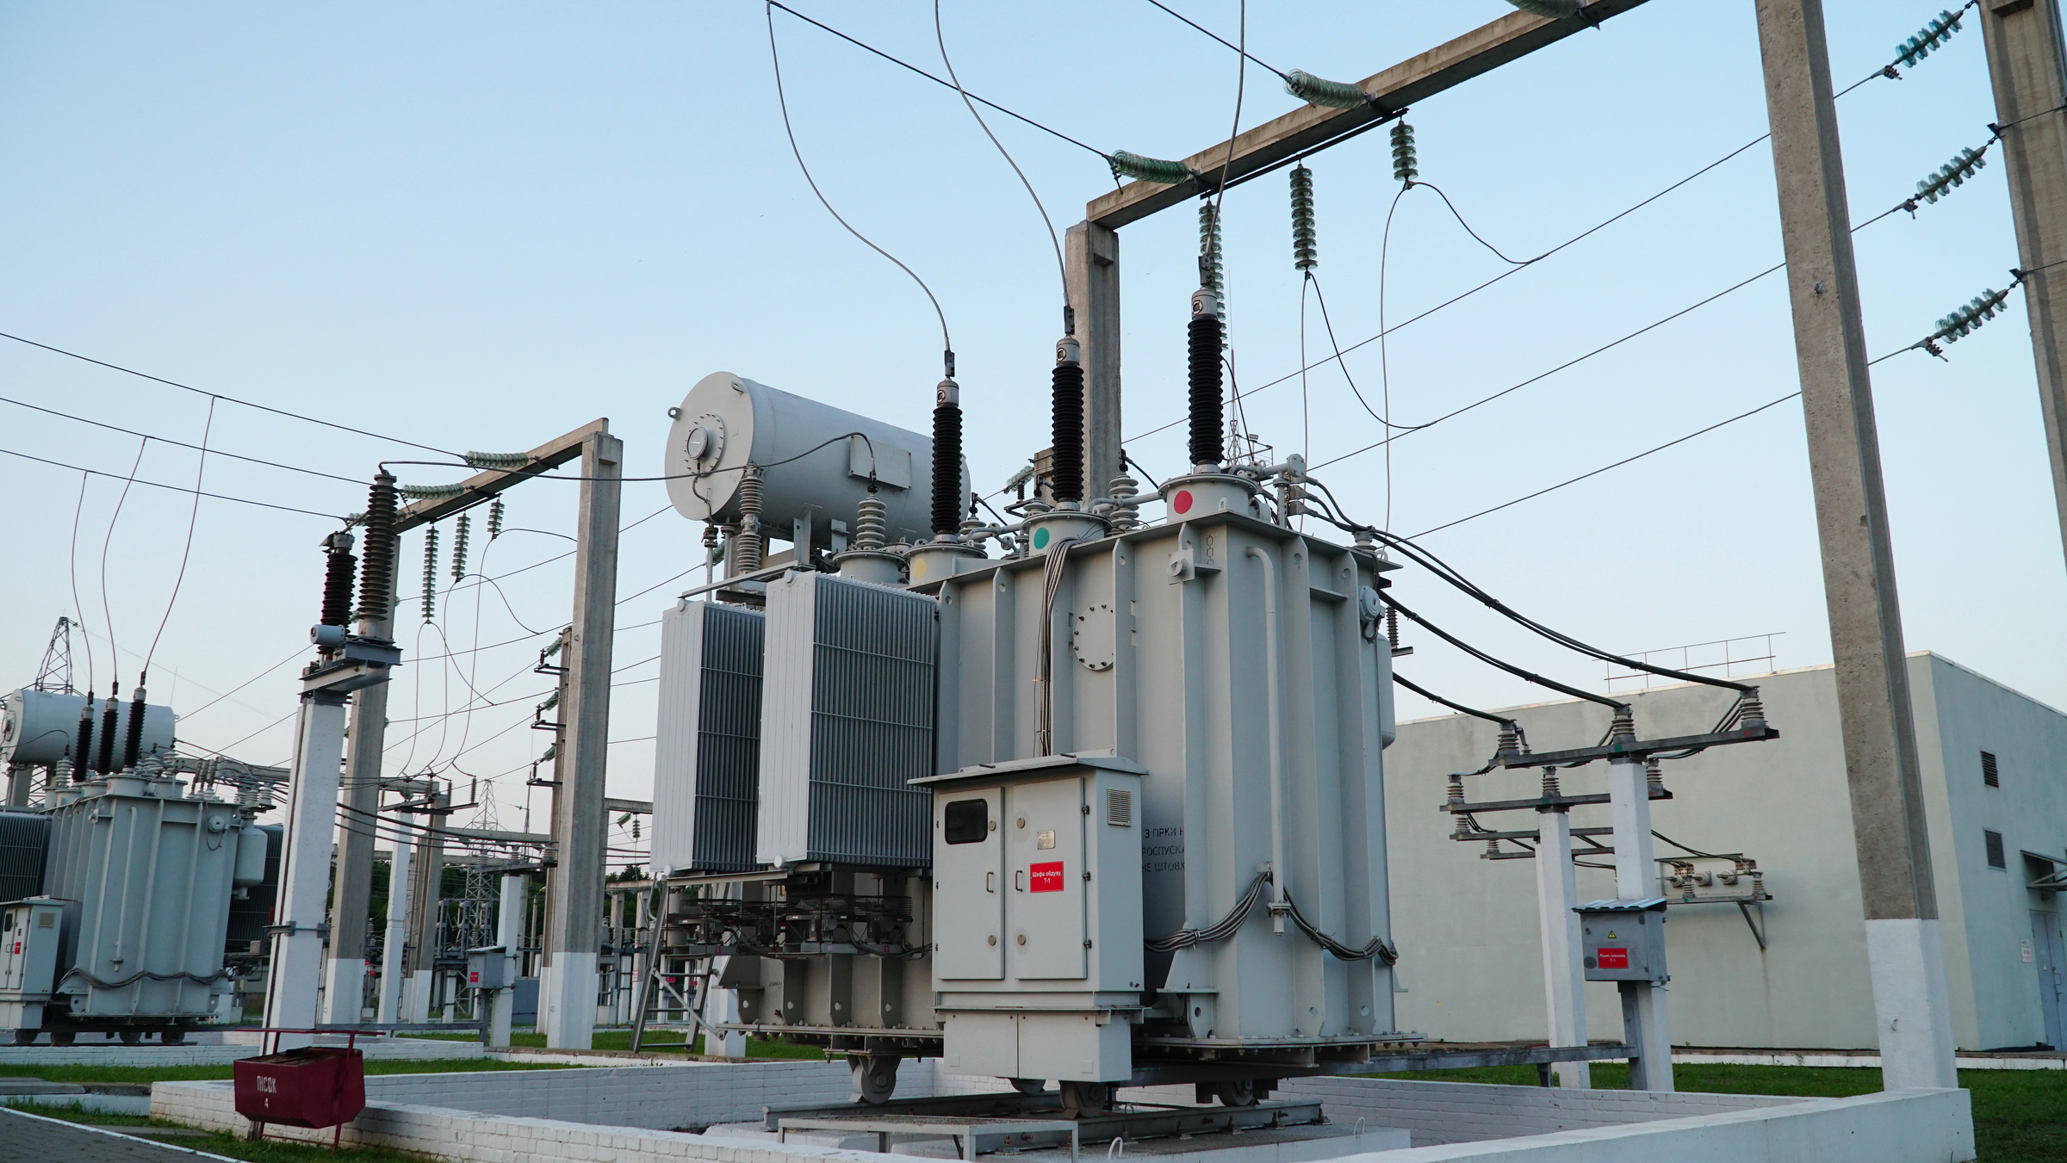
  MG POWER ASSOCIATES
ABOUT US
  MG Power Associates Inc. is a high voltage service provider to the North American power transmission, generation and distribution market.
Our team and strategic alliance partners are specially trained, accredited and experienced, tradespersons and technicians with decades of experience working with and for some of North America’s largest utilities and OEM’s.
www.mgpowerassociates.com

Slide 5
  MG POWER ASSOCIATES
OUR SERVICES
www.mgpowerassociates.com

Slide 6






  MG POWER ASSOCIATES
Transformer Installations
Insulating Fluid Services
Substation Testing
Repairs and Maintenance
OEM Witnessing / Erecting Engineer Services
Inspections
We specialize in delivering professional turnkey solutions for the installation and maintenance of Power Transformers and other High-Voltage equipment.
www.mgpowerassociates.com
Notes:
remove descriptions
we perform power transformer turnkey installation servicing including but not limited to these 5 things>
We specialize in delivering professional turnkey solutions for the installation and maintenance of power transformers and other high-voltage equipment.

Slide 7
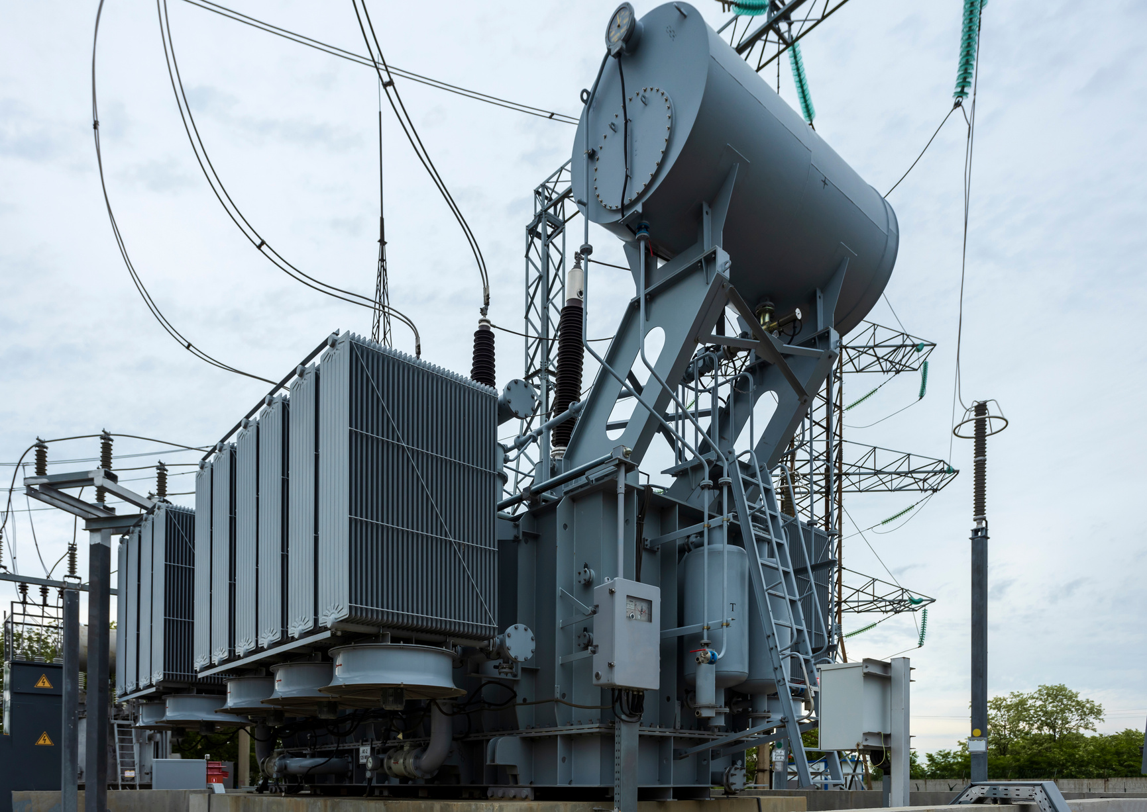

TRANSFORMER INSTALLATIONS
We specialize in servicing a wide range of transformer types, including distribution transformers, power transformers, autotransformers, as well as step-up and step-down transformers. Our expertise extends to voltage classes ranging from 13.5 kV to 765 kV, ensuring we can meet the needs of various industrial, commercial, and utility applications.
We Offer:
Transformer Installation
Component Procurement and Replacement
Decommissioning and Disposal
Upgrades
www.mgpowerassociates.com

Slide 8
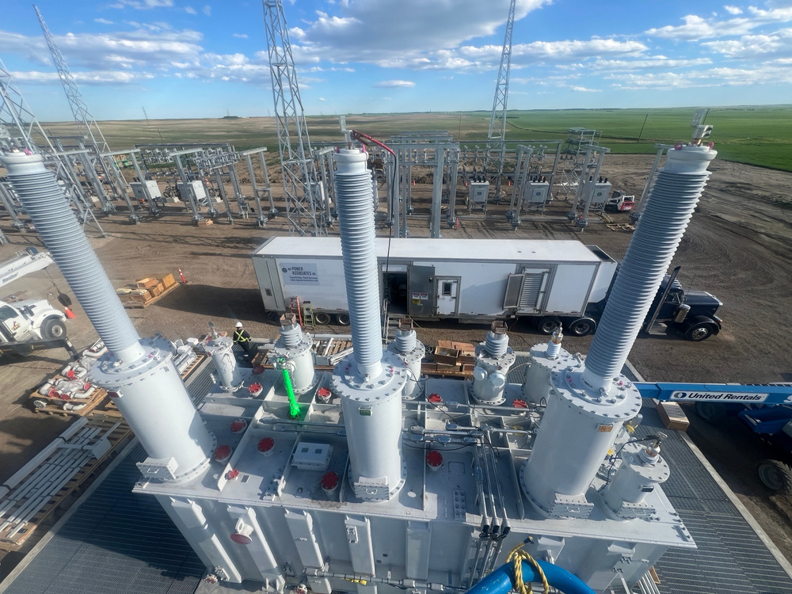
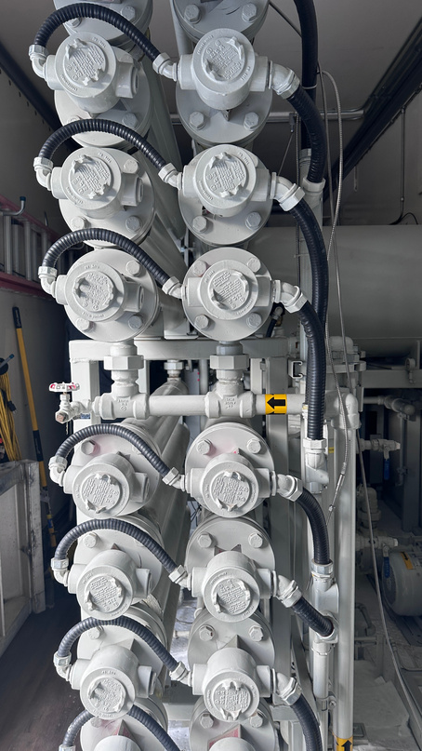
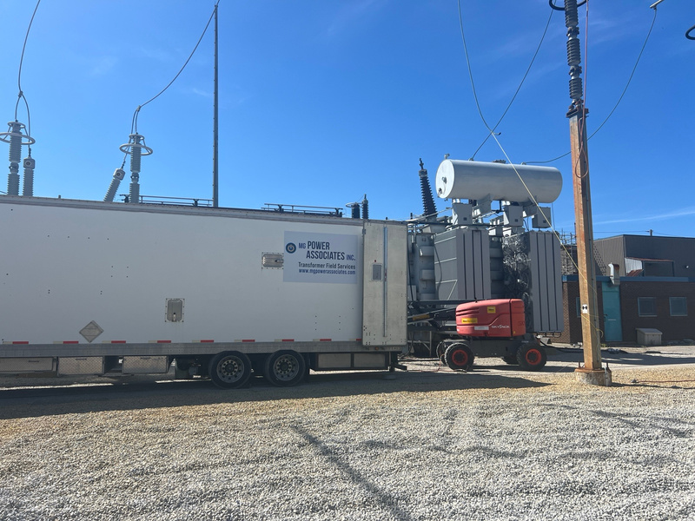
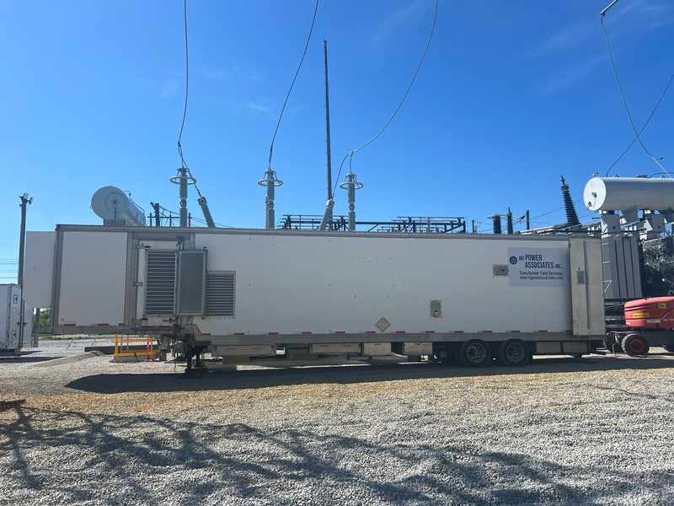
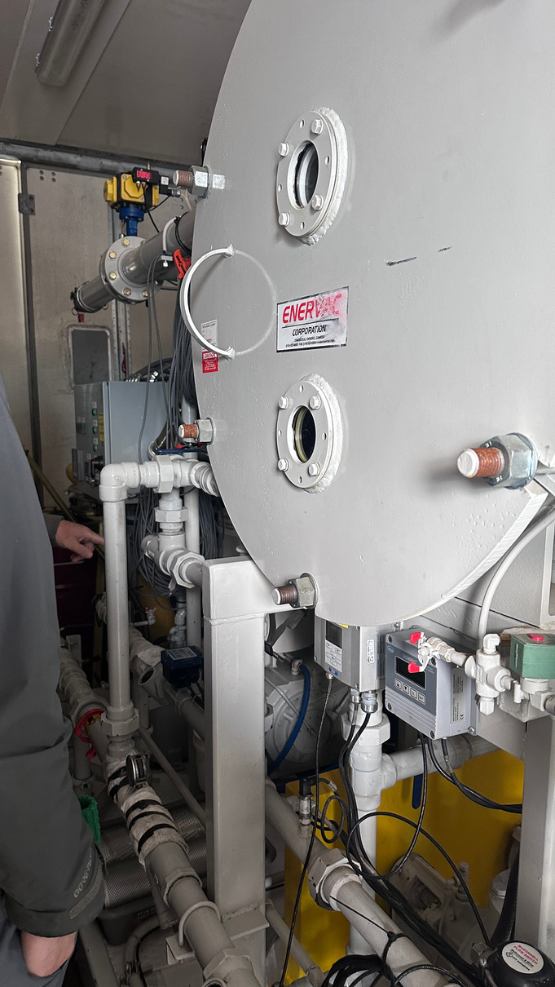
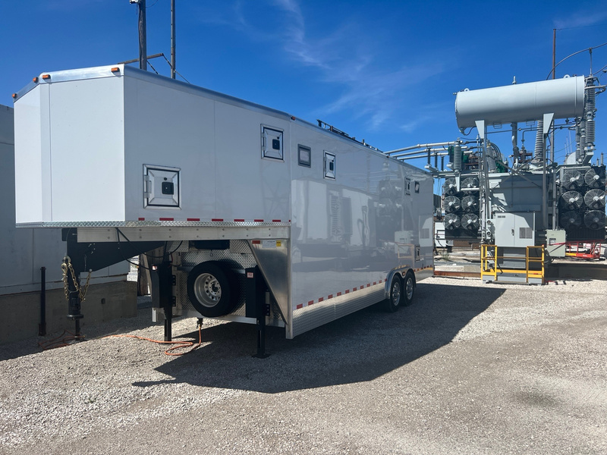
  MG POWER ASSOCIATES
Insulating Fluid Services
MG Power owns and operates four advanced, mobile vacuum oil processors, ensuring flexibility and reliable service delivery across North America.
Dehydration
Degassification
Vacuum Filling and Processing
Insulating Fluid Treatment
Fluid Analysis
Processors with capabilities up to 2400 USG/hr
Online DGA Monitoring
Oil Processor Rentals
www.mgpowerassociates.com
Notes:
Change to Services we offer
relabel on fluid services slide
capabilities of our processors on a square note
rentals for our trailers

Slide 9
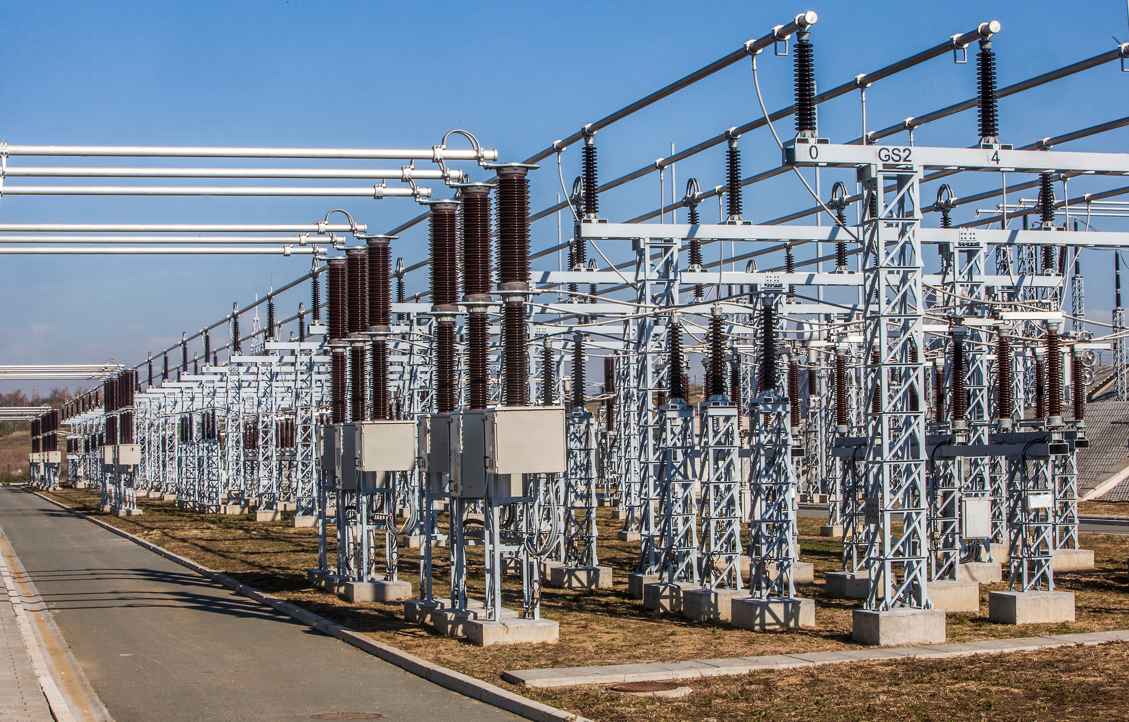
  MG POWER ASSOCIATES
Substation testing
We perform comprehensive transformer commission testing to ensure proper installation, while complying with design specifications.
  Transformer Commission Test
    SFRA
    Winding Resistance
    Power Factor
    Insulation Resistance
    CT Testing
  Other Specialty Test
    Oil and Water Flow Leak
    Partial Discharge
    Hi-pot Testing
    Dielectric Frequency Response
    DC Battery Systems
    Protection Relays
    Breakers
www.mgpowerassociates.com
Notes:
change stock photo
also add the 4 reliable mobile vacuum oil processing here

Slide 10
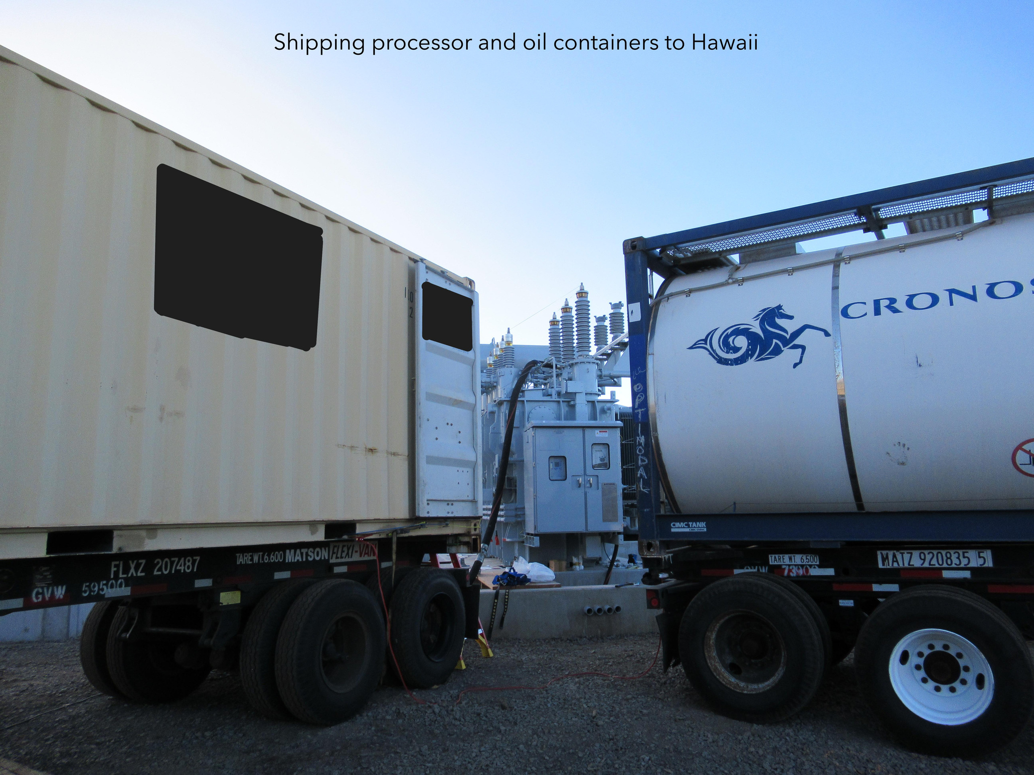
REPAIRS
During the life-cycle of your Power Transformer, we provide the following:
Gasket Replacement
LTC Maintenance
Switch Alignments
Welding
Painting and Touch Up
Procurement and Replacement
Radiator Replacement and Retrofits
Heat Exchanger Retrofits
Cooling Package Upgrades
...and more
www.mgpowerassociates.com
Notes:
make the logo white

Slide 11
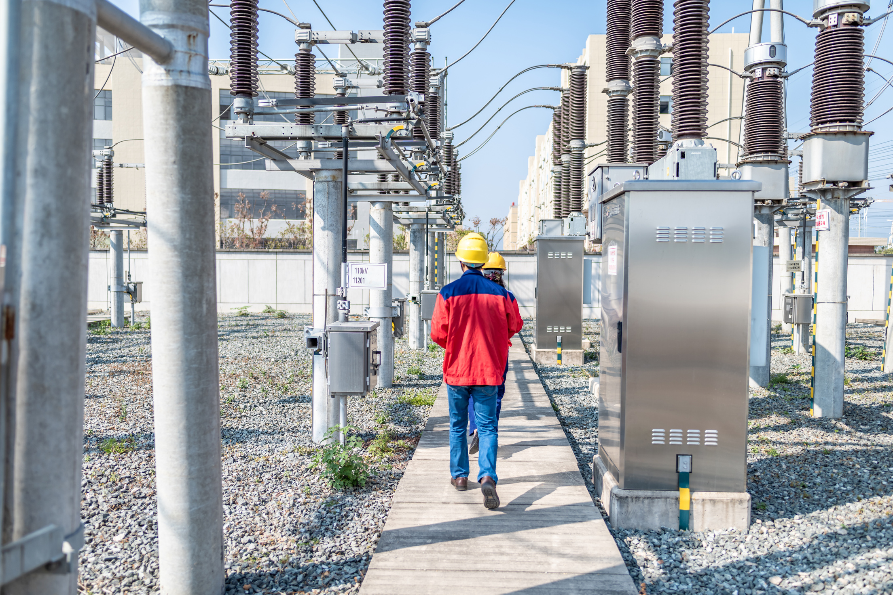
OEM WITNESS/ERECTING ENGINEER SERVICES
  Our team specializes in providing comprehensive supervisory services for leading transformer OEM’s, utilities, and power generation companies. We ensure efficient and high-quality execution of transformer installations.
Jobsite Supervision
Visual Inspections
Infrared/Thermal Scanning
Advanced Substation Security and Monitoring Systems
Transformer Condition Assessment
Comprehensive Annual Inspection
  We prioritize seamless coordination, while adhering to industry standards.
www.mgpowerassociates.com

Slide 12

INSPECTIONS
Our inspection process is designed to ensure transformer reliability and longevity. We achieve this through detailed assessments that identify potential issues before they become critical.
Review and Analysis of DGA & Oil Quality Results
Detecting Insulating fluid leaks including SF6 Accessory testing
Visual Inspections
Comprehensive Annual Inspections
www.mgpowerassociates.com
Notes:
make the logo white

Slide 13
OTHER EQUIPMENT WE SERVICE
Control Buildings
Protection Relays
Grounds and Sites
Batteries
HV Switches
SF6/Oil Breakers
ISO Phase Bus
Switchgear
Notes:
Remove or modify

Slide 14
  MG POWER ASSOCIATES
OUR Projects
www.mgpowerassociates.com

Slide 15

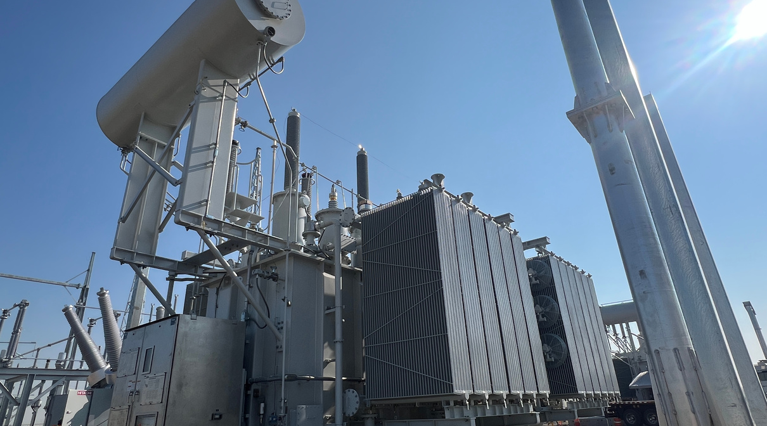
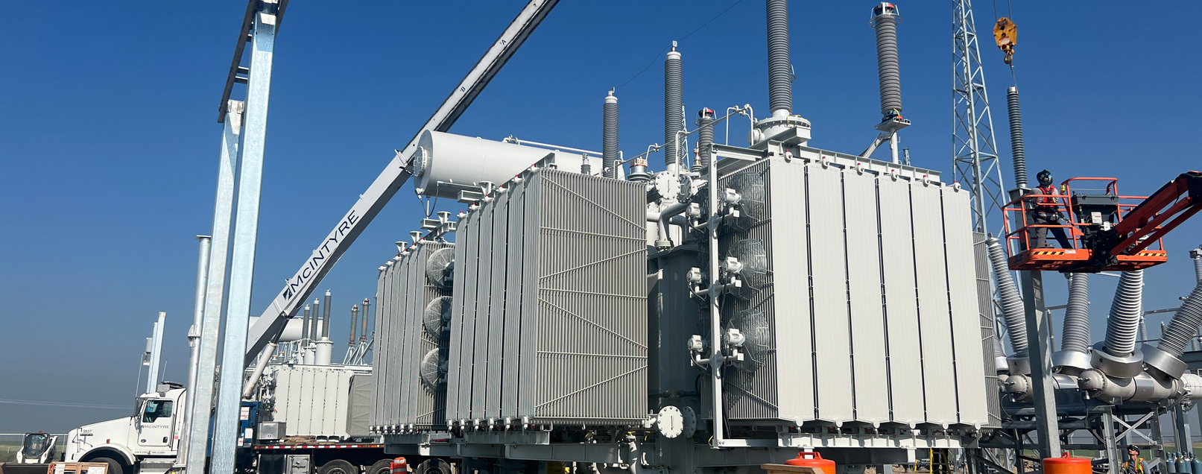




2 x 240 kV
Installation
Wind Farm Project

Slide 16
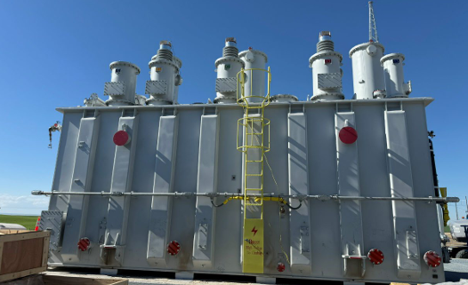

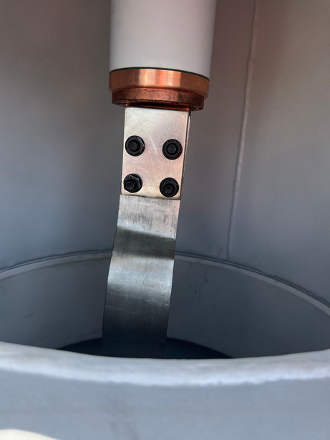
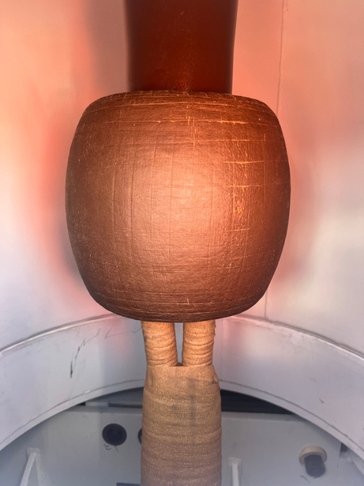
Turrets and Bushings Installed
2 x 240 kV Installation
Wind Farm Project
X1 Internal Connection

Slide 17

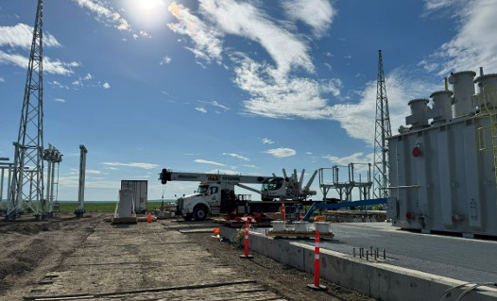
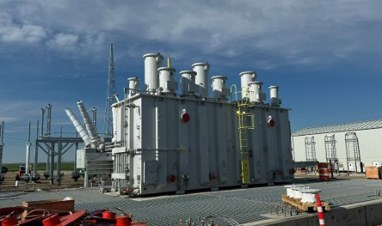
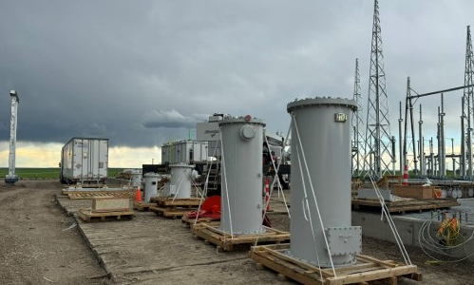
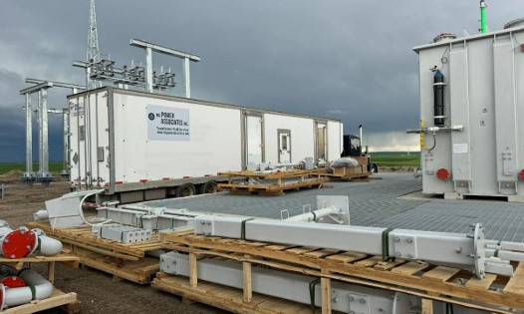
Turrets Installed
2 x 240 kV Installation
Wind Farm Project
Site Conditions / Parts Staged
VOP in position near T1

Slide 18
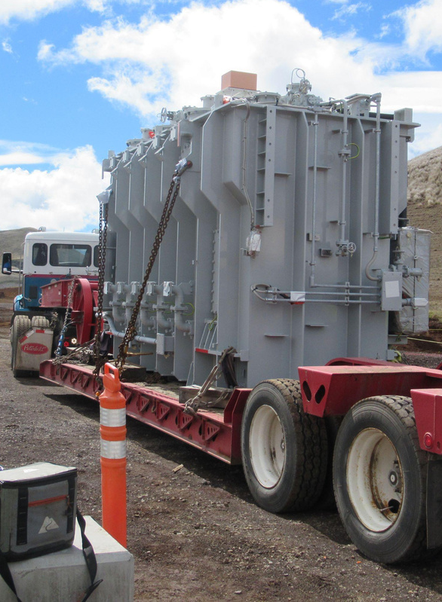
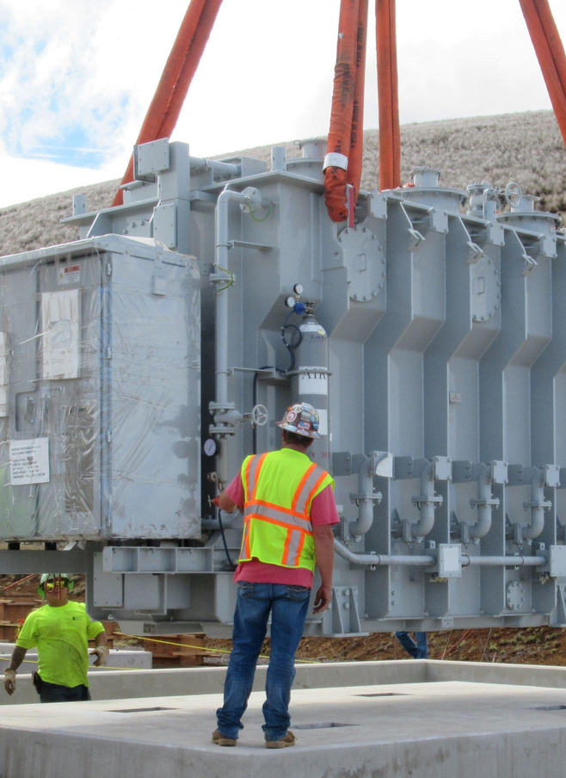
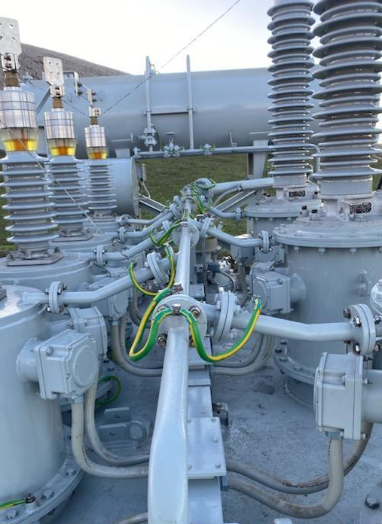
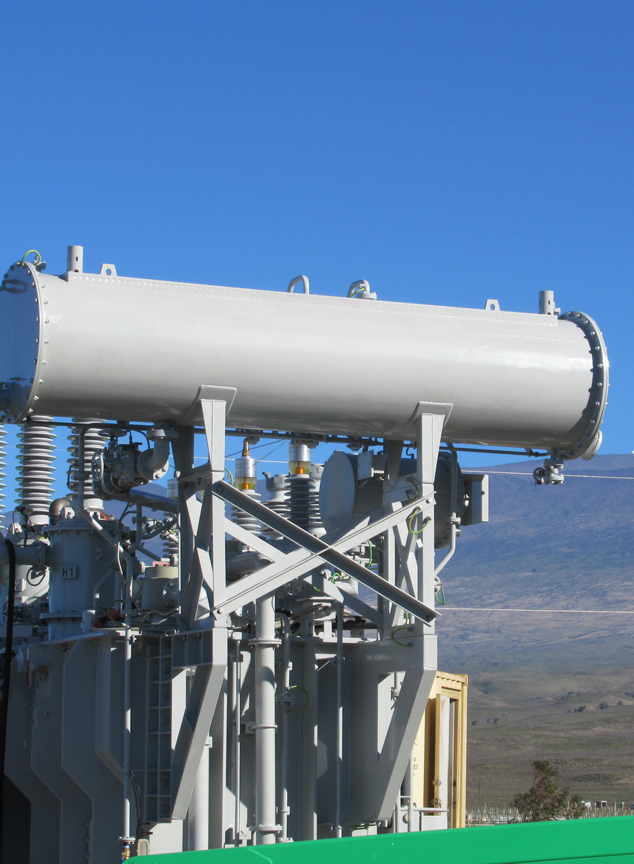
69 kV Installation
Hawaii Solar Farm Project
Transformer reaches the site
Transformer carefully placed on its pad
Piping, CT’s, and grounding tasks are completed
Final view

Slide 19
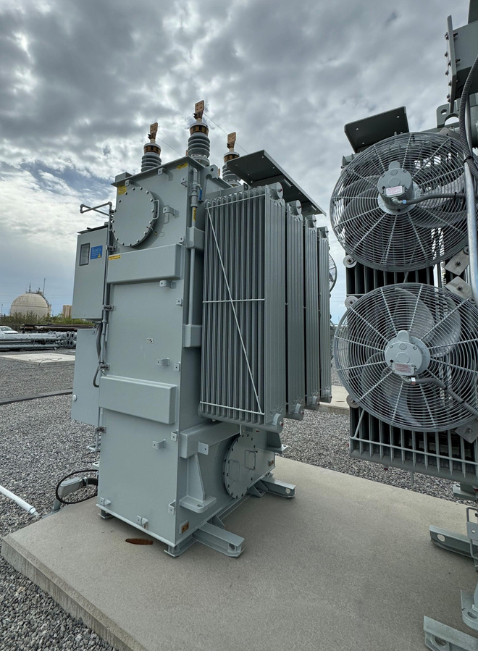
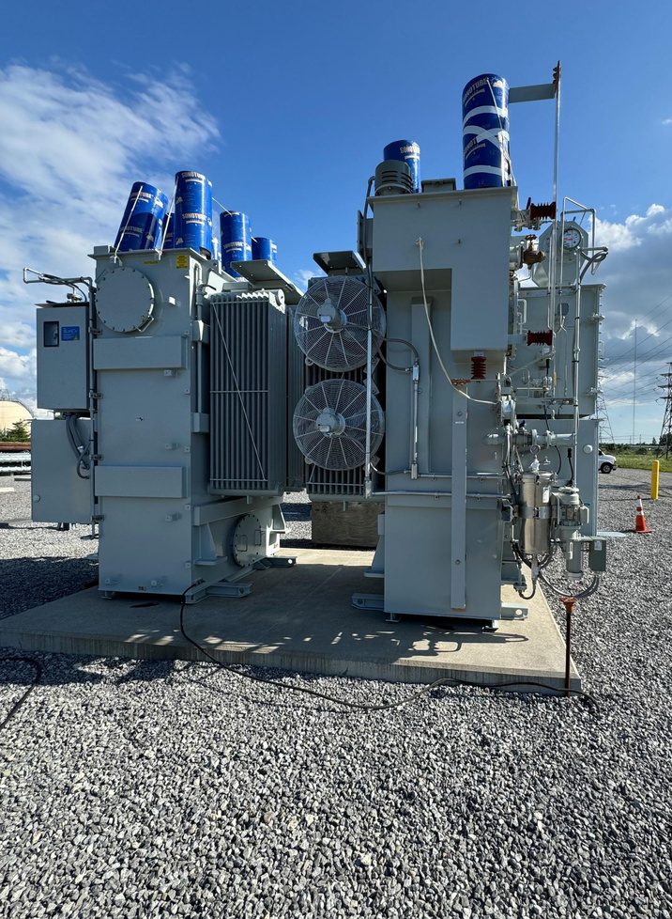
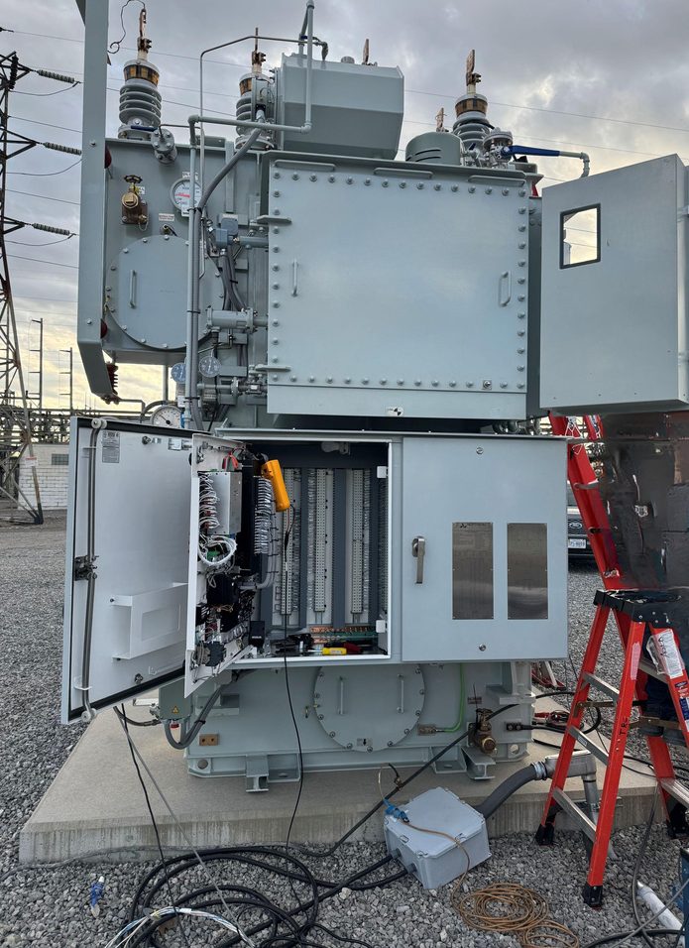
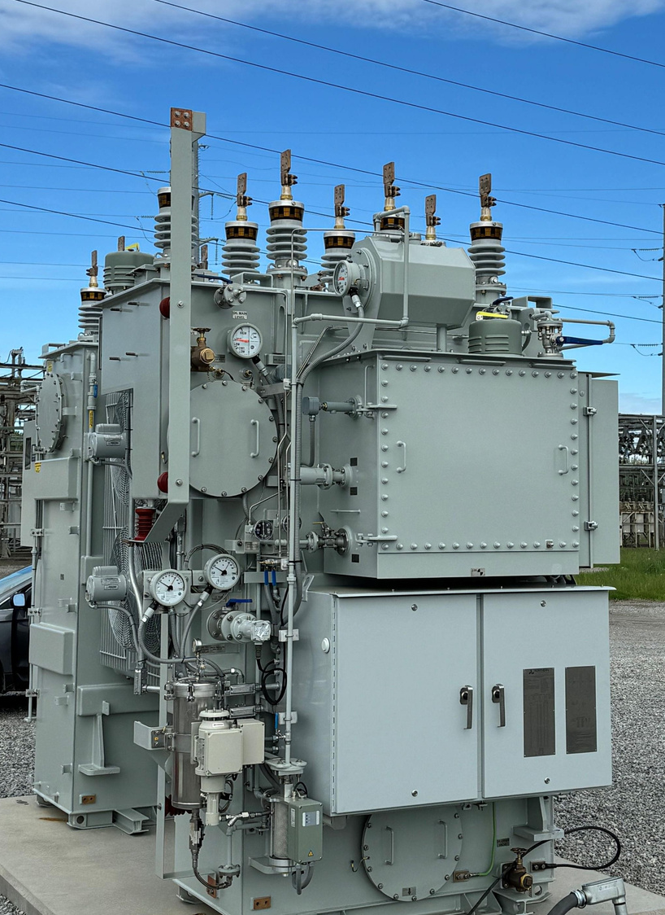
4 x 4688 kVA Installation
Niagara Project
1 of 4 shipped
Efficiently placing 2 transformers on pad
High Voltage Acceptance Testing
Completed HV Testing on 4 transformers

Slide 20
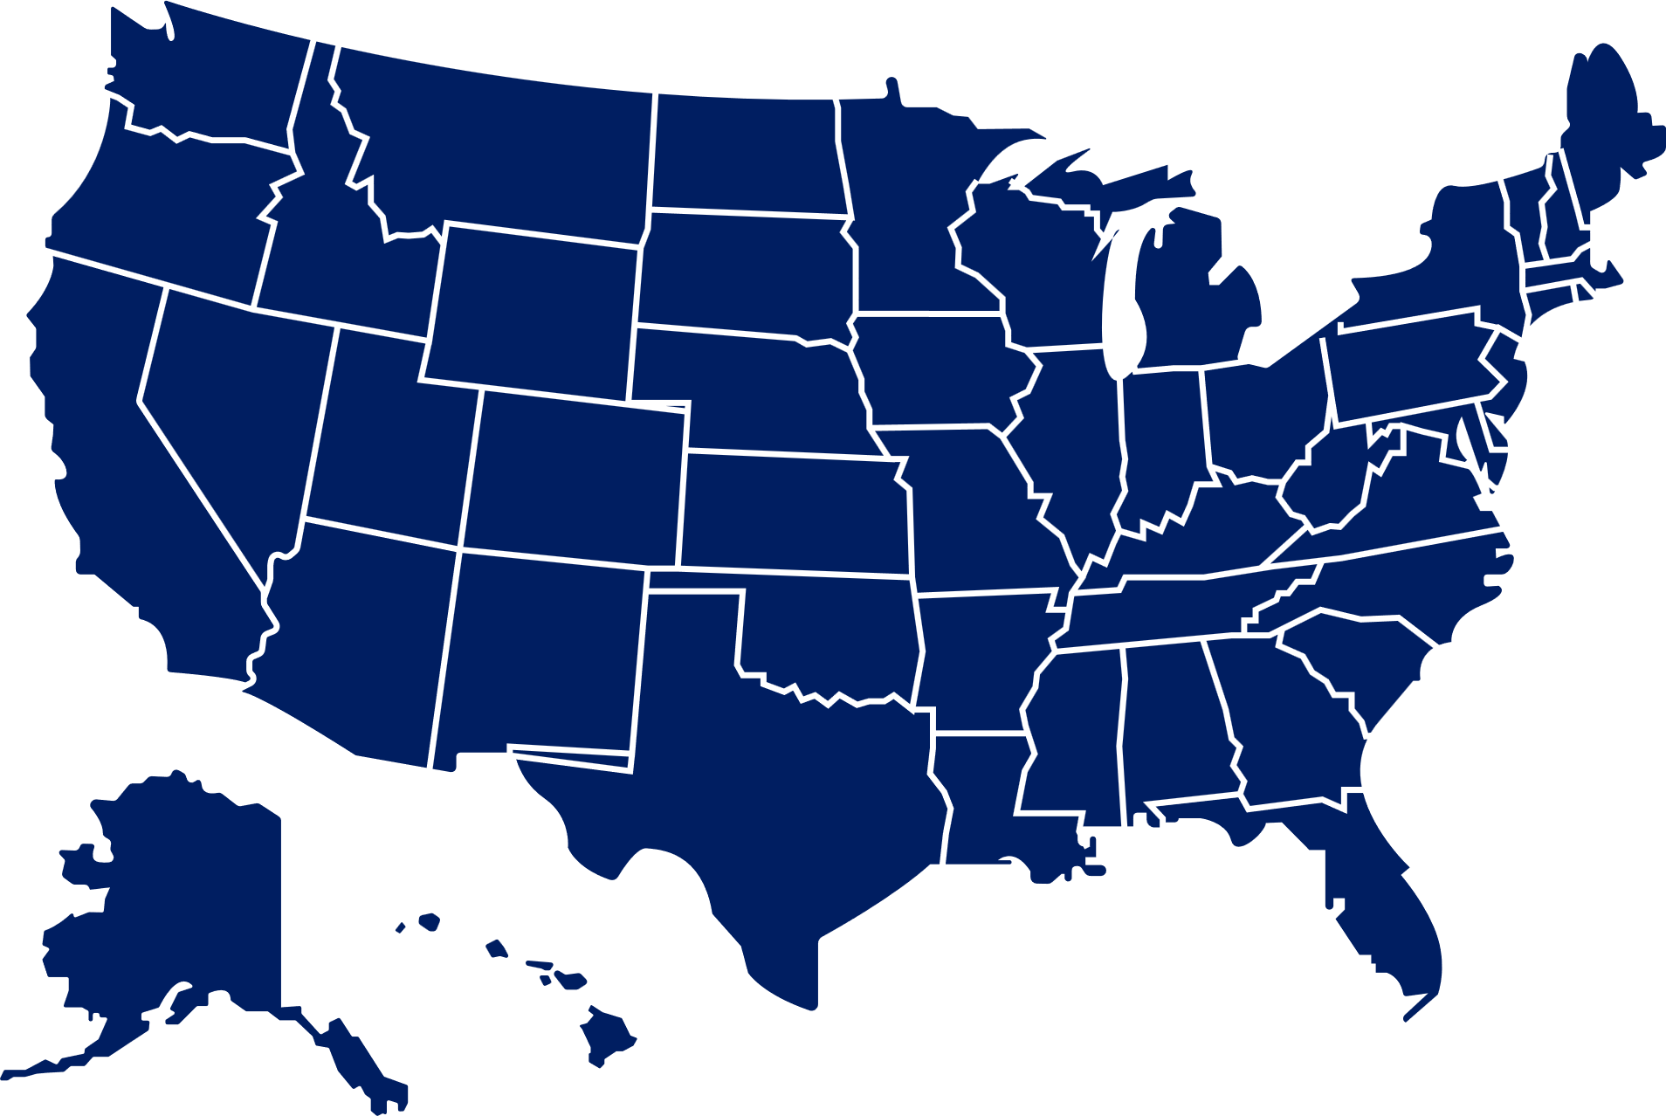


servicing coast to coast
We proudly serve all 50 of the US and across Canada, offering medium and high voltage services to the power transmission, generation, and distribution market. Our team of experienced engineers and technicians has decades of expertise working with North America's top utilities and OEMs.
Notes:
This still needs editing

Slide 21





Let’s Build a Reliable Future Together
Are you ready to take the next step in improving your energy infrastructure?
Whether you need a new transformer installation, system upgrades, or ongoing maintenance, our team is here to help.
Get in touch with us:
Contact to our email
info@mgpowerassociates.com
Visit our website
www.mgpowerassociates.com
Call us
US 765-425-4132 | CA 709-636-9981

Slide 22


APPLIED LEAK SEAL INC.
BUSINESS OVERVIEW
Leak Sealing Solutions for High Voltage Equipment:
Transformers, Circuit Breakers and Medium to High Voltage Equipment
Notes:
Gaskets may break down. to fix a leak
art more than science
Fixed leaks in a unique, more personalized way

Slide 23
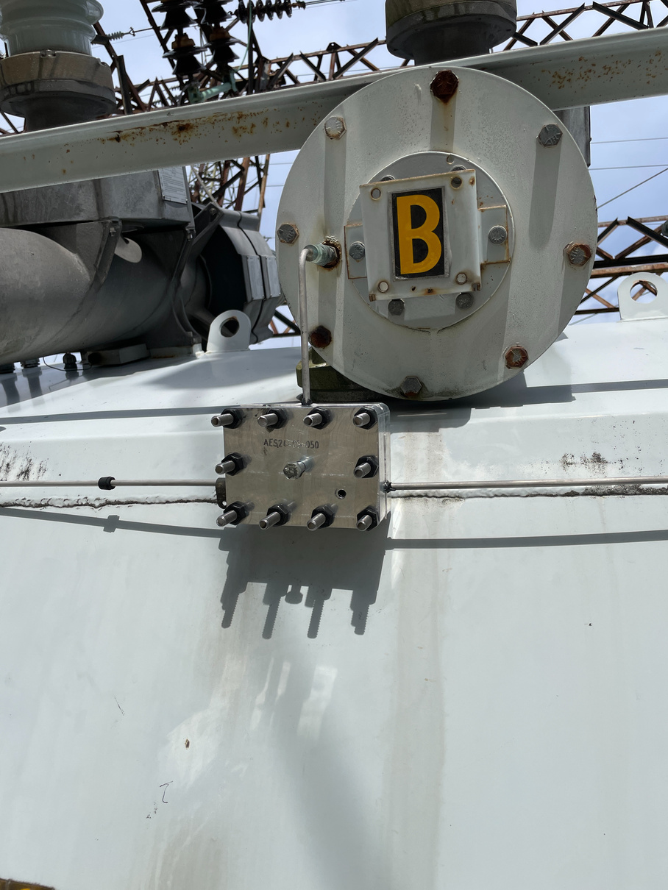
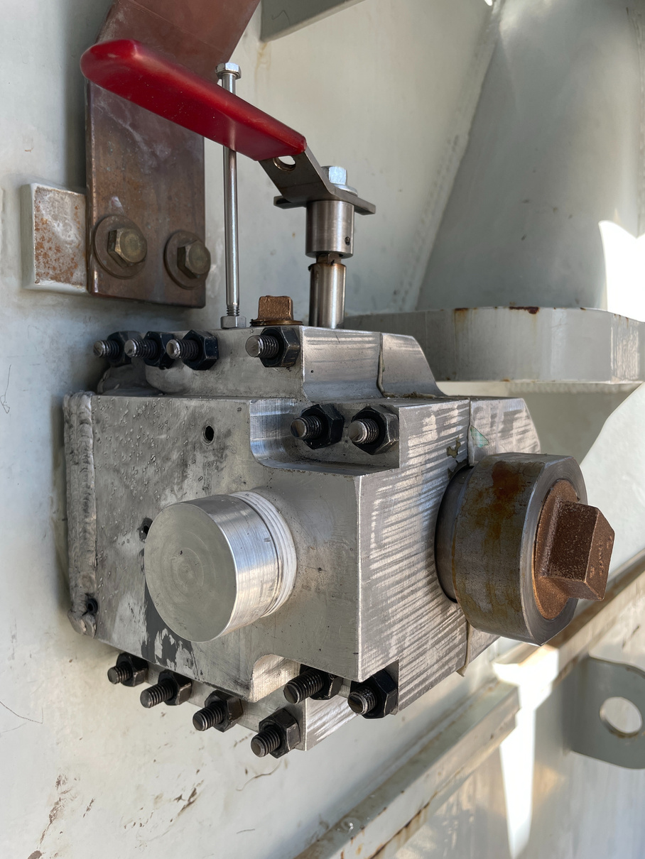
ABOUT US
Applied Leak Seal Inc. is an independent specialty service provider to the power generation and utility sector across North America, with expertise in innovative and proven leak sealing solutions.
www.appliedleakseal.com

Slide 24











Age
Vibration
WHY DO LEAKS OCCUR?
Assembly
Environment
Stress
Temperature Changes
Load Fluctuation
Human Factors

Slide 25

THE NEGATIVE CONSEQUENCES OF LEAKS
DGA
Oxygen
Environmental
Fines
Asset Reliability
Remediation
Safety
Moisture ingress
www.appliedleakseal.com

Slide 26




CURRENT INDUSTRY RESPONSES TO LEAKS
The
  APPLIED LEAK SEAL Solution
  Inaction
  Regasket or Replace
www.appliedleakseal.com
Notes:
Current industry responses to leaks
1. Inaction
2. regasket or replace
3. The Applied Leak Seal Solution
Add next slide:

Slide 27


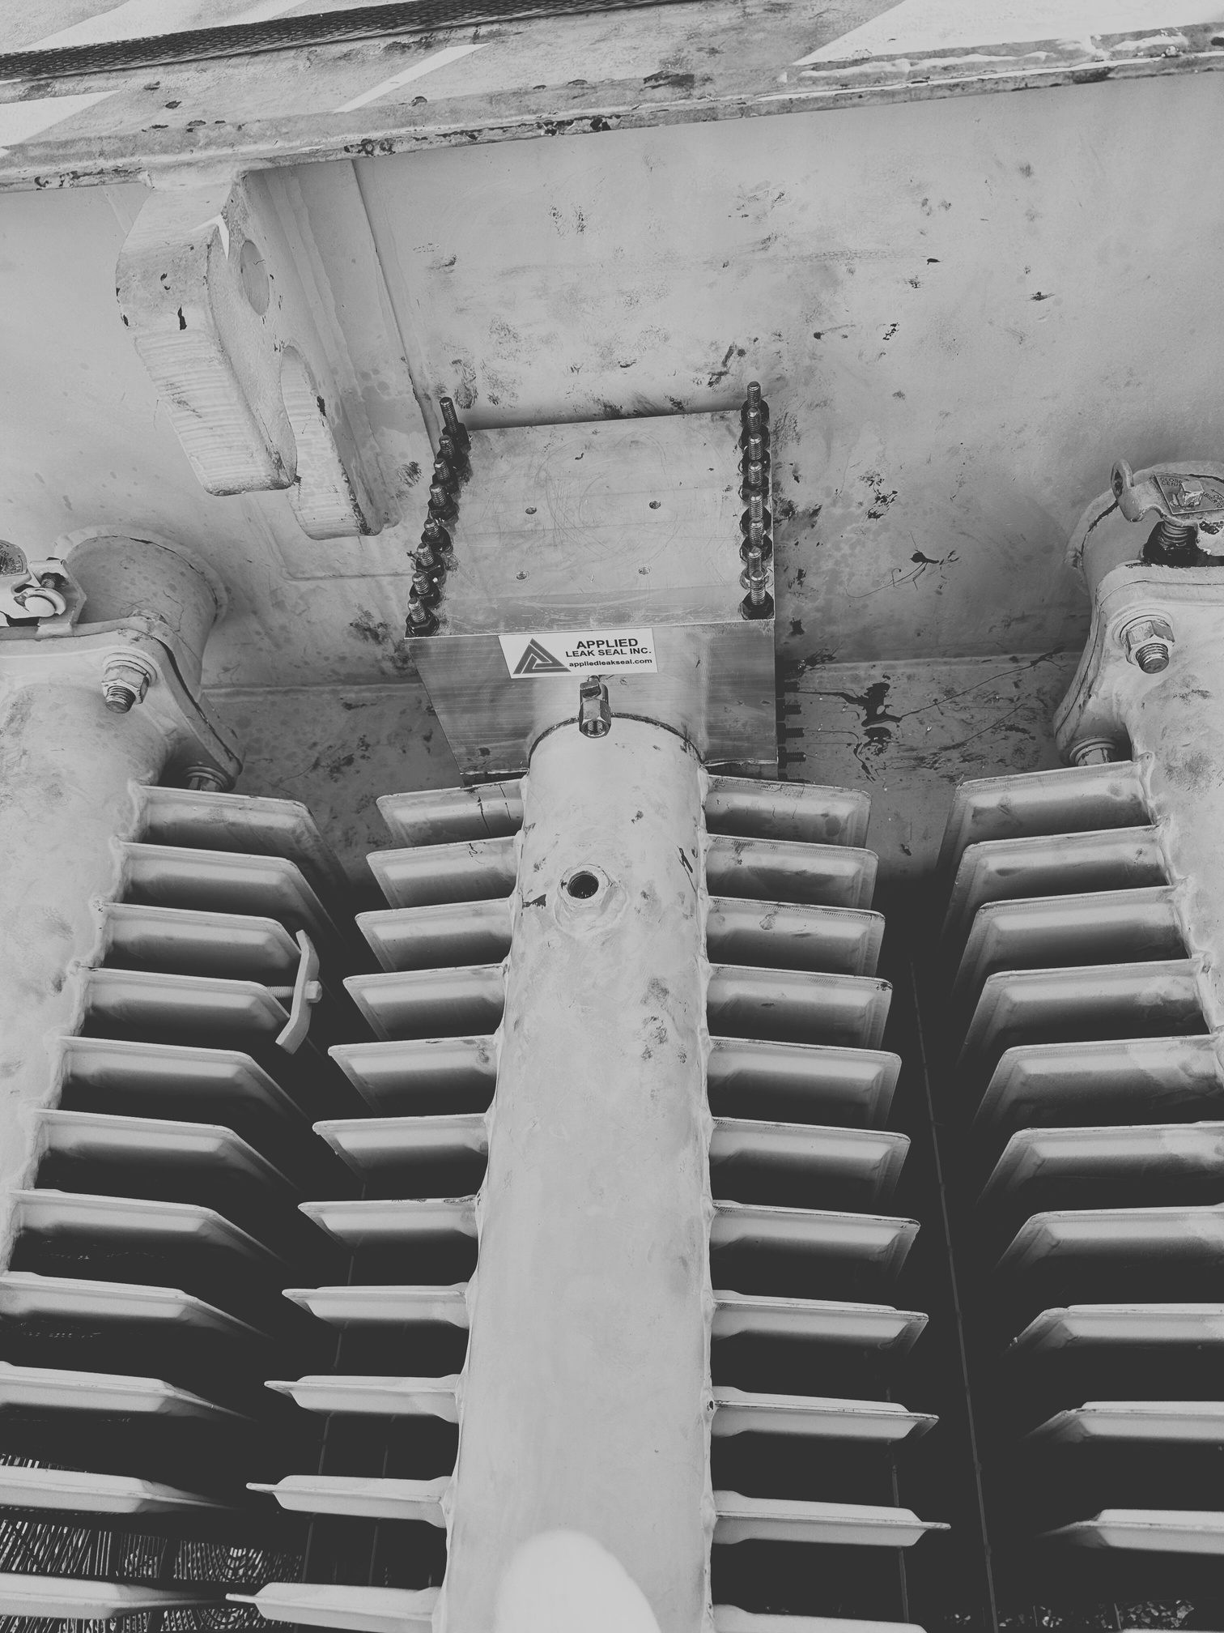


WORKING WITH APPLIED LEAK SEAL INC
  We approach the repair utilizing Applied Leak Seal’s specialty O-ring compatible leak sealant along with the BEST methodology.
Custom Enclosure/Clamp
Prior to the repair, a site visit takes place to obtain a measurement of the leaking apparatus. A custom PVC or Aluminum enclosure or flange-to-flange clamp is produced, installed, and the cavity filled with our sealant.
Injectable Cap Nuts/Washers
Our sealant is a rubber based compound that can easily be removed within minutes by our clients’ technicians.
Designed to replacing existing nuts and injected with sealant.
Drill & Inject (D&I)
The gasket grove is drilled and injected with our sealant followed by placement of brass plugs

Slide 28
3D SCANNER
We are utilizing our own 3D scanner to obtain measurements from the leaking apparatus.
This efficient and versatile handheld device is easy to operate and provides precise, detailed measurements, even in demanding conditions and on complex surfaces.
Notes:
Add a Scan of valve get it from Bruce
picture of the actual scanner connected to the laptop

Slide 29

OUR PROCESS CAN BE APPLIED TO
Bushings / Various Flanges and Threaded Connections
Cover Plate / Manholes
Pressure, Temperature, and Level Gauges
Pump Flanges
Tap Changer and Compartment Flanges
Tubing Connections
CT Boards or Junction Blocks
Drain and Sample Valves
Radiator Fins, Headers and Valves
Welds
SF6 / Oil Breakers
www.appliedleakseal.com
Notes:
addresses all sorts of gas oil and sf6s leaks

Slide 30


SAMPLES OF OUR PROJECTS
Custom Enclosure/Clamp

Slide 31
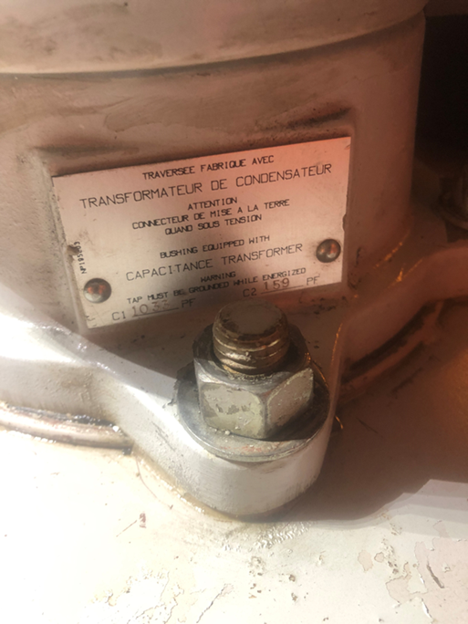
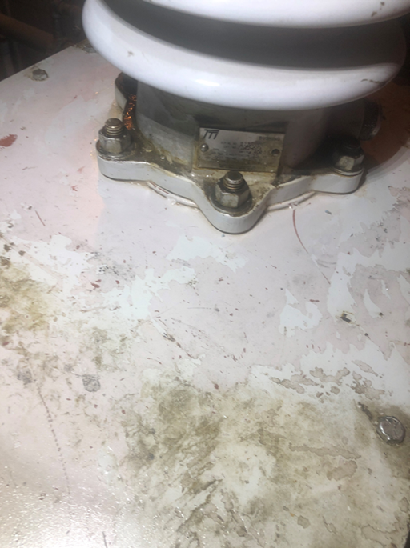
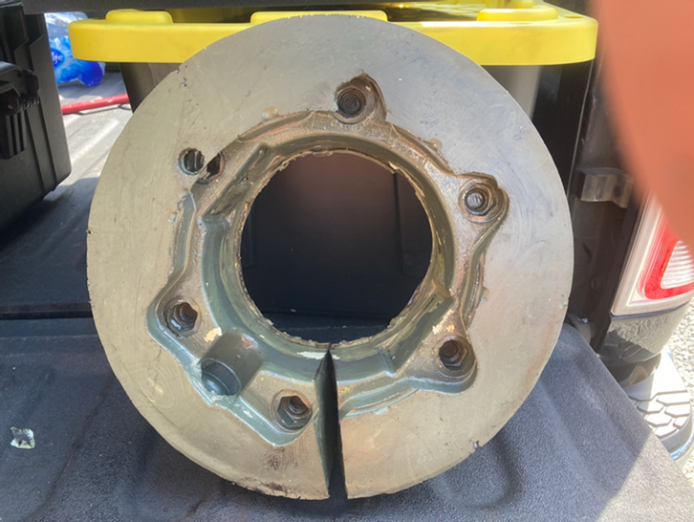
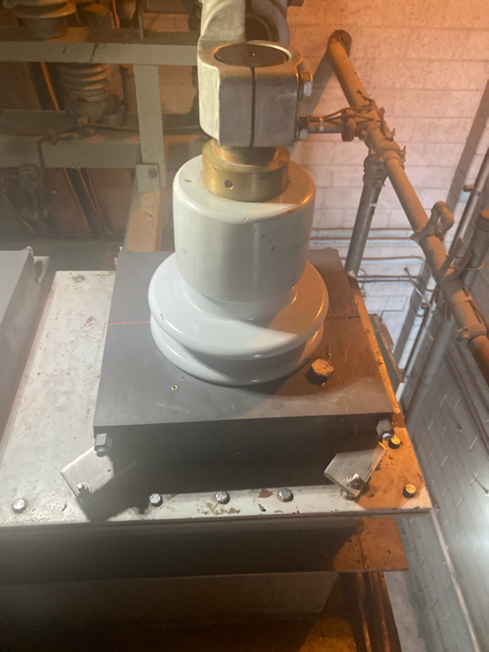
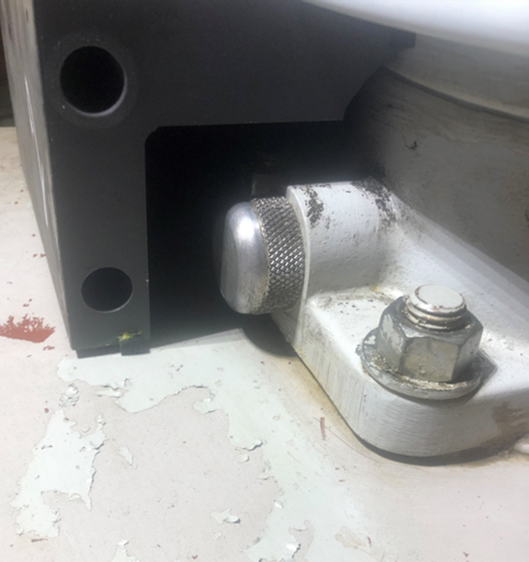
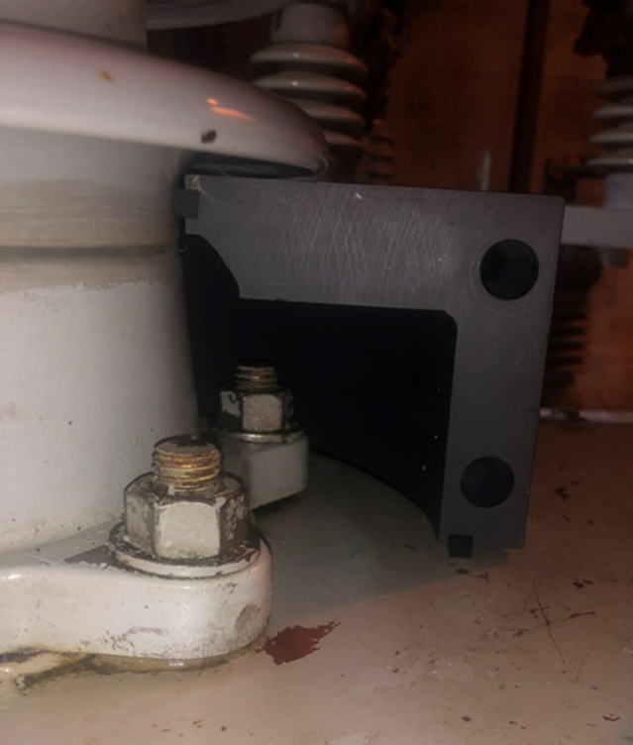
Bushing Flange Gasket Leak
Before
After
Notes:
recommendation to remove this slide ask for appr

Slide 32
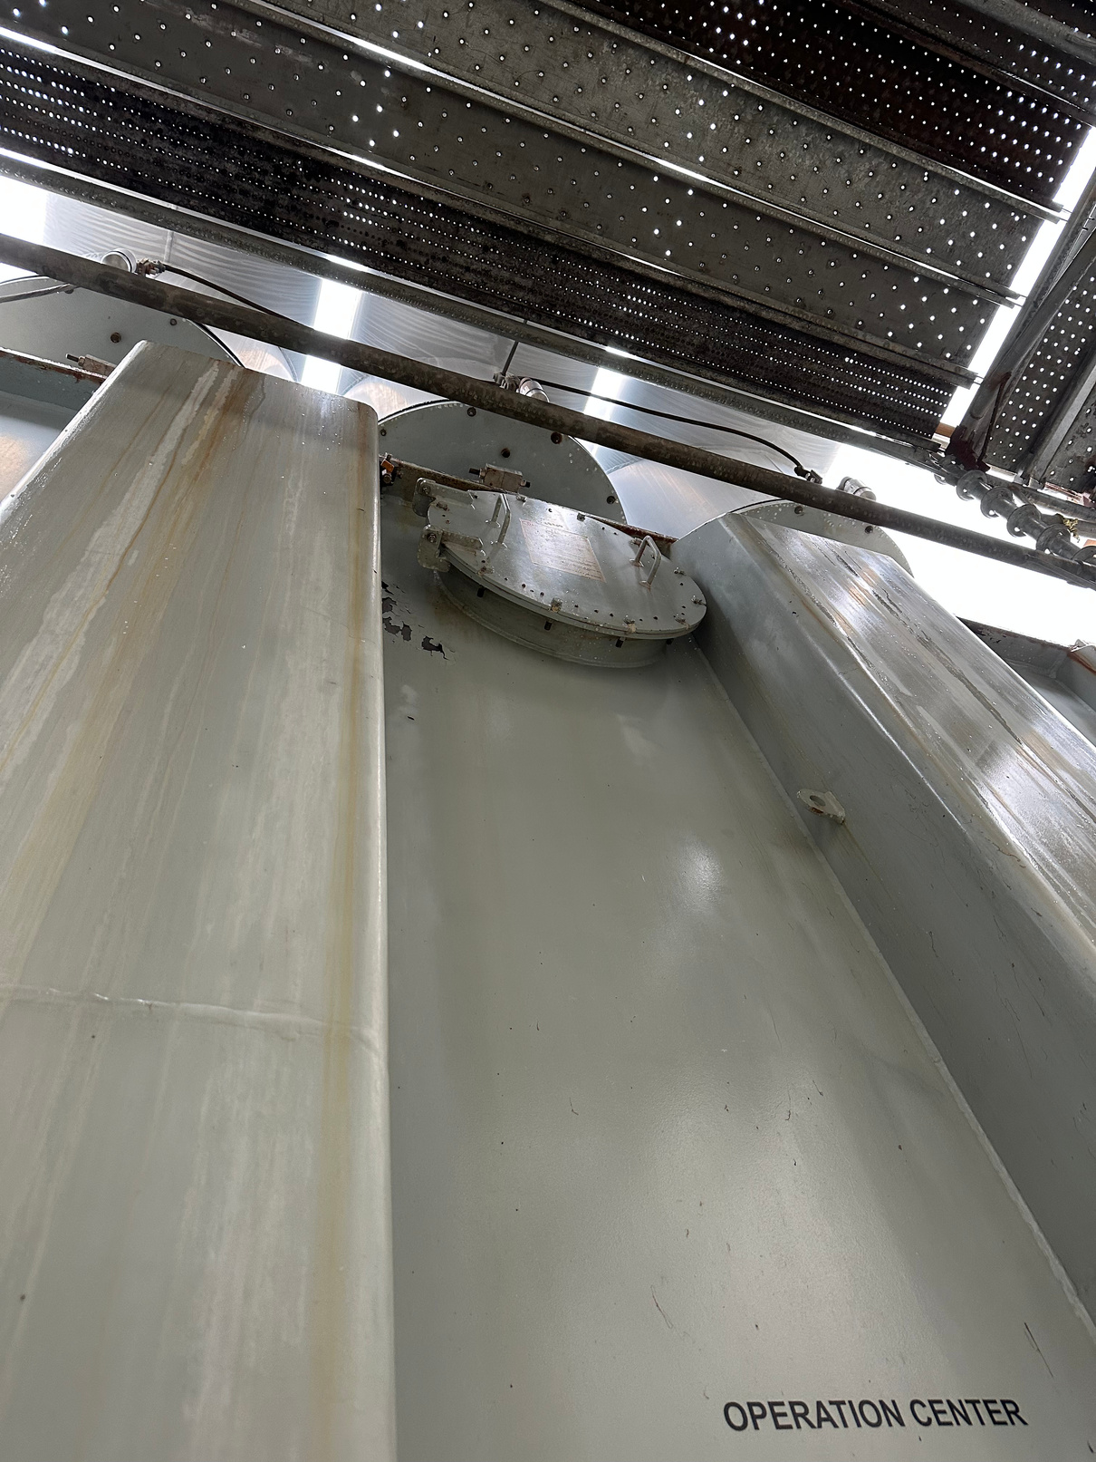
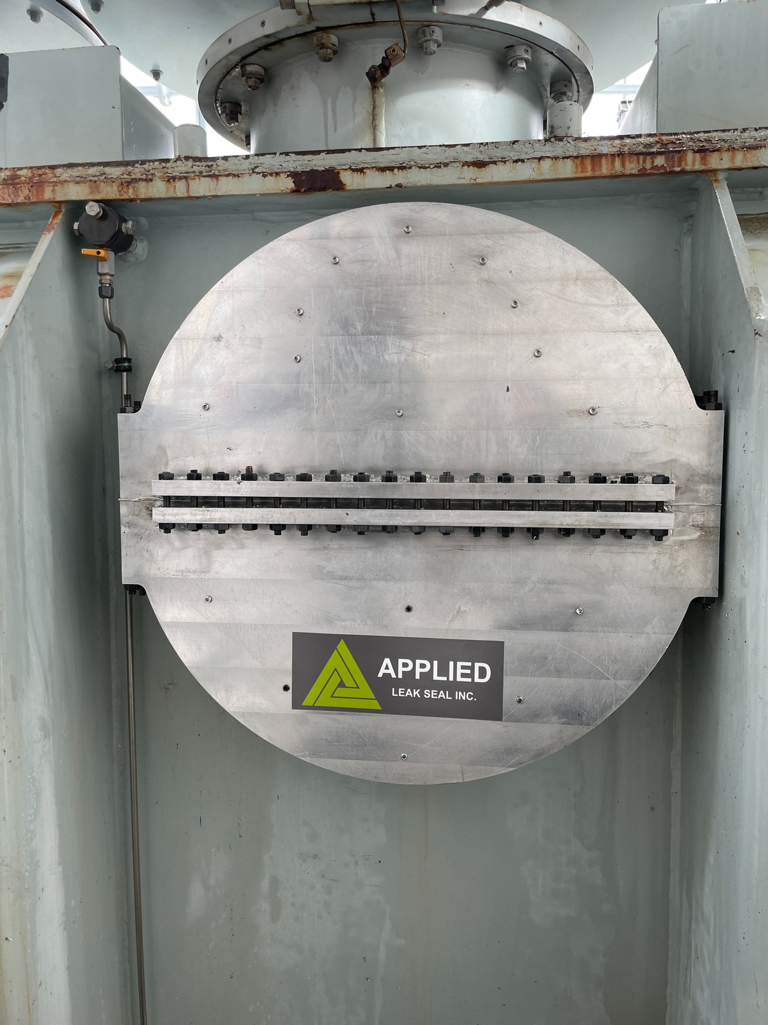
Access Cover Enclosure
Before
After
www.appliedleakseal.com
Notes:
recommendation to remove this slide ask for appr

Slide 33
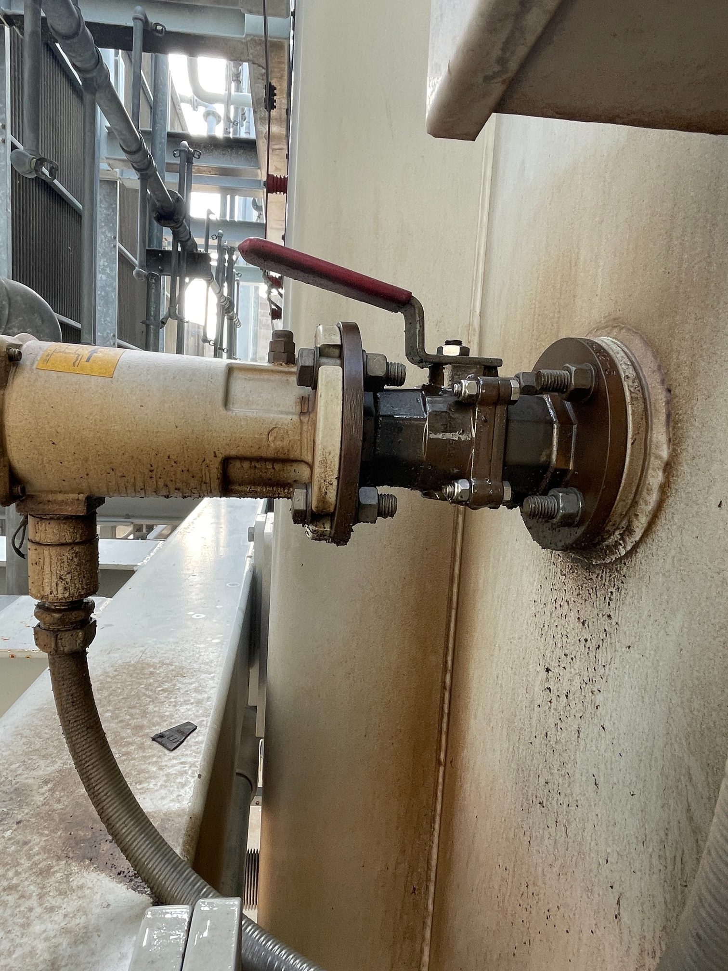
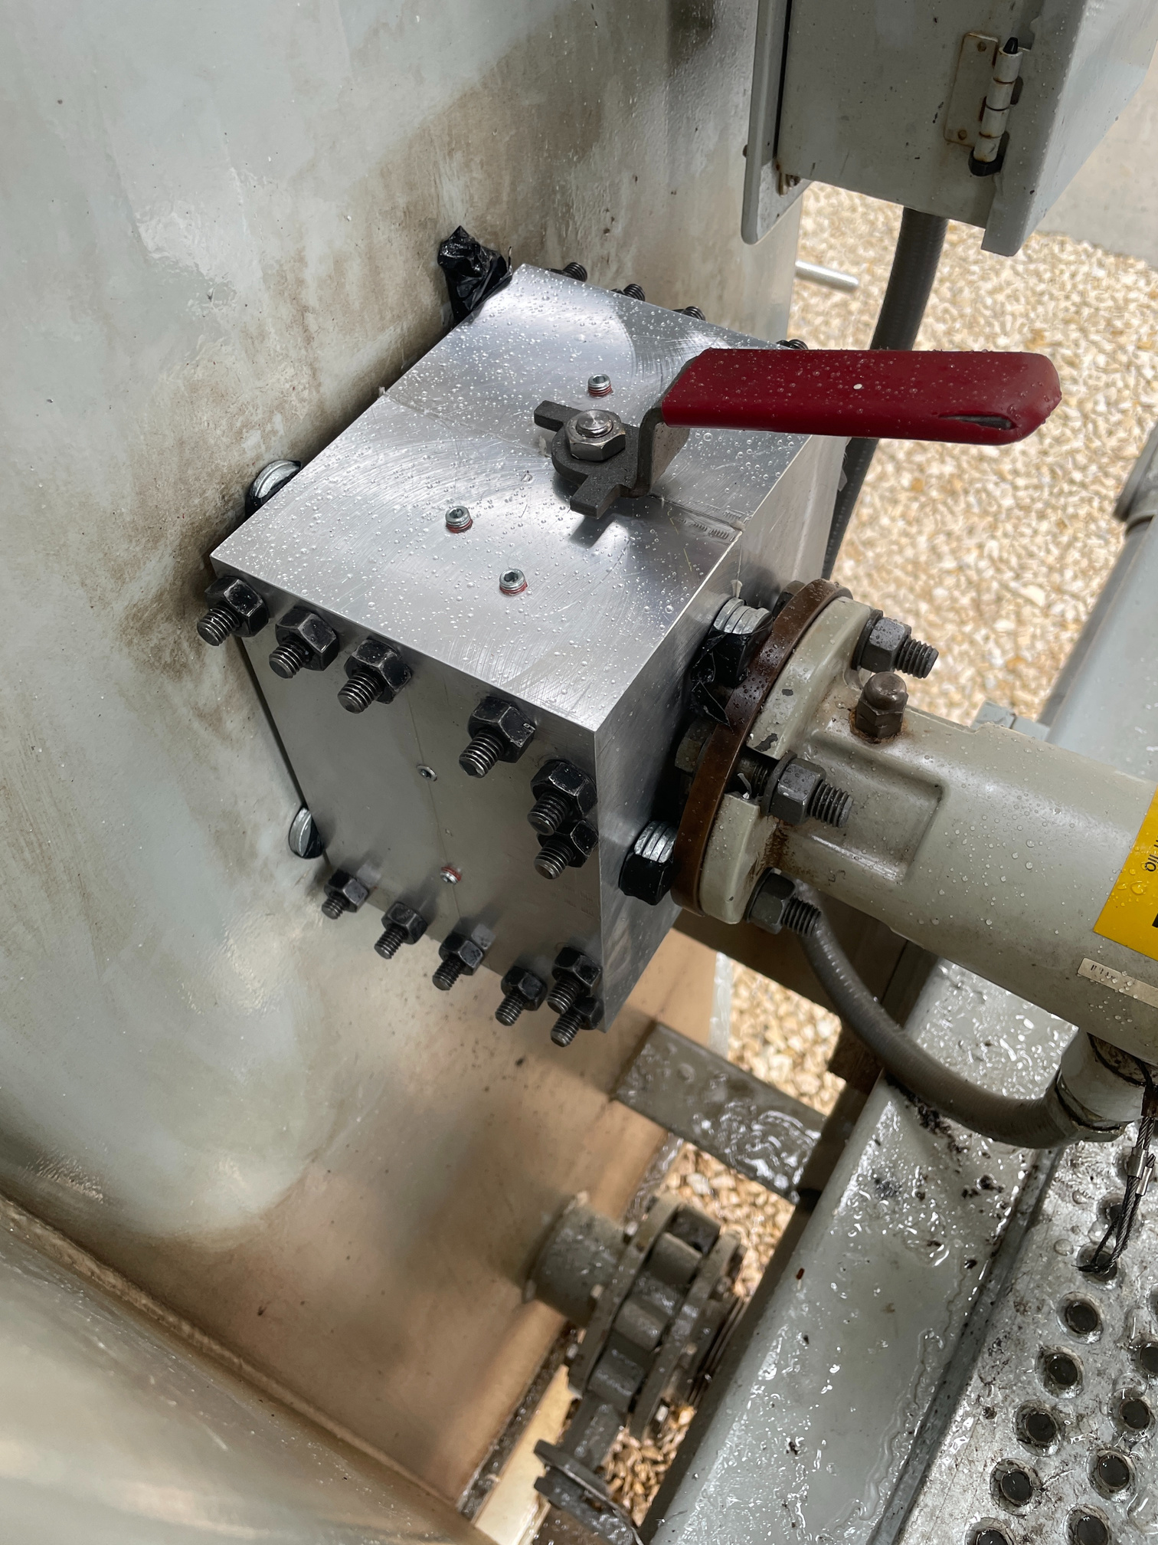
SPR Isolation Valve
Before
After
www.appliedleakseal.com

Slide 34
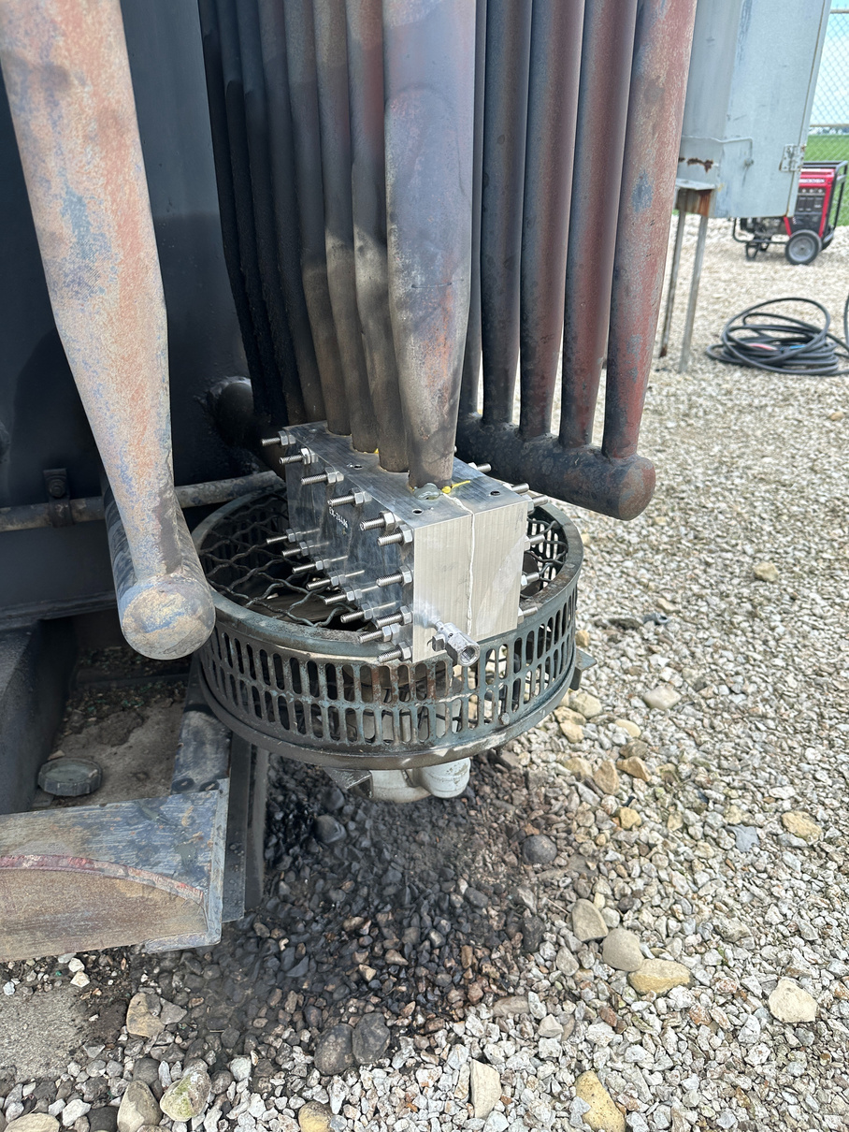
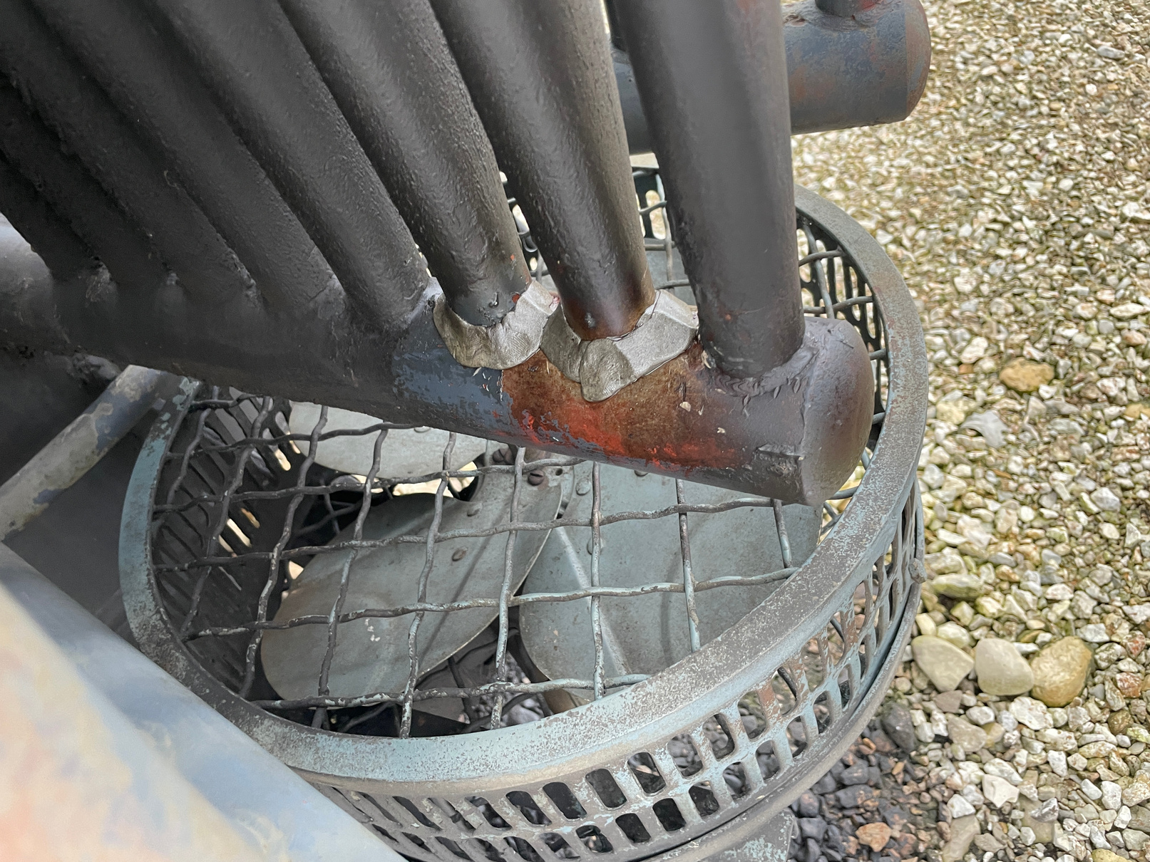
5-Bore Radiator Fin Tube Enclosure
During
After
www.appliedleakseal.com
Notes:
recommendation to remove this slide ask for appr

Slide 35
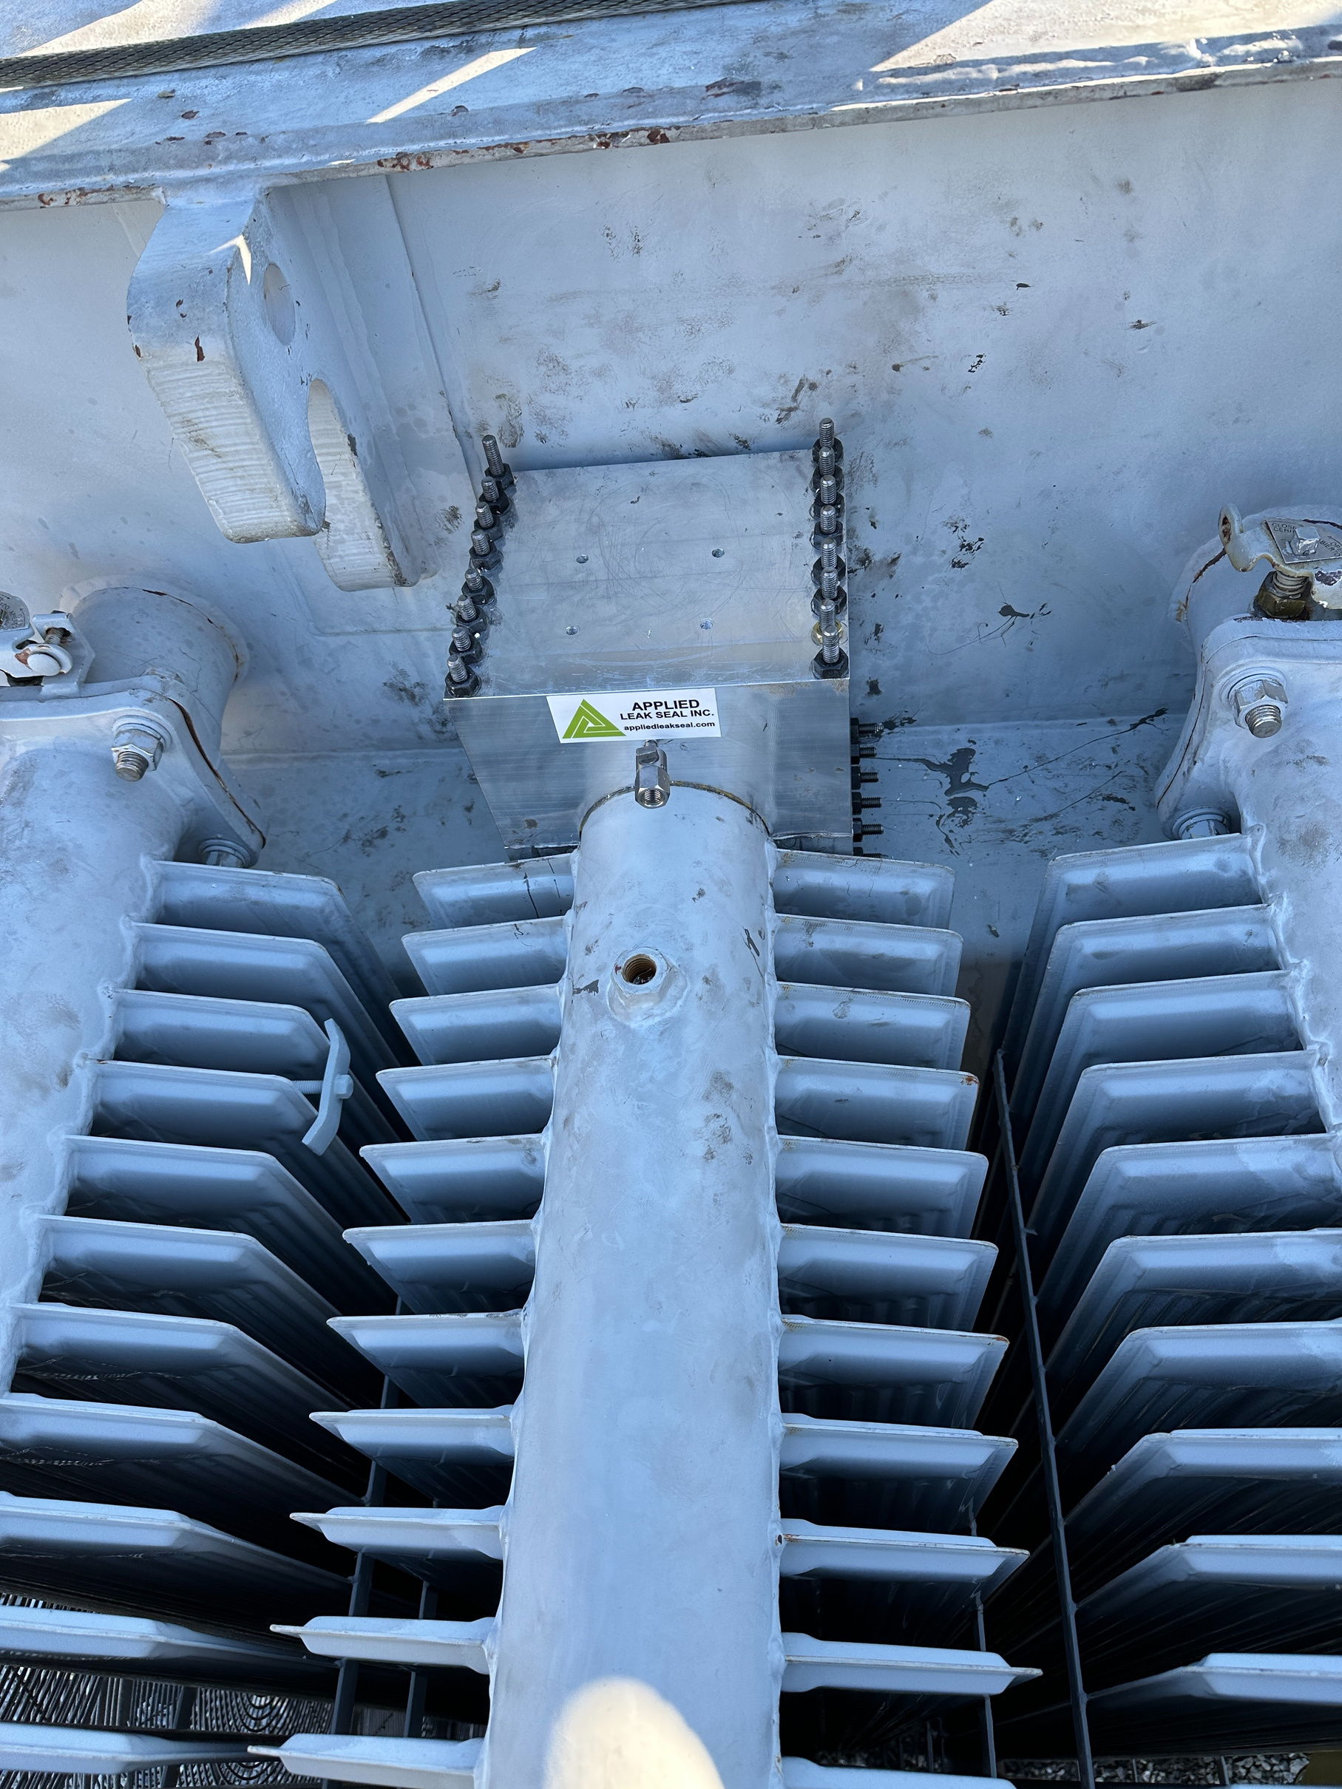
Rad Valve Enclosure
www.appliedleakseal.com
Notes:
move this slide after our projects/process

Slide 36
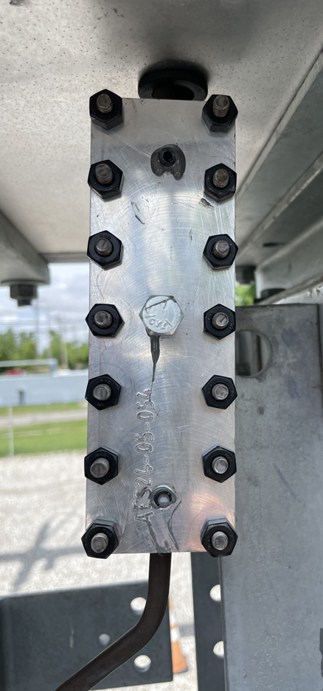
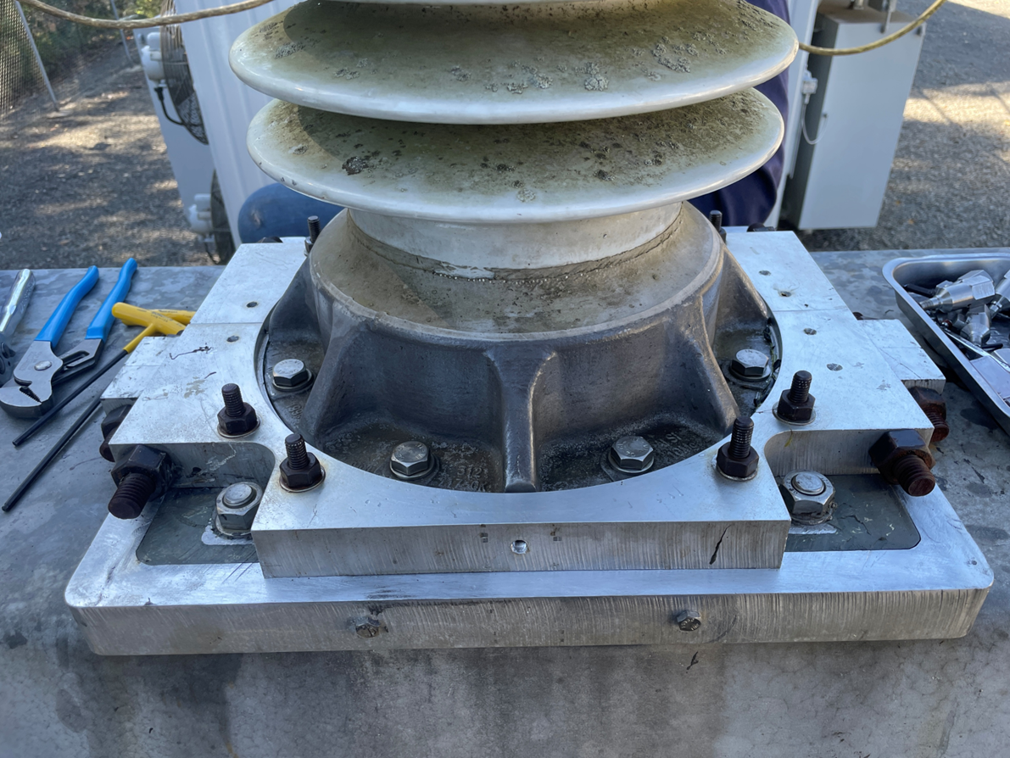
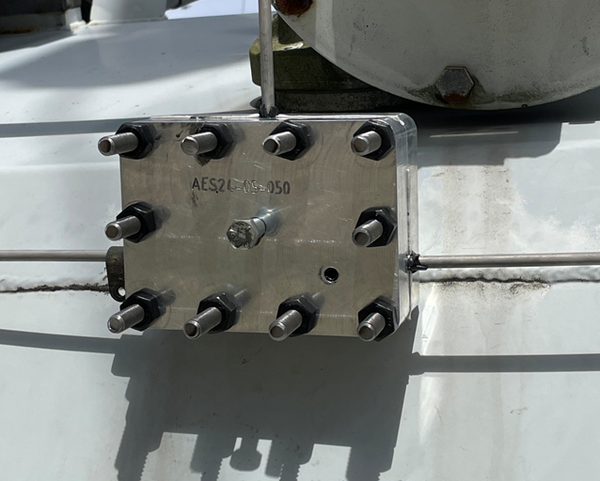
SF6 Clamps
www.appliedleakseal.com
Notes:
recommendation to remove this slide ask for appr

Slide 37
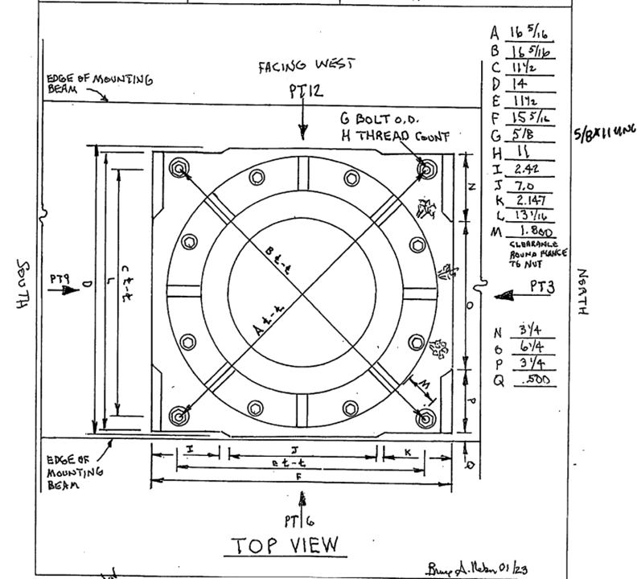
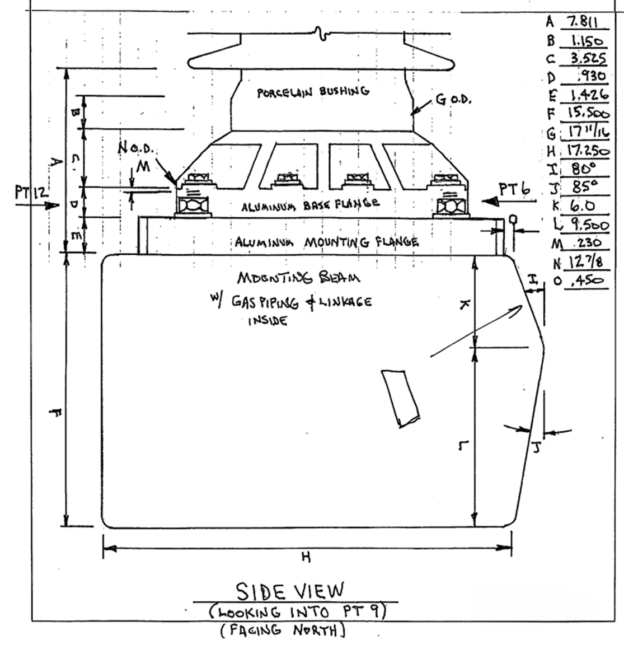
Technician Measure-Up Data
www.appliedleakseal.com

Slide 38

Conceptual Drawing from Engineer after Measurements were taken
www.appliedleakseal.com

Slide 39
SAMPLES OF OUR PROJECTS
Injectable Cap Nuts/Washers

Slide 40




Transformer Access Hatch
Before
During
Completed
www.appliedleakseal.com
Notes:
DON'T REMOVE

Slide 41
SAMPLES OF OUR PROJECTS
Drill & Inject

Slide 42



Drill and Inject Lower Radiator Isolation Valve Flange
Drill & Inject Process
Completed
Before
During
Note: Sealant travel through gasket grove to injection port.
www.appliedleakseal.com
Notes:
crop the 3rd photo to just show the square (flange)

Slide 43



Drill Inject 10 Bolt Manway Flange - During

Slide 44


Drill Inject 10 Bolt Manway Flange - Completed

Slide 45




APPLIED LEAK SEAL INC.
FOR RELIABLE LEAK SEALING SOLUTIONS FOR TRANSFORMERS AND CIRCUIT BREAKERS
GET IN TOUCH WITH US:
US 1-302-660-6080 | CA 1- 709-636-9981
www.appliedleakseal.com
info@appliedleakseal.com

