Slide 1
Introduction of engineering team of High Voltage Solutions Kft.
Disclaimer
The information contained in this document is confidential, privileged and only for the information of the intended recipient and may not be used, published or redistributed without the prior written consent of High Voltage Solutions Kft.
High Voltage Solutions Kft, Hungary hvsolutions.eu

Slide 2
The core of engineering Team gained its experience at CG Electric and Hyundai Energy in development of high-voltage switchgear.
From January 2022 the Team continued under High Voltage Solutions Kft. Hungary
Development, design and manufacturing of 72.5kV – 245kV GIS and AIS
1995
Starting long-term cooperation with Southern States LLC
Ganz Ansaldo
Ganz Transelektro
CG Electric
(Hungary)
Development, design and testing of 145kV – 800kV GIS and AIS
Development of SF6-free AIS
2011
Hyundai Technology Center
2025
2022
HVS is becoming a member of the SSIH group
High Voltage Solutions Kft. (HVS)

Slide 3
Our strengths
Interruption analysis (CFD) – interrupter design
Flexible engineering team
Cost-effective designs
Complete solutions

Slide 4
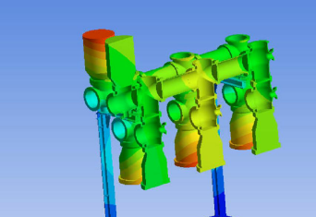
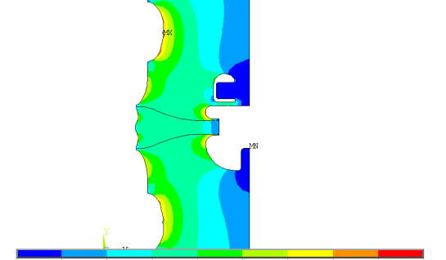

Flexible engineering team
We are an engineering team of seven experienced mechanical and electrical engineers. When required, the team can be expanded with additional specialists to meet increased workload.
We use state-of-the-art engineering software for design and analysis, including Ansys, SolidWorks, and others.
Our capabilities cover all types of design and analytical tasks required to develop high-voltage switchgear—including electrical, mechanical static, and dynamic/motion analyses.

Slide 5
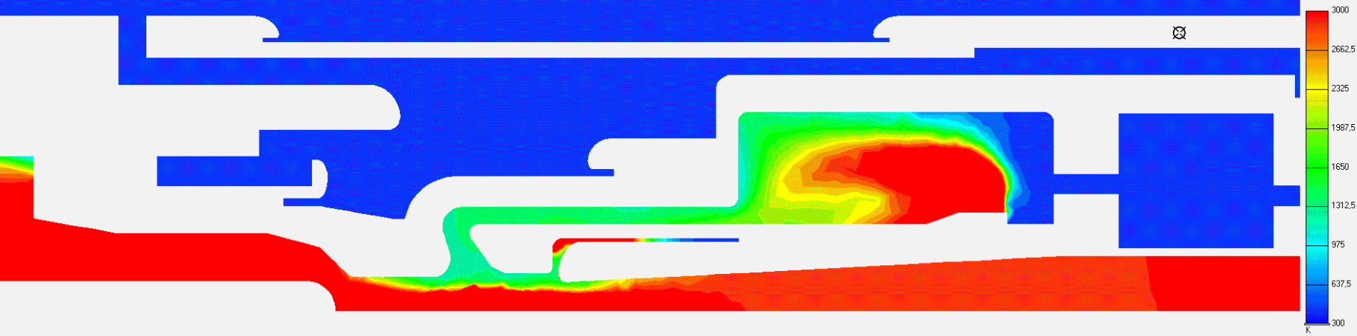
Interruption analysis – interrupter design
We have more than 15 years experience with our circuit breaker interruption analyis software (CFD) enabling reduced development cycles and fewer physical tests.
In the last years the software has been upgraded to handle alternative gases such as CO₂-O₂ mixture
The system is under continuous development with feedback from laboratory tests.

Slide 6
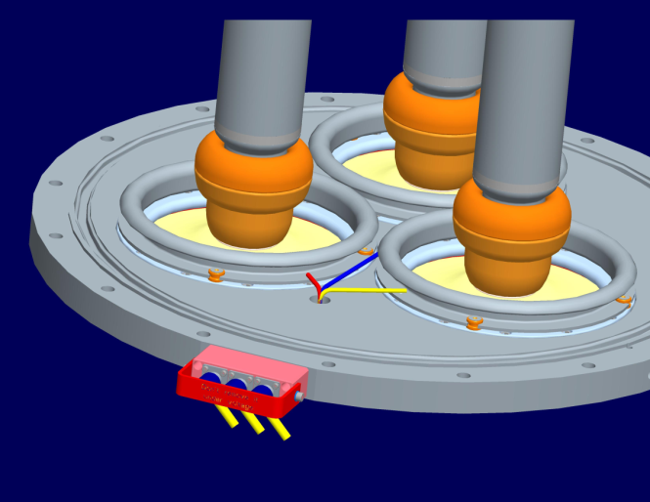
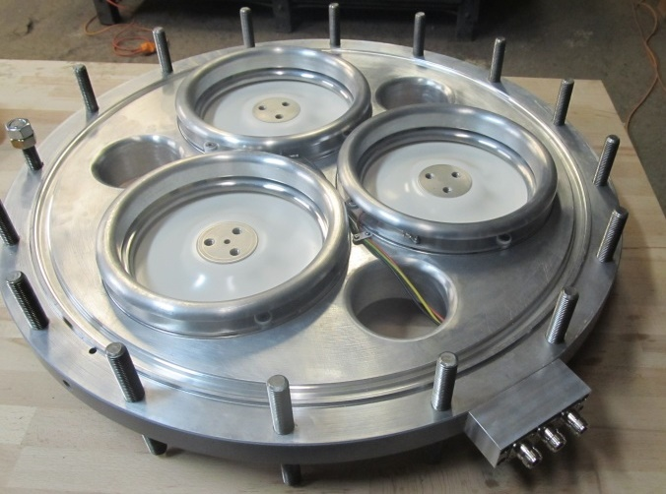
Complete solutions
We provide complete solutions—from technical specifications and engineering design to prototype manufacturing, development, and type testing, site support.
From design…
…to the tested prototype.

Slide 7
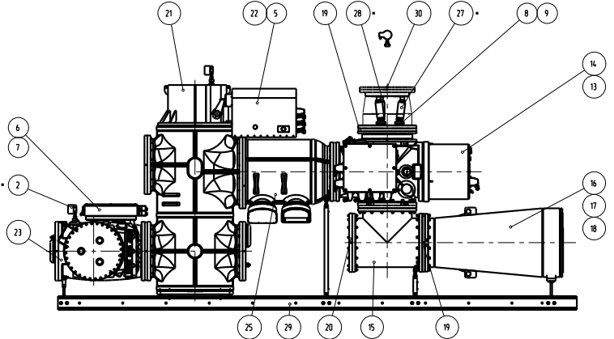
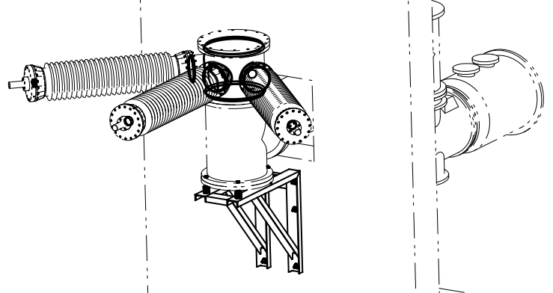
Cost effective designs
The team has extensive hands-on experience in the manufacturing, assembly, and maintenance of gas-insulated switchgear. Our design engineers support prototype assembly and type testing, ensuring direct feedback and practical insight.
Our focus is on cost-effective design, optimized component manufacturing, and easy assembly.

Slide 8
Highlights of activities and products of the Engineering Team

Slide 9
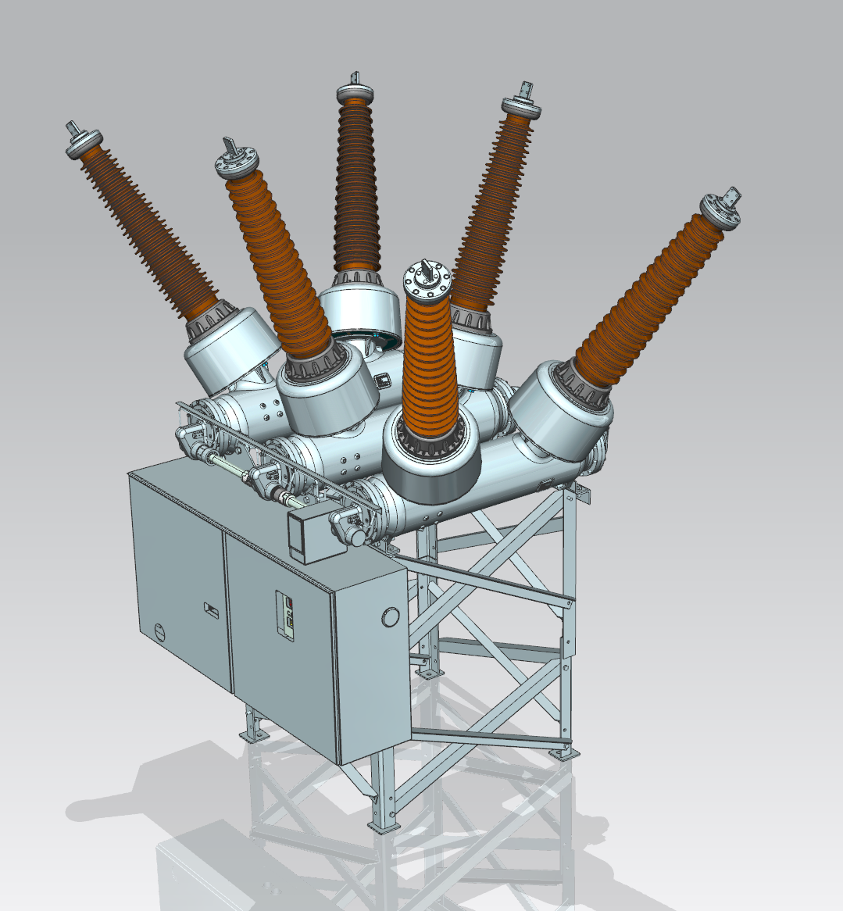
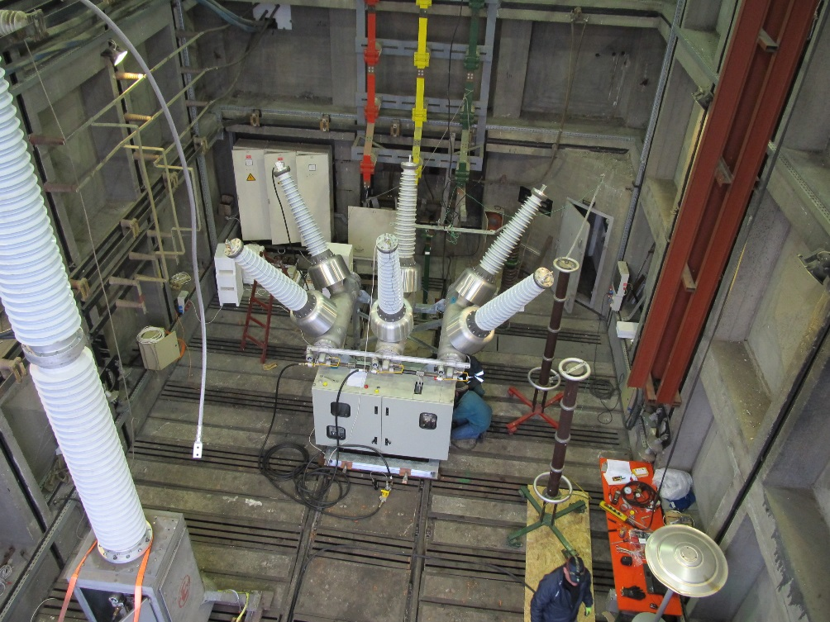
Designed for the US market.
The Team
designed the breaker, prepared all manufacturing drawings,
performed CFD analysis and improvements of the interrupter,
adapted an existing mechanical drive with with full mechanical analysis
managed the development and type testing at the Dekra (Veiki) laboratories in Hungary
145kV 40kA Dead Tank Breaker for Hyundai
Type testing at Veiki laboratories

Slide 10
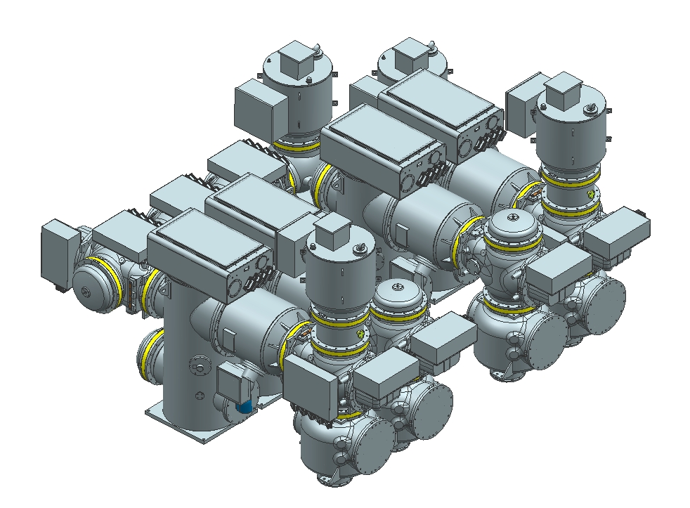
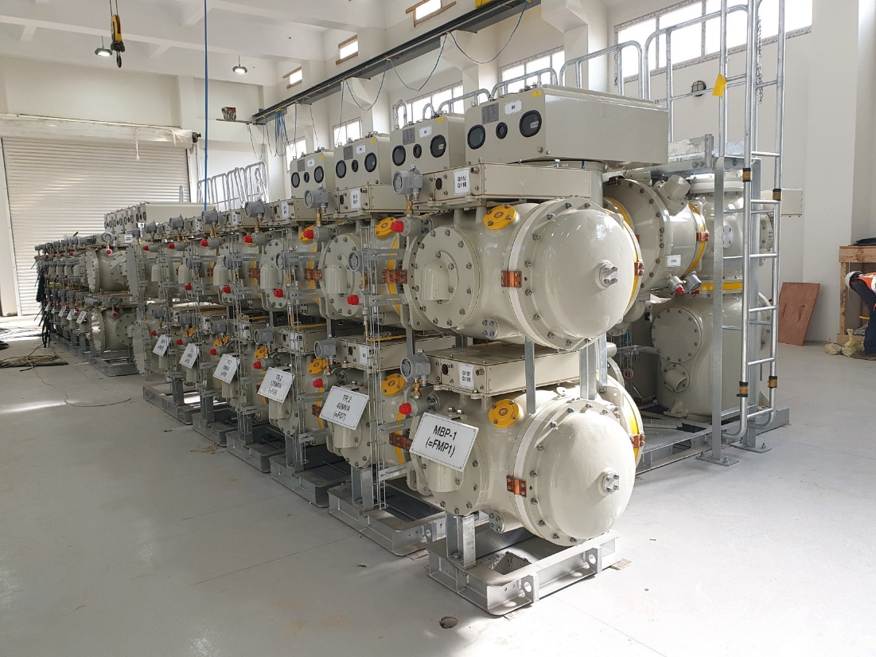
Designed for the international market. (2014)
The Team:
designed all components, prepared manufacturing drawings,
performed CFD analysis and improvements of the interrupter,
conducted the development testing of the interrupter in the laboratory of Dekra (Veiki) in Hungary.
145kV 40kA Gas Insualted Swichgear (GIS) for Hyundai
3D model of the GIS
Substation in Finland

Slide 11
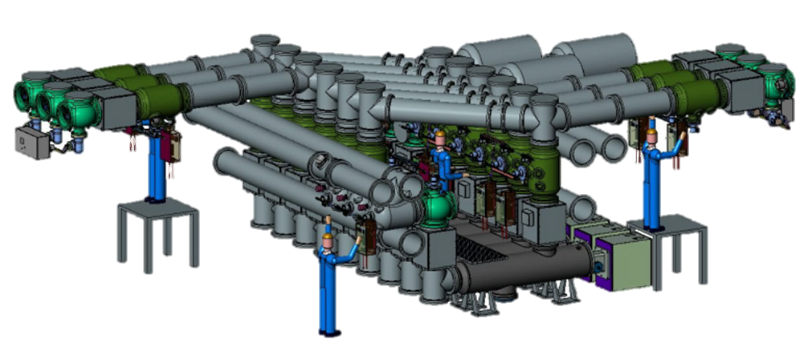
The Team:
designed all components, prepared all manufacturing drawings,
performed the CFD analysis and improvements of the interrupter.
245kV 63kA Gas Insulated Switchgear (GIS)

Slide 12
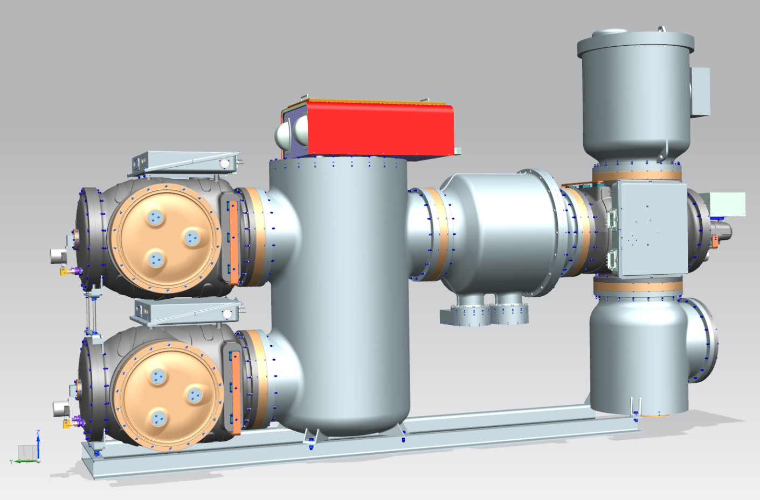
145kV 40kA Dry air insulated switchgear with vacuum interrupter (2021)
This was a new technology: SF6 free design.
The Team:
designed all components, (except the vacuum chamber) prepared all manufacturing drawings,
performed dry-air dielectric basic insulation tests in Hungary at Testroom of Ganz Transformer factory,
worked out the dielectric limit factors,
prepared the mechanical simulation of the vacuum chamber and the spring drive.

Slide 13
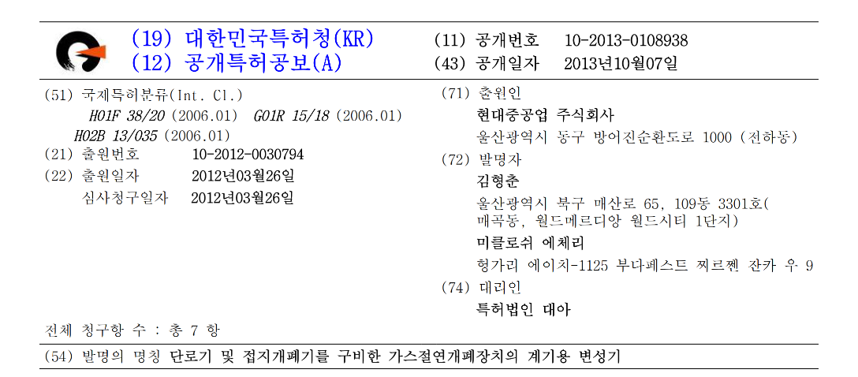
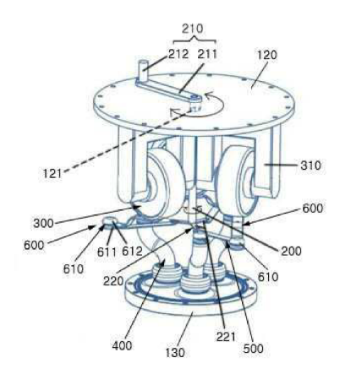
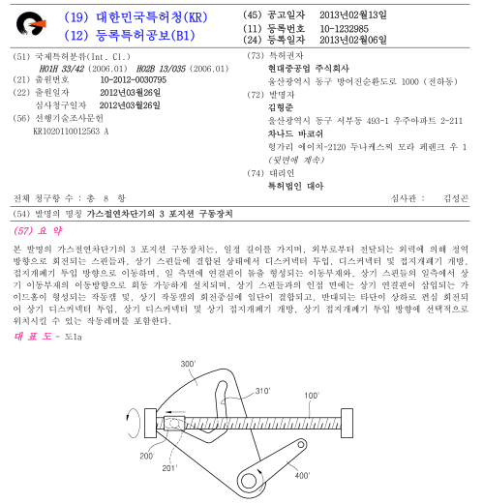
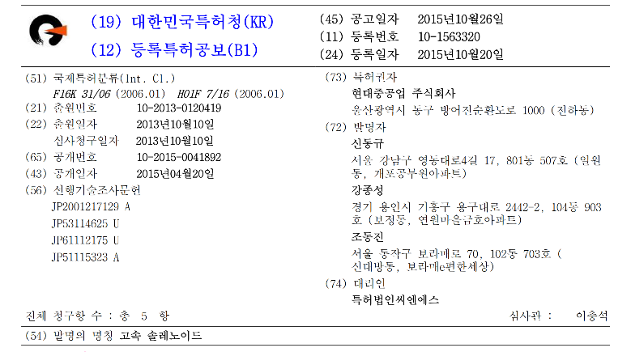
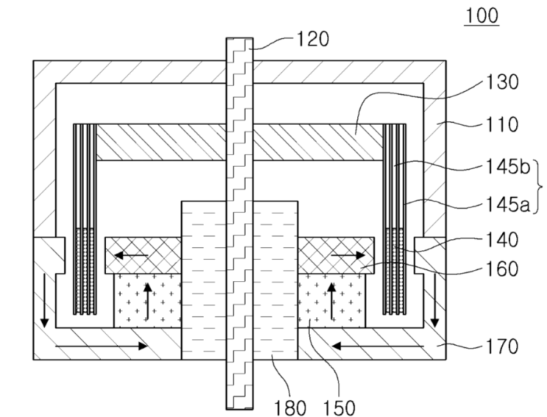
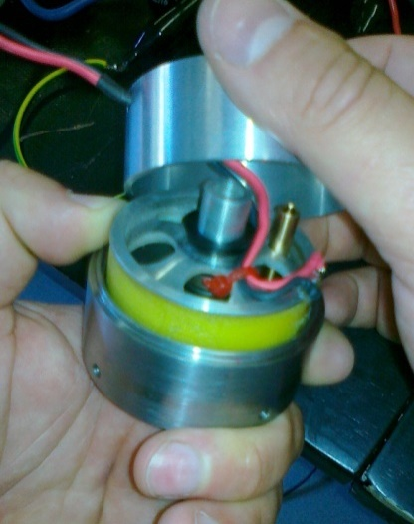
Patents and IP
3 phase GIS voltage transformer
Novel disconnector mechanism
High speed solenoid for 2 cycle circuit breakers

Slide 14
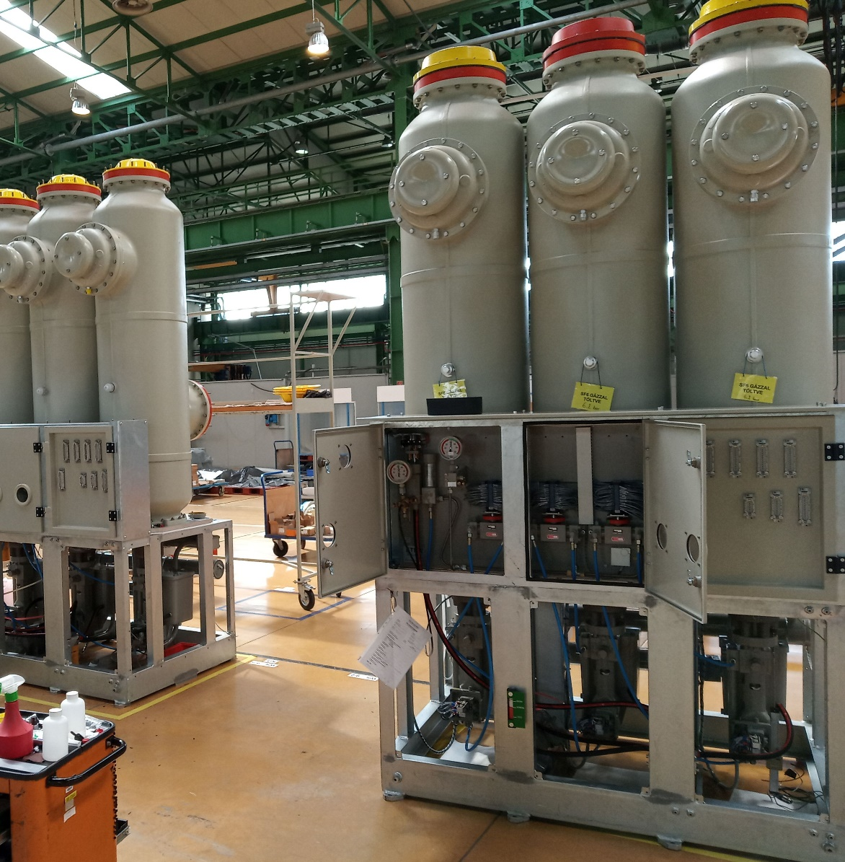
Execution of 245 kV GIS Bays Manufacturing and Assembly (2022)
Ganz (Hungary) received an order for two 245 kV GIS bays but lacked sufficient engineering and manufacturing resources. HVS was commissioned to execute the full manufacturing and assembly process.
HVS provided:
Full project status survey
Verification of available components
Support for ordering missing parts
Engineering support for manufacturing partners
Organization of the complete technology chain, including hiring qualified fitters, painters, welders, etc.
Management of assembly and testing
Support during factory acceptance testing
Several HVS engineers had previously worked as key personnel (Head of Division, Engineering, Development) at Ganz, giving HVS a unique advantage in executing the project.

Slide 15
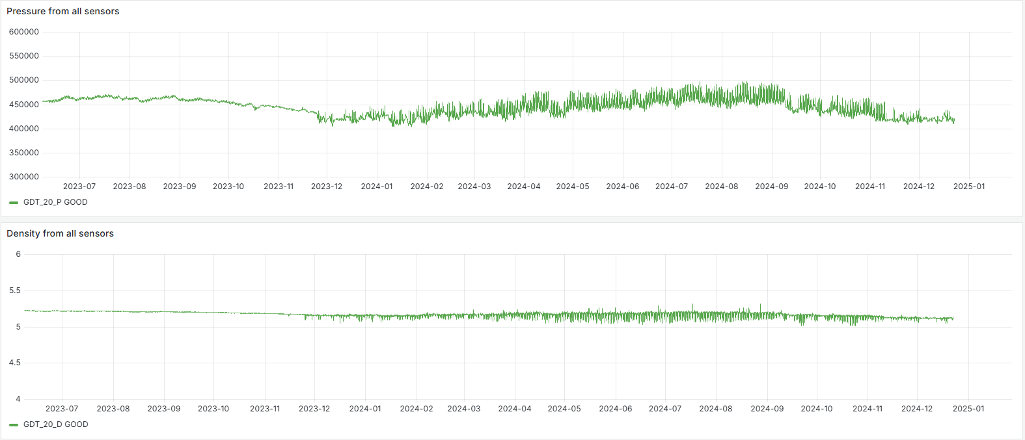
Development project: Online monitoring system for switchgear
Gas density (monitoring of tightness)
Hidraulic drive (static pressures, drops etc.)
Breaker/switcher (travel record analysis, switching times)
Long-term system test

Slide 16
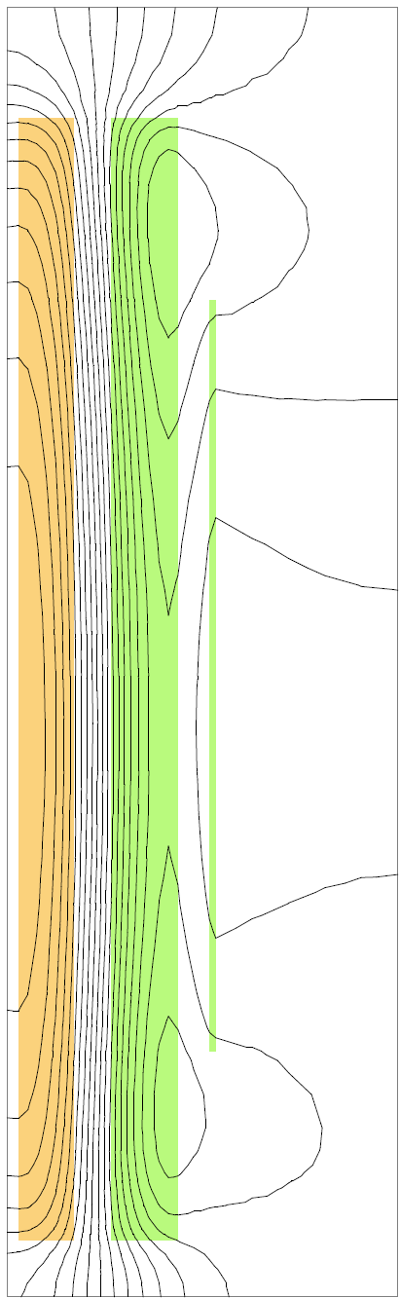
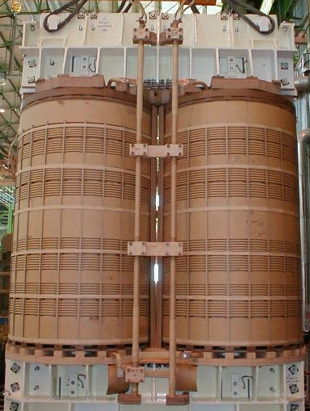
Transformer consultancy
With our external specialists we can provide consultancy for high voltage power transformers including:
Design documentation review
Surveys and investigations of faults and incidents
Analysis of transformer design, calculating of lightning impulse distribution, short-circuit withstand capability, cooling performance, and more.
Withnessing of tests at third party laboratories

Slide 17

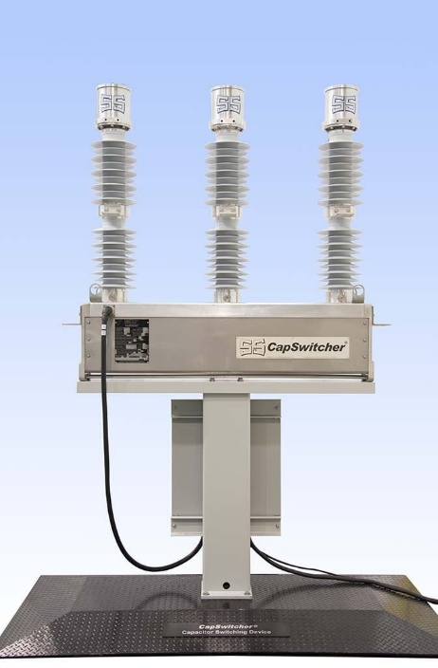
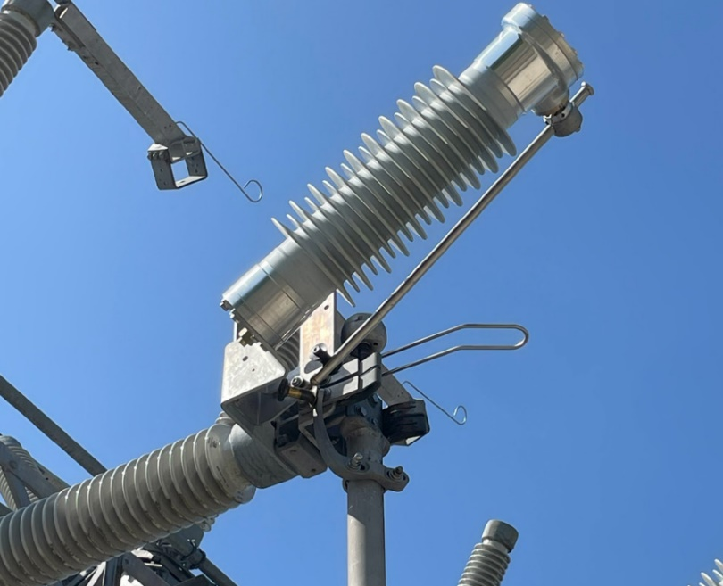
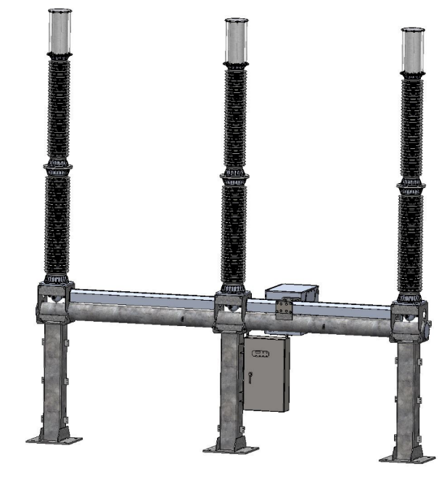
Through a long-term framework contract, we provide SSL with support in various projects with engineering activities including design analysis, CFD optimization, test assistance.
245kV CapSwitcher
38kV CapSwitcher
145kV LLS simulations, test assistance at Dekra laboratories Hungary

Slide 18
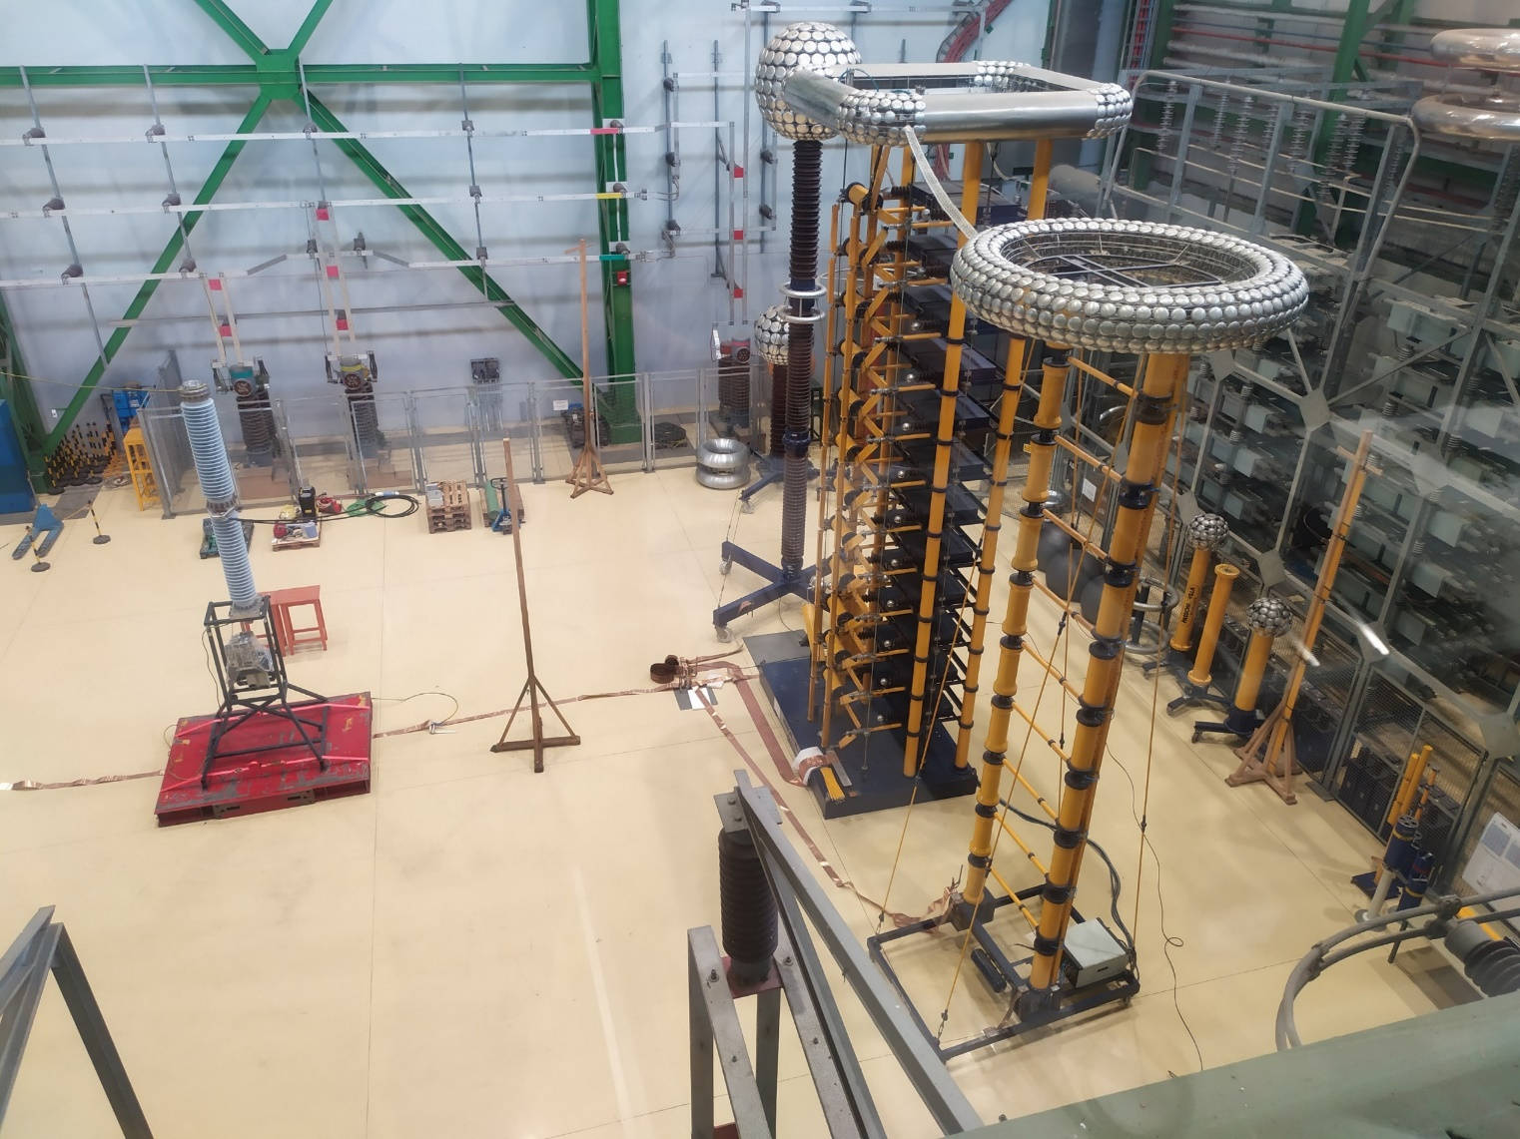
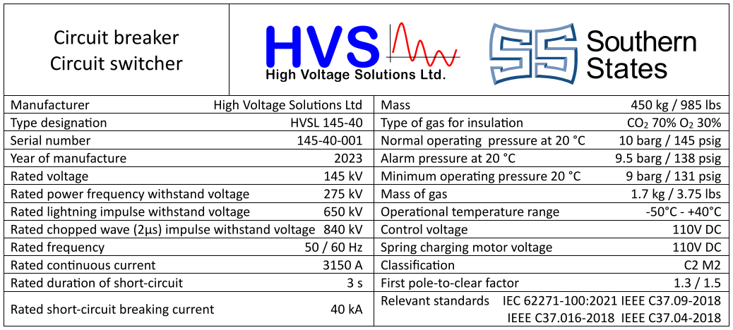
Development of 145kV alternative gas insulated Switcher/LTB (2022-23)
Rated data of the new CO2+O2 insulated Live Tank Breaker
Dielectric tests has been successfully performed at Ganz Transformer Factory test room

Slide 19
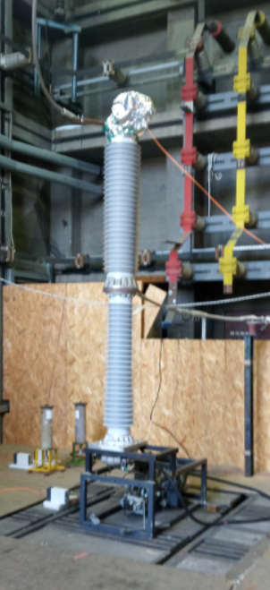
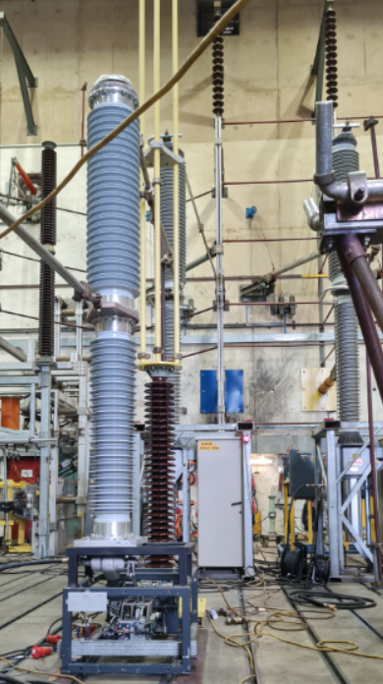
Power testing of the 145kV alternative gas insulated Switcher/LTB (2024-25)
Prototype breaker in VEIKI test cell Prototype breaker in KEMA synthetic lab

Slide 20
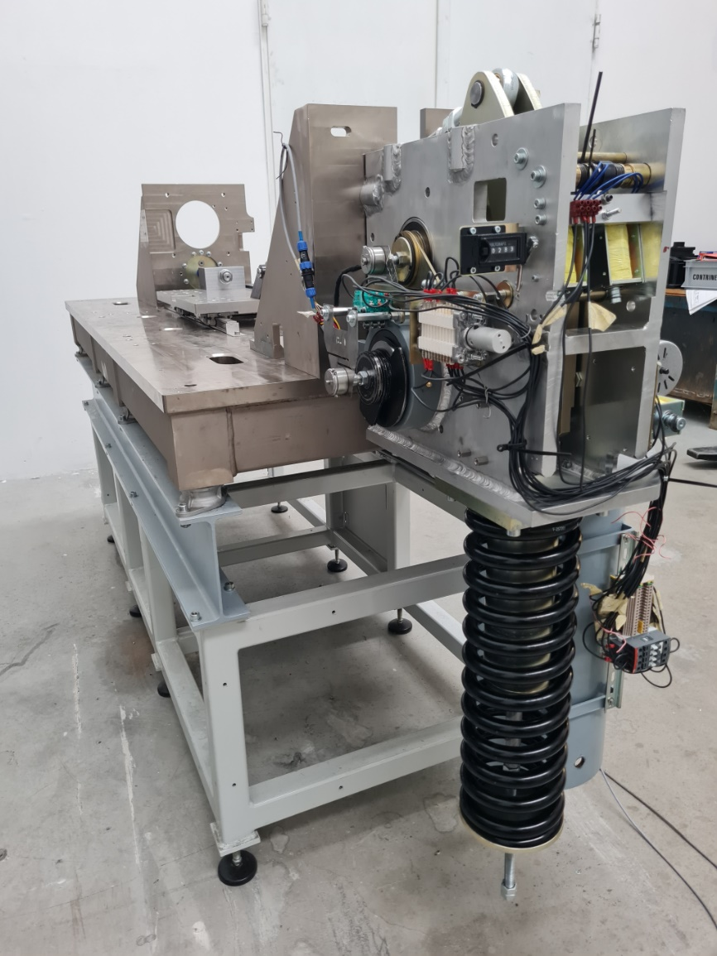
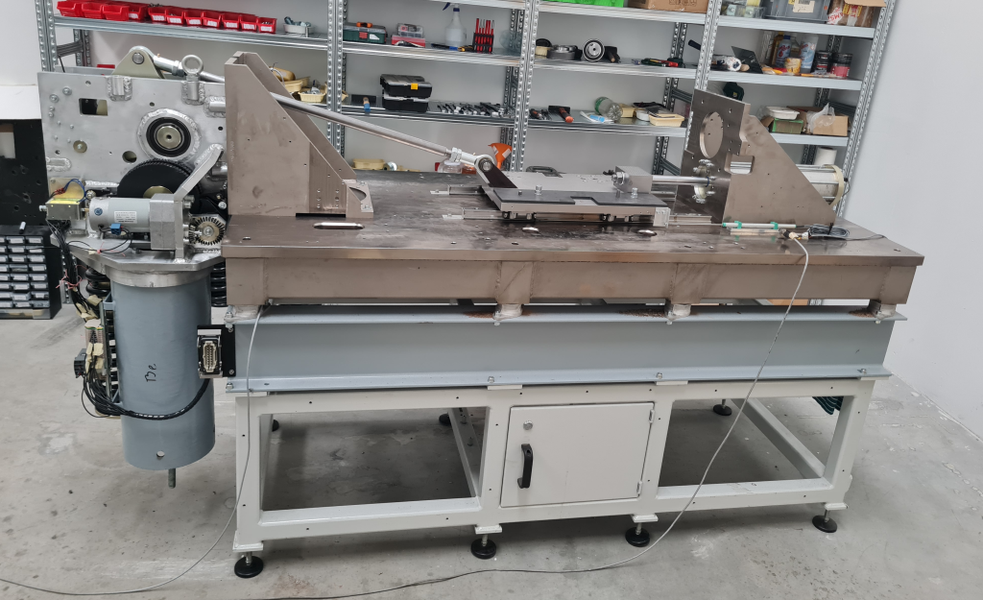
Development of a spring operated drive for the circuit breaker
A high-reliability design is required to ensure 20000 operating cycles.

Slide 21
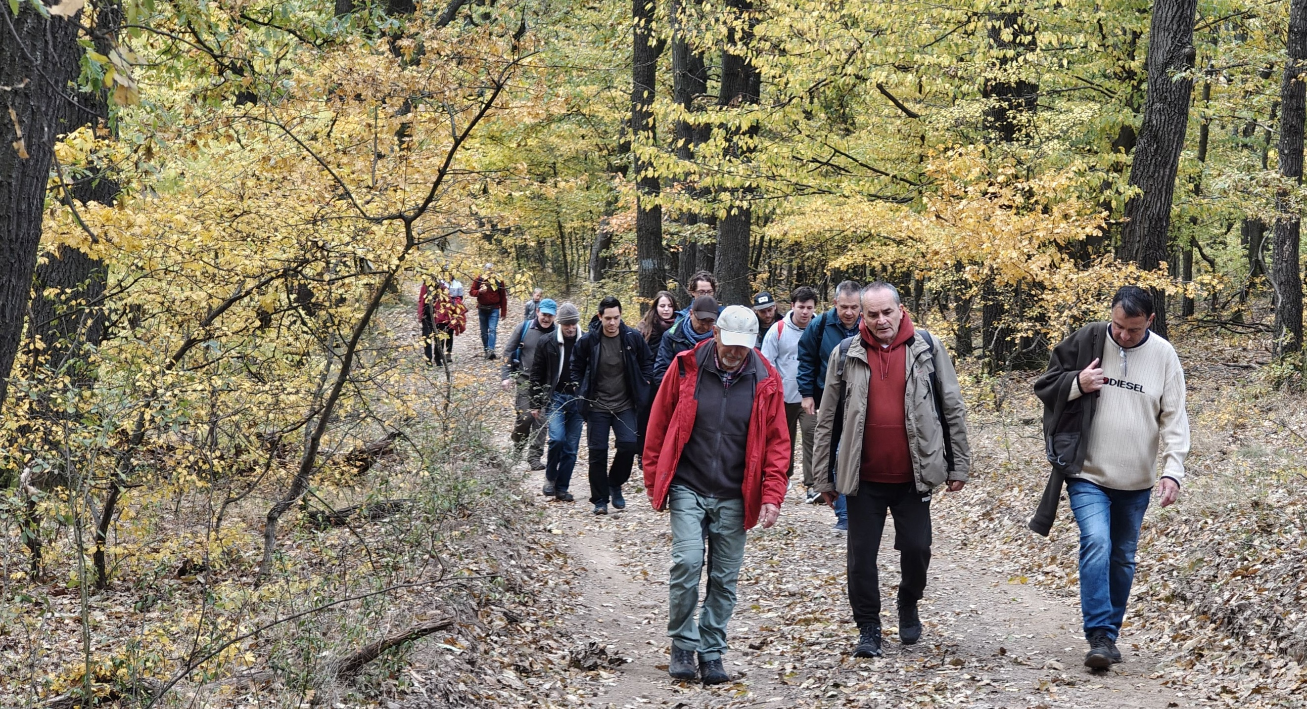
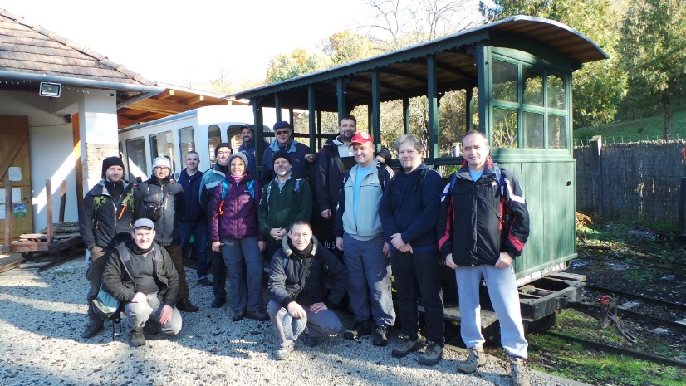
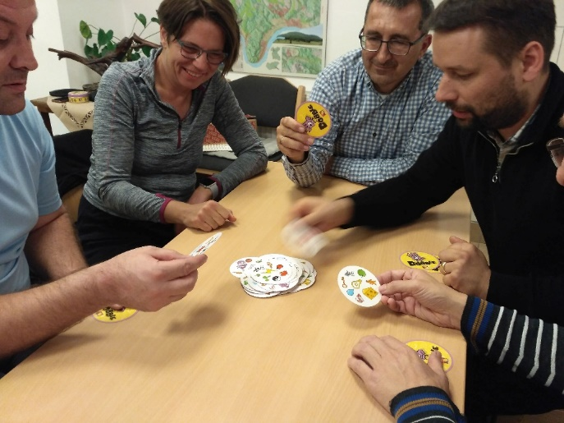

Our „well being program” includes regular corporate retreat for team building. Employees, families and even our close suppliers and business partners are invited.
The company provides health insurance to all employees with preventive check-ups.

