Slide 1

A compound semiconductor integrated device manufacturing company for AI Infrastructures (Photonics and Power)
Nov 13, 2025

Slide 2
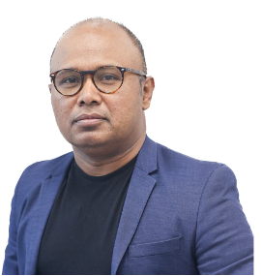
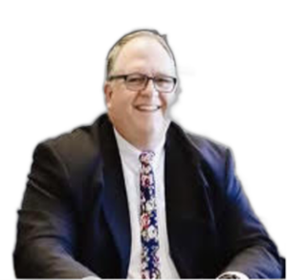
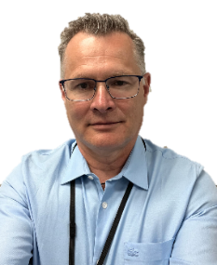
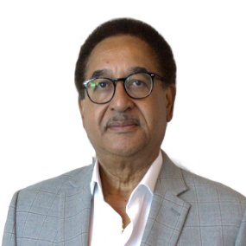
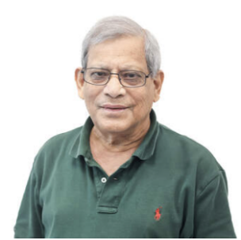
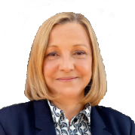
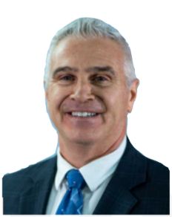
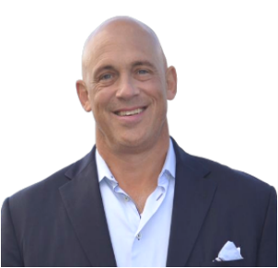














Leadership Team
Rafi Islam, PhD
CEO/CTO
PhD in Materials Engineering from ASU. 13+ years in manufacturing at Intel. 20 yrs experience in semiconductors.
Ironman Triathlete
Ron Elwood, CPA
CFO
30 years of C-level experience in various accounting roles
CFO role with Baer, Inc. and Bright International Corp.
Lead on Audit Committee.
JP Debray, PhD, MBA
Director of Products (Photonics)
PhD in Material Science. Specialist in optoelectronic devices.
Over 25 yrs of experience
Michel Francois, PhD
Director of Research
PhD in Electrical Engineering from Drexel University.
Si, SiC, GaAs Design and Processing. over 35 yrs exp.
Iqbal Ali, PhD Director of Fab Operation
PhD in Materials Science U of Arizona
Worked for Intel, Applied Materials, Texas Instruments
Chantal Arena, PhD Director of Business Development (Photonics)
35 years of exp. in
Semiconductor Devices, Equipment and Process. co-founded two startups
Marc Papageorge, VP, Dir. of Bus. Dev. and Sales, Power
MS from Ga Tech Materials Engineering. 30+ patents, Former COO of Sicamore Semiconductor
Andrew Schwinger, CFA
Sales and Marketing Photonics
20+ years in consulting, marketing, and investment mgmt. in the USA, Tokyo, and Hong Kong
____________________________________________________________________________________________________________________ ©Cactus Materials, Inc. 2025 – Proprietary and Confidential

Slide 3
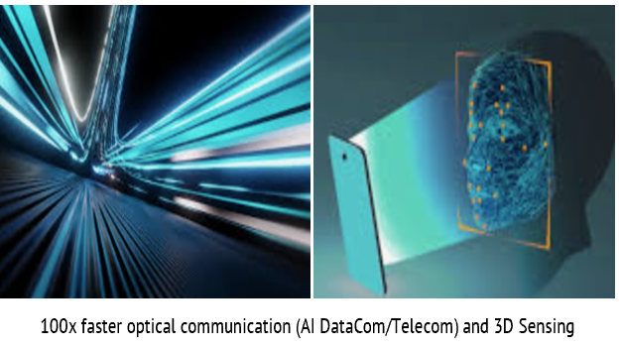
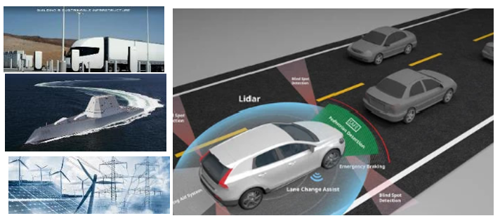





Business Units
Foundry
AI Photonics
Power
Foundry
Founded in 2016, Stealth mode until 2018
Based in TEMPE, Arizona
Employees: 30 and Growing
Fabrication of Silicon & GaAs Photonics
Fabrication of Power Electronics Using Si & SiC
Fully Vertically Integrated
Aerospace, Electric Grid, Data Center, and Defense
Device Foundry Services
(30% of the fab capacity)
III-V Epitaxy Wafers Development
102+ Patents
In-house Design and Fab Manufacturing
(Vertically Integrated)
102+ Patents
____________________________________________________________________________________________________________________ ©Cactus Materials, Inc. 2025 – Proprietary and Confidential

Slide 4
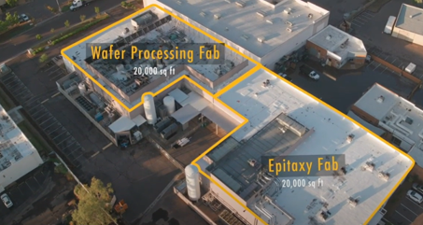



Cactus Fab: 40,000 sq ft Facility
ITAR REGISTERED AND DEPARTMENT OF DEFENSE (DOD) TRUSTED SUPPLIER – IN PROGRESS
Frontend + Backend : 20,000 sq ft
cSiC Power + AI Photonics fab
Class 100 Clean Room
100+ pieces of advanced Equipment & tools
Wafer Thinning + Dicing
Epitaxy Fab + Test : 20,000 sq ft
2 MBEs (Molecular Beam Epitaxy), 2 MOCVDs (Metal Organic Vapor Deposition), 1 SiC Epitaxy tool
Characterization tools (Laser/detectors)
Probing room for finished devices (VCSEL+PD)
LINK
1.5 Minute Video Clip of the Fab
____________________________________________________________________________________________________________________ ©Cactus Materials, Inc. 2025 – Proprietary and Confidential

Slide 5
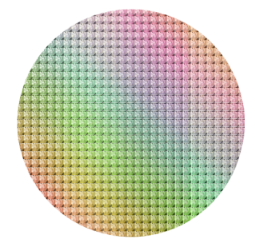
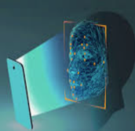

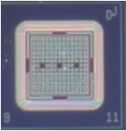
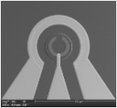
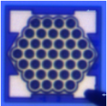
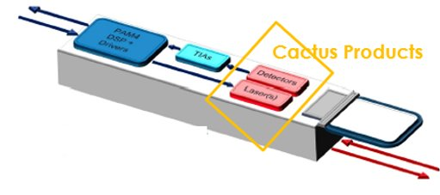
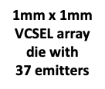
AI PHOTONICS PRODUCTS AND VALUE PROPOSITIONS
ULTRA UFD® and INDIGO IRD® Detector Chips
Market
10x Faster (TOF) – 10 ps vs. ns
Radiation Hardened
3D Sensing:
VCSEL (Laser)
AI Data Center:
VICTORY VCSEL Laser Chip
AI Telecom (6G)
10x lower cost using patented processes
Eye Safety, longer wavelength
3D Integrated through bonding -packaging
SiC Power Chips and Photonics
LIDAR
49,419 VCSEL/Wafer
141,493 PD/Wafer
____________________________________________________________________________________________________________________ ©Cactus Materials, Inc. 2025 – Proprietary and Confidential

Slide 6




Current Photonics Products (2026)
 | Lasers (GaAs, Dilute Nitride) |  |  |  |  |  | Detectors |  | Modules | Photonic Int Ckt (PIC)
Products | 850 nm 25G VCSEL | 940 nm 25G VCSEL | 980 nm 25G VCSEL | **1310 -1380 nm iVCSEL | **1450 nm EEL | 1310/1450/1550 Detector | 850 nm 25G PD | 940/980 nm 25G PD | ROSA & TOSA Module | 1.6Tb/sec - 3.2 Tb/sec Transceiver
Design Tape-out | Done | Oct 30, 25 | Nov 7, 25 | Ver0: Done Ver1: Feb, 25 | Ver0: Done Ver1: Feb, 25 | Done | Done | Ver0: Done Ver1: Nov 30,25 | Dec 15, 2025 | Feb 15, 26
Epi Date | Done | Dec, 25 | Dec, 25 | June, 26 | June, 26 | June, 26 | Oct, 25 | Dec, 25 | N/A | N/A
Manufacturing | Cactus | Cactus | Cactus | Cactus | Cactus | Cactus | Cactus | Cactus | Phix, NL Co-packaged | Cactus Tower Jazz, AIM Photonics;
Process Date | Dec 15, 25 | TBD* | TBD* | Aug, 26 | Aug’ 26 | Aug’ 26 | Feb 15, 26 | Feb 15, 26 | Jan 30, 26 | March 3- June 15, 26
Modules | TO-46 (e-laser, Taiwan) | TO-46 (e-laser, Taiwan) |  | TO-46 (Siltronics, CA) |  |  | TO-46 (e-laser) | TO-46 (Siltronics, CA) | Phix, NL Co-packaged | Fabrinet, Thailand Co-packaged
Product Launch | Jan 17-22 | *Depends on Anchor Customer Engagement |  | Nov 3th-4th |  |  | March 15, 26 |  |  | Nov 3th-4th
**Cactus have unique value proposition with performance and cost target
____________________________________________________________________________________________________________________ ©Cactus Materials, Inc. 2025 – Proprietary and Confidential

Slide 7
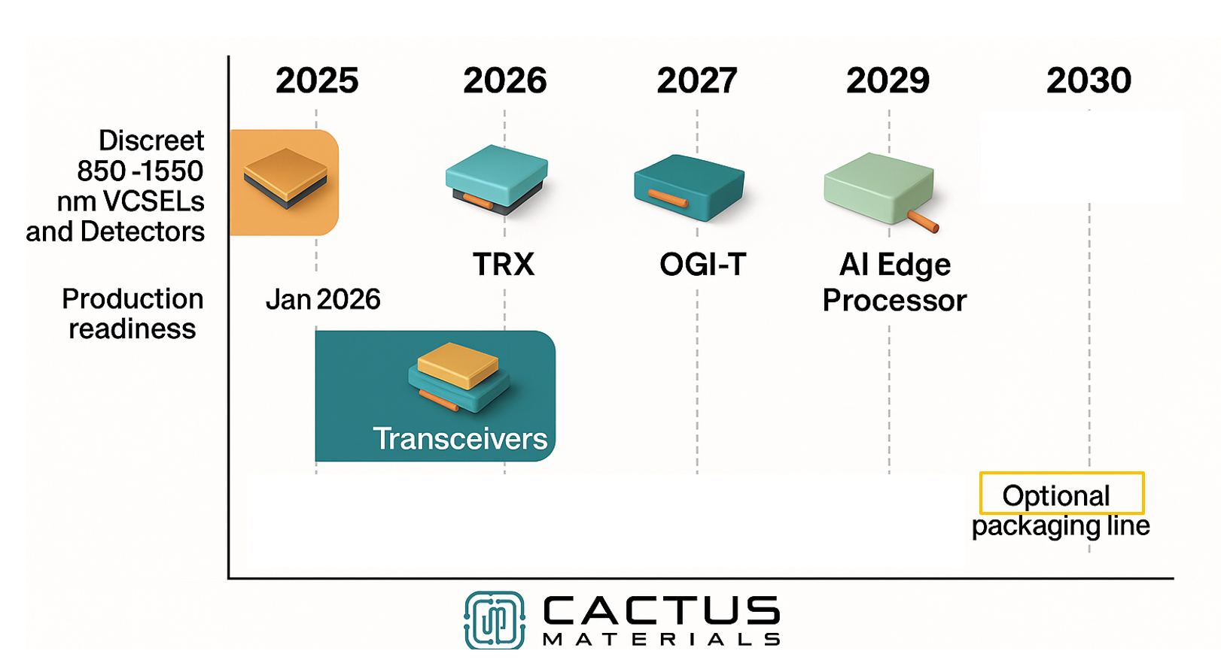
2027+ Roadmap: Ai Optical Interconnect

Slide 8
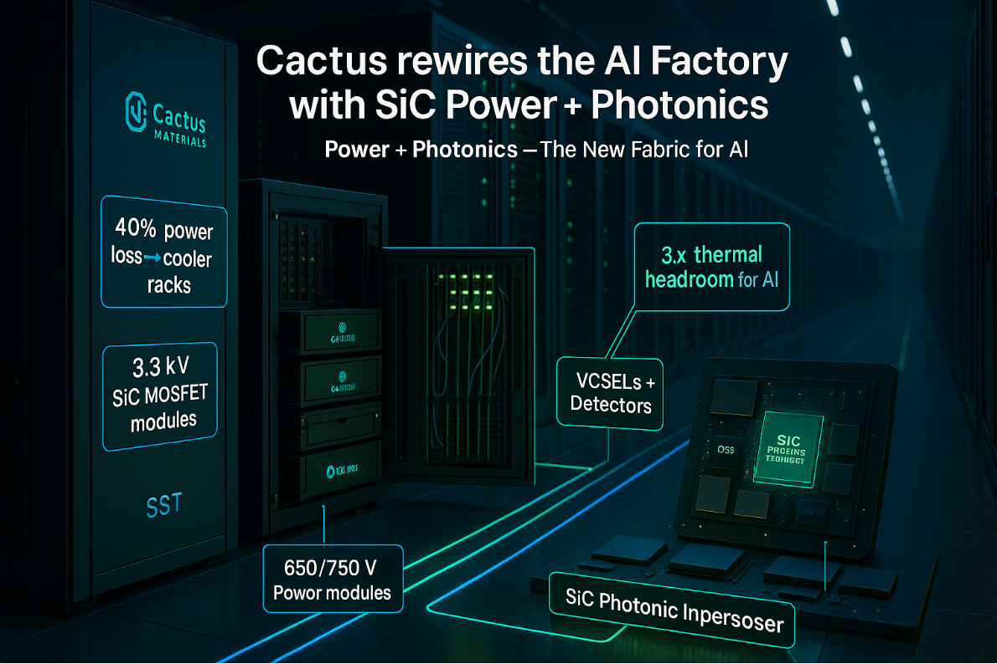
USE CASE: AI Infrastructure: SiC Power + Photonics
____________________________________________________________________________________________________________________ ©Cactus Materials, Inc. 2025 – Proprietary and Confidential

Slide 9
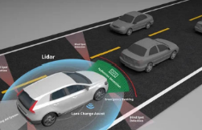


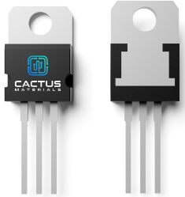
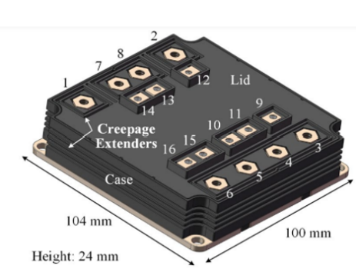
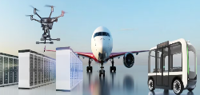

WBG (SiC) Power PRODUCTS
Markets
SiC Power Chips and Module (650V-3.3kV, 5kV+)
MOSFET, DIODE, JFET, Thyristor, SiC Modules (SST)
Mobility (Automotive, Train, EV Charging station)
Low RDSon Power chips and modules
High reliability and Temperatures (up-to 800⁰C)
Electric Grid
Defense & Aerospace: (high voltage 20kV+ electrification: Navy, Army)
Industrial
Data Center
____________________________________________________________________________________________________________________ ©Cactus Materials, Inc. 2025 – Proprietary and Confidential

Slide 10
SiC Product List – power devices
____________________________________________________________________________________________________________________ ©Cactus Materials, Inc. 2025 – Proprietary and Confidential

Slide 11
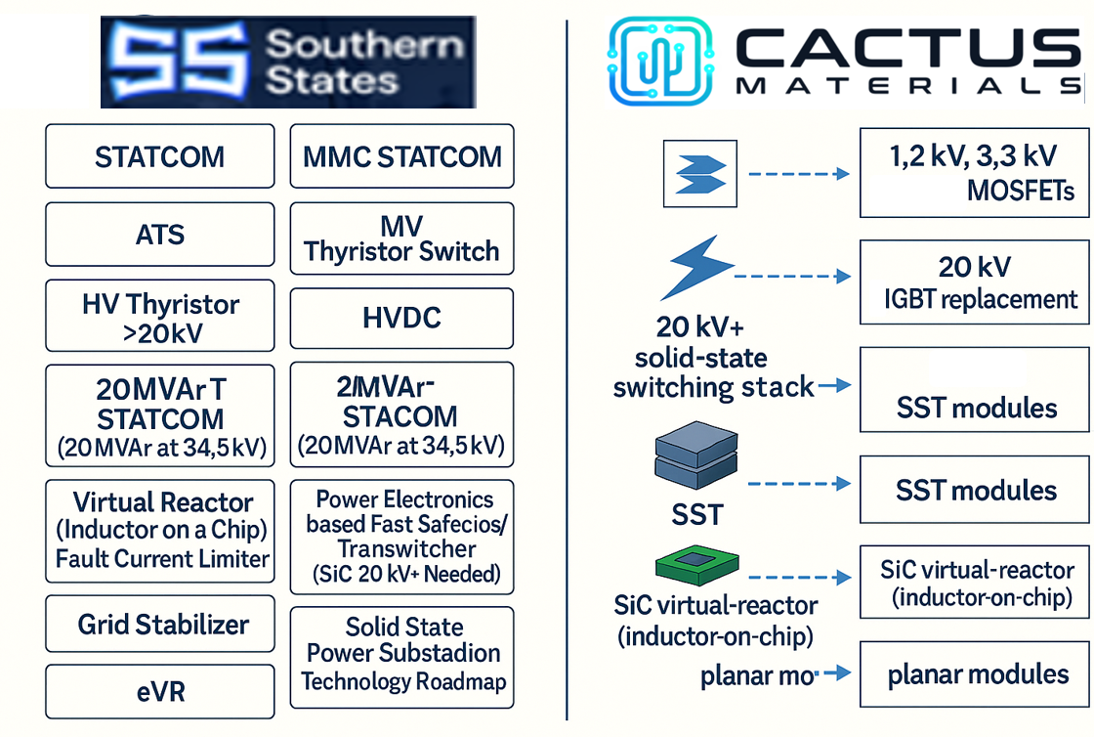
USE CASE– power devices
Products in the market, TO-246; DIGIKEY
**Module: 3.3kV/500A (in development, Q1 2026).
Rdson lower than Infineon
Simulation completed, Design ECD: Q2, 2026
Manufacturing: Q4,2026
SST Submodule: Q2, 2026
***SST System: Q4, 2027
TBD, Align Strategy
Planar Chips Products in the market
Trench design and Products by Q1, 26
** Collaboration with SSL/Product delivery in Q1, 2026
*** In discussion for partnership (SSL, Vertiv, HERON, NVIDIA)
____________________________________________________________________________________________________________________ ©Cactus Materials, Inc. 2025 – Proprietary and Confidential

Slide 12
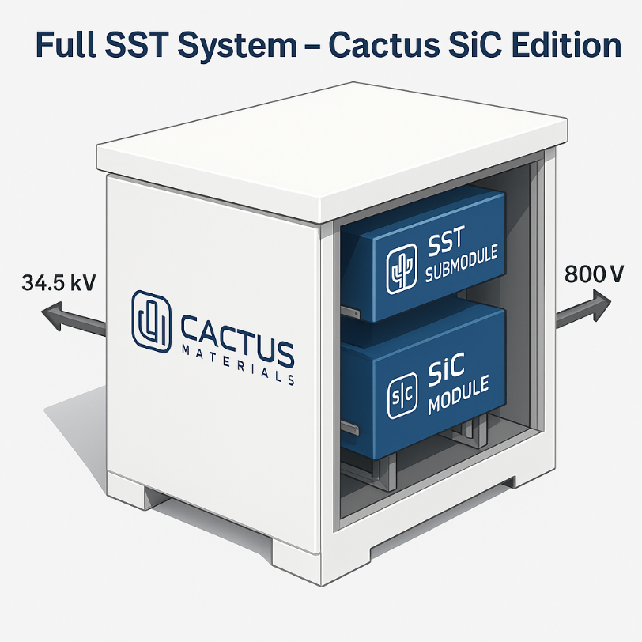
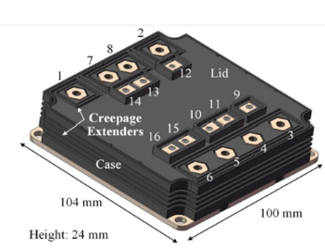
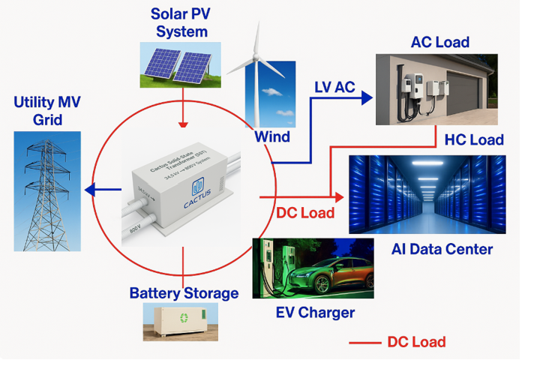
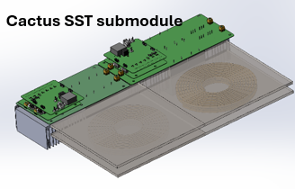



Development Product:
Cactus Solid-State Transformer (SST)
SST 34.5 kV AC to 800V DC conversion in direct alignment with NVIDIA’s 800A rack architecture
Cactus is redefining high-voltage power conversion—building 34.5 kV → 800 V SST systems with our SiC technology and products.
Co-engineered with leading U.S. universities tailored for data-center power.
____________________________________________________________________________________________________________________ ©Cactus Materials, Inc. 2025 – Proprietary and Confidential

Slide 13
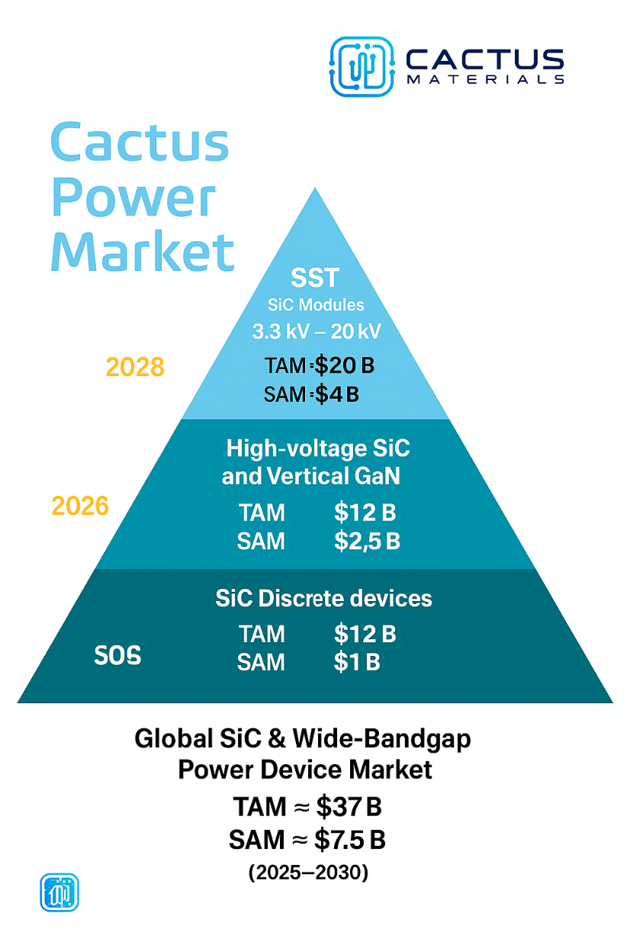
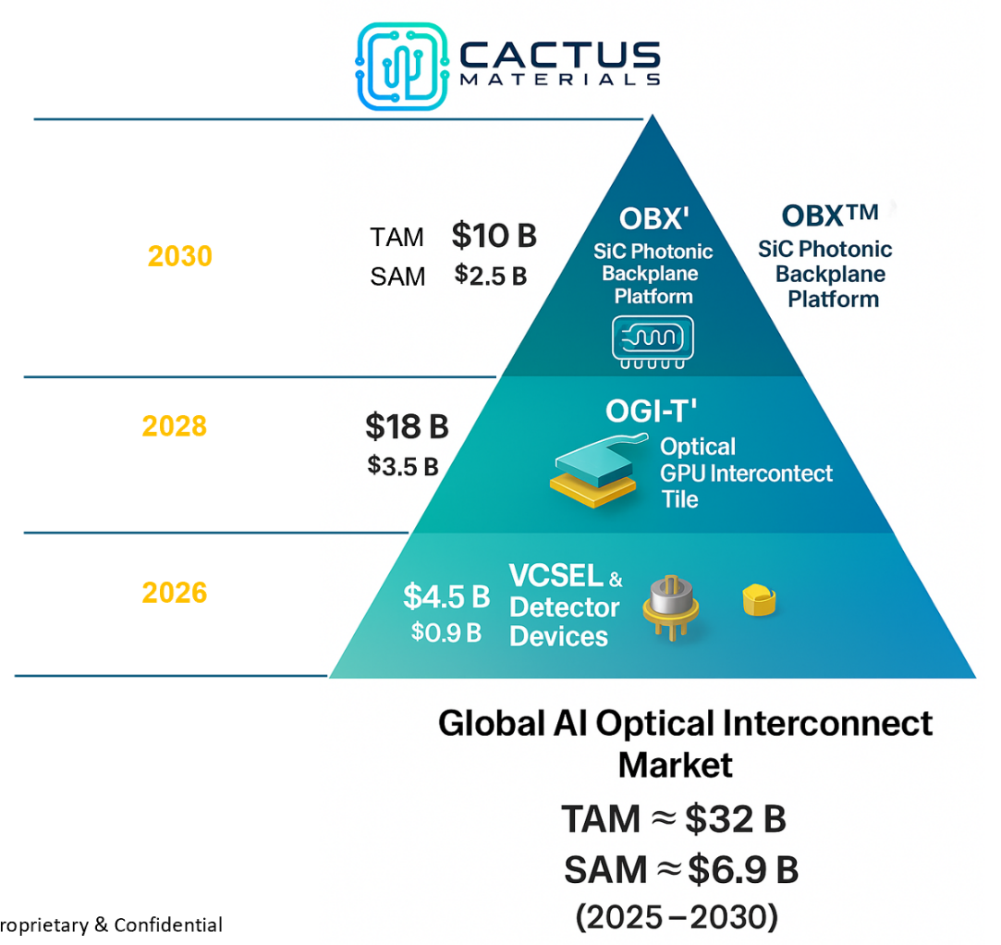
Market
AI Photonics (GaAs)
Product Launch Year
Market: Grid Modernization, Defense Power Systems, Data Centers
Product Launch Year
Market: MVDC, EV Infrastructure, Aerospace Power, Renewables
2025
Market: EV Chargers, Industrial Drives, Power Supplies
(TAM: 12B, SAM:2.5B)
(2030 Market)
(2030 Market)
____________________________________________________________________________________________________________________ ©Cactus Materials, Inc. 2025 – Proprietary and Confidential

Slide 14

Employee Well-Being – Strategic Pillar
1) Physical Well-Being
Health Insurance
Workplace Ergonomics: Standing desks, anti-fatigue flooring in labs, eye health programs
Movement Integration: “Walk & Talk” 1:1s
Subsidized gym membership
2) Psychological Safety & Mental Well-Being
Manager Training: Supportive Leadership: Coaching on empathetic communication, micro-stress management
No “Hero Culture” Policy: Reward predictability and planning, not burnout
3) Financial Well-Being
Planned Equity Participation Post-IPO: Founder communication on company growth
4) Career Growth & Development:
Individual Career Maps: Clear path for promotions and skill growth
Education Stipend: Support engineers for studies (50%)
5) Specialty Well-Being for Lab/Foundry Teams
Incorporating Safety culture- part of daily Huddle meeting at 7:30 AM in the fab
Real-time toxic gas monitoring system (Honeywell)
Predictable schedules, recovery protocols
“Stop Work Authority” culture if safety is concern, Anyone can halt unsafe work without penalty

Slide 15
Summary Enabling the next wave of revolution in Photonics/POWER SEMICONDUCTORS
Cutting-edge mixed materials GaAs, Si, SiC semiconductor design and manufacturer
Dual-Use technology, Photonics (VSCL & Detector) and Power (3.3kV+ & High Temp)
Grid Focused for SiC 2kV – 10kV (JFET, IGBT, MOSFET) & STATCOM Modules to SST
Recent factory ISO 9001-2015 Certified & ITAR DFARS Readiness
Vertically Integrated Business (Design, Fab, Wafer Bonding, Test, Module)
Strategic Investment Partner Focusing on STATCOM & Grid Applications
____________________________________________________________________________________________________________________ ©Cactus Materials, Inc. 2025 – Proprietary and Confidential

Slide 16


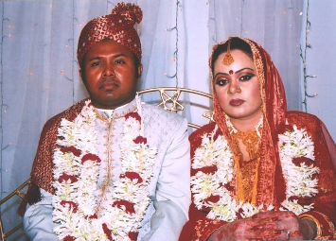


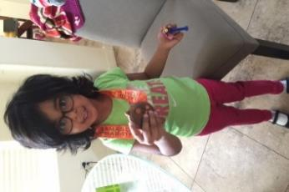

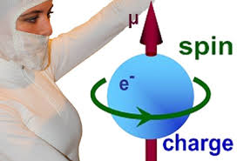
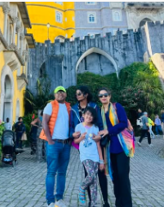

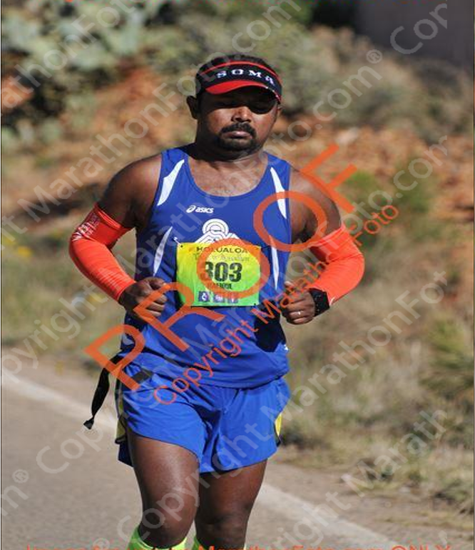
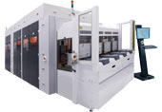
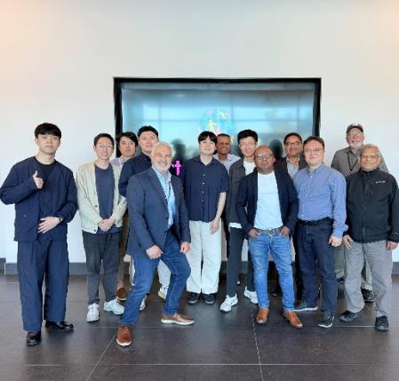
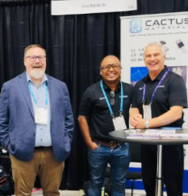

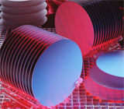
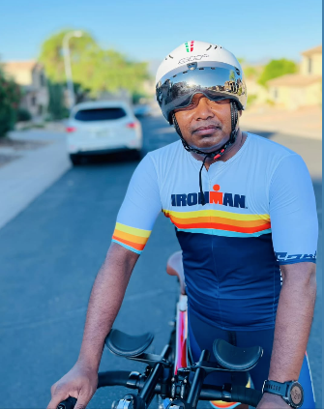


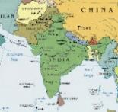

TMG- SPTD
2 factories start-up from ground-up from 15 employee to 500! One of the lucky one to be one of the founding members
PHD in Materials Engineering, ASU, 2005
Married, Another BUETian (PhD)
Litho Engineering Manager (2006-15)
Becoming Proud Father, 2010
Litho/Bonding/Nanoimprinting equipment dev Engineer
Cactus Materials, Inc. CEO, Founder
(2018 – Now)
MSc in Chemical Engineering, TTU, TN (2000)
Marathon 20+,
Ironman 140.6, 70.3 (10+)
BSc in Chemical Engineering, BUET, 1998
Born/Raised in Bangladesh
Rafi’s Story
Notes:
Life to
Life has an end.. We know end state. So every problem has an end state – but house along the way is ours- better crafted that house and make end state memorable and beautiful!
Bangladesh: 160 M people, same size as New York, almost ½ of US population. Like any other countries – it has low and high side. Some of the high side- like any other country – it is beautiful.. Naïve.. Hospitable.. You might know.. One noble laurate – Dr. Yunus.. Low side.. Population, competition across all segments of the country.. Political instability..
Accident during MS
Close to hurricane in Hawai – 2010.

Slide 17

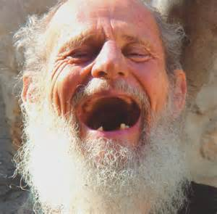

Start State
END State
We can control
Same as Problem Solving
Notes:
Life to
Life has an end.. We know end state. So every problem has an end state – but house along the way is ours- better crafted that house and make end state memorable and beautiful!
Bangladesh: 160 M people, same size as New York, almost ½ of US population. Like any other countries – it has low and high side. Some of the high side- like any other country – it is beautiful.. Naïve.. Hospitable.. You might know.. One noble laurate – Dr. Yunus.. Low side.. Population, competition across all segments of the country.. Political instability..
Accident during MS
Close to hurricane in Hawai – 2010.

